Slide 1
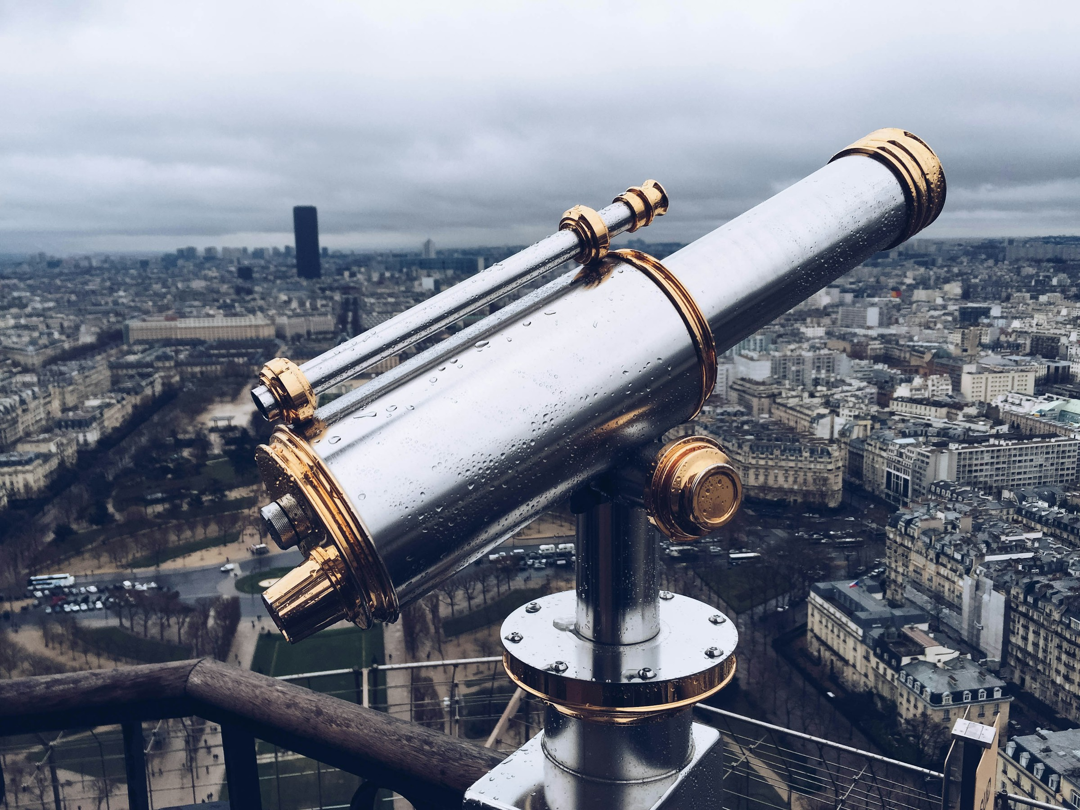
Search and Exploration of Documentary Photography Using Multimodal Large Language Models
Taylor ARNOLD + Lauren TILTON
Journées DHNord
Salle de séminaire de l’IRHiS
Lille, France
7 novembre 2024, 10h30 > 11h30
https://distantviewing.org

Slide 2

1. Introduction
01 – Distant Viewing | Introduction

Slide 3
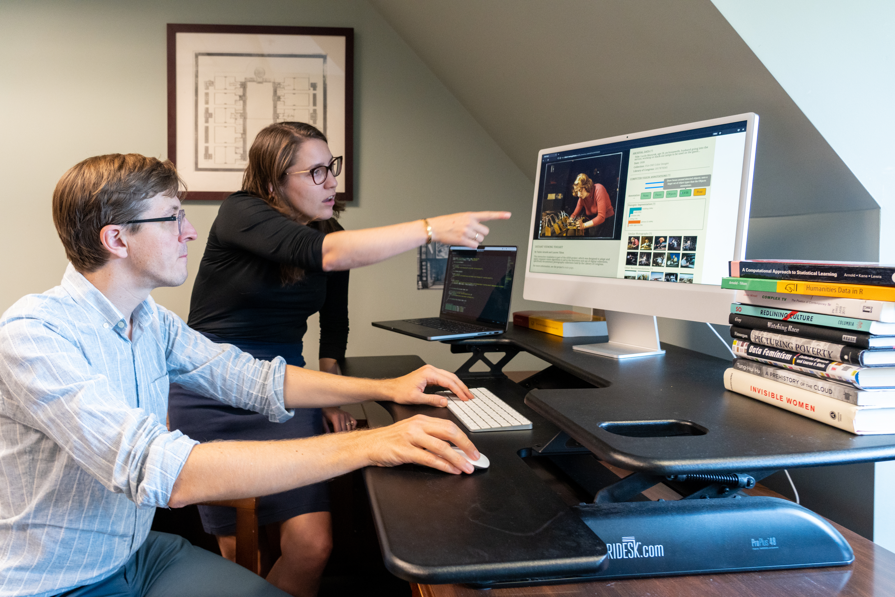
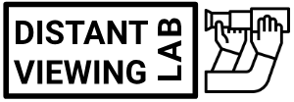

Distant Viewing Lab
The Distant Viewing Lab uses and develops computational techniques to analyze visual culture on a large scale.
We develop tools, methods, and datasets that can be re-used by other researchers. The lab engages closely with critical cultural and data studies, aiming to make explicit the interpretive act of algorithmic logic.
Generously supported through funding from:
https://distantviewing.org
01 – Distant Viewing | Introduction

Slide 4
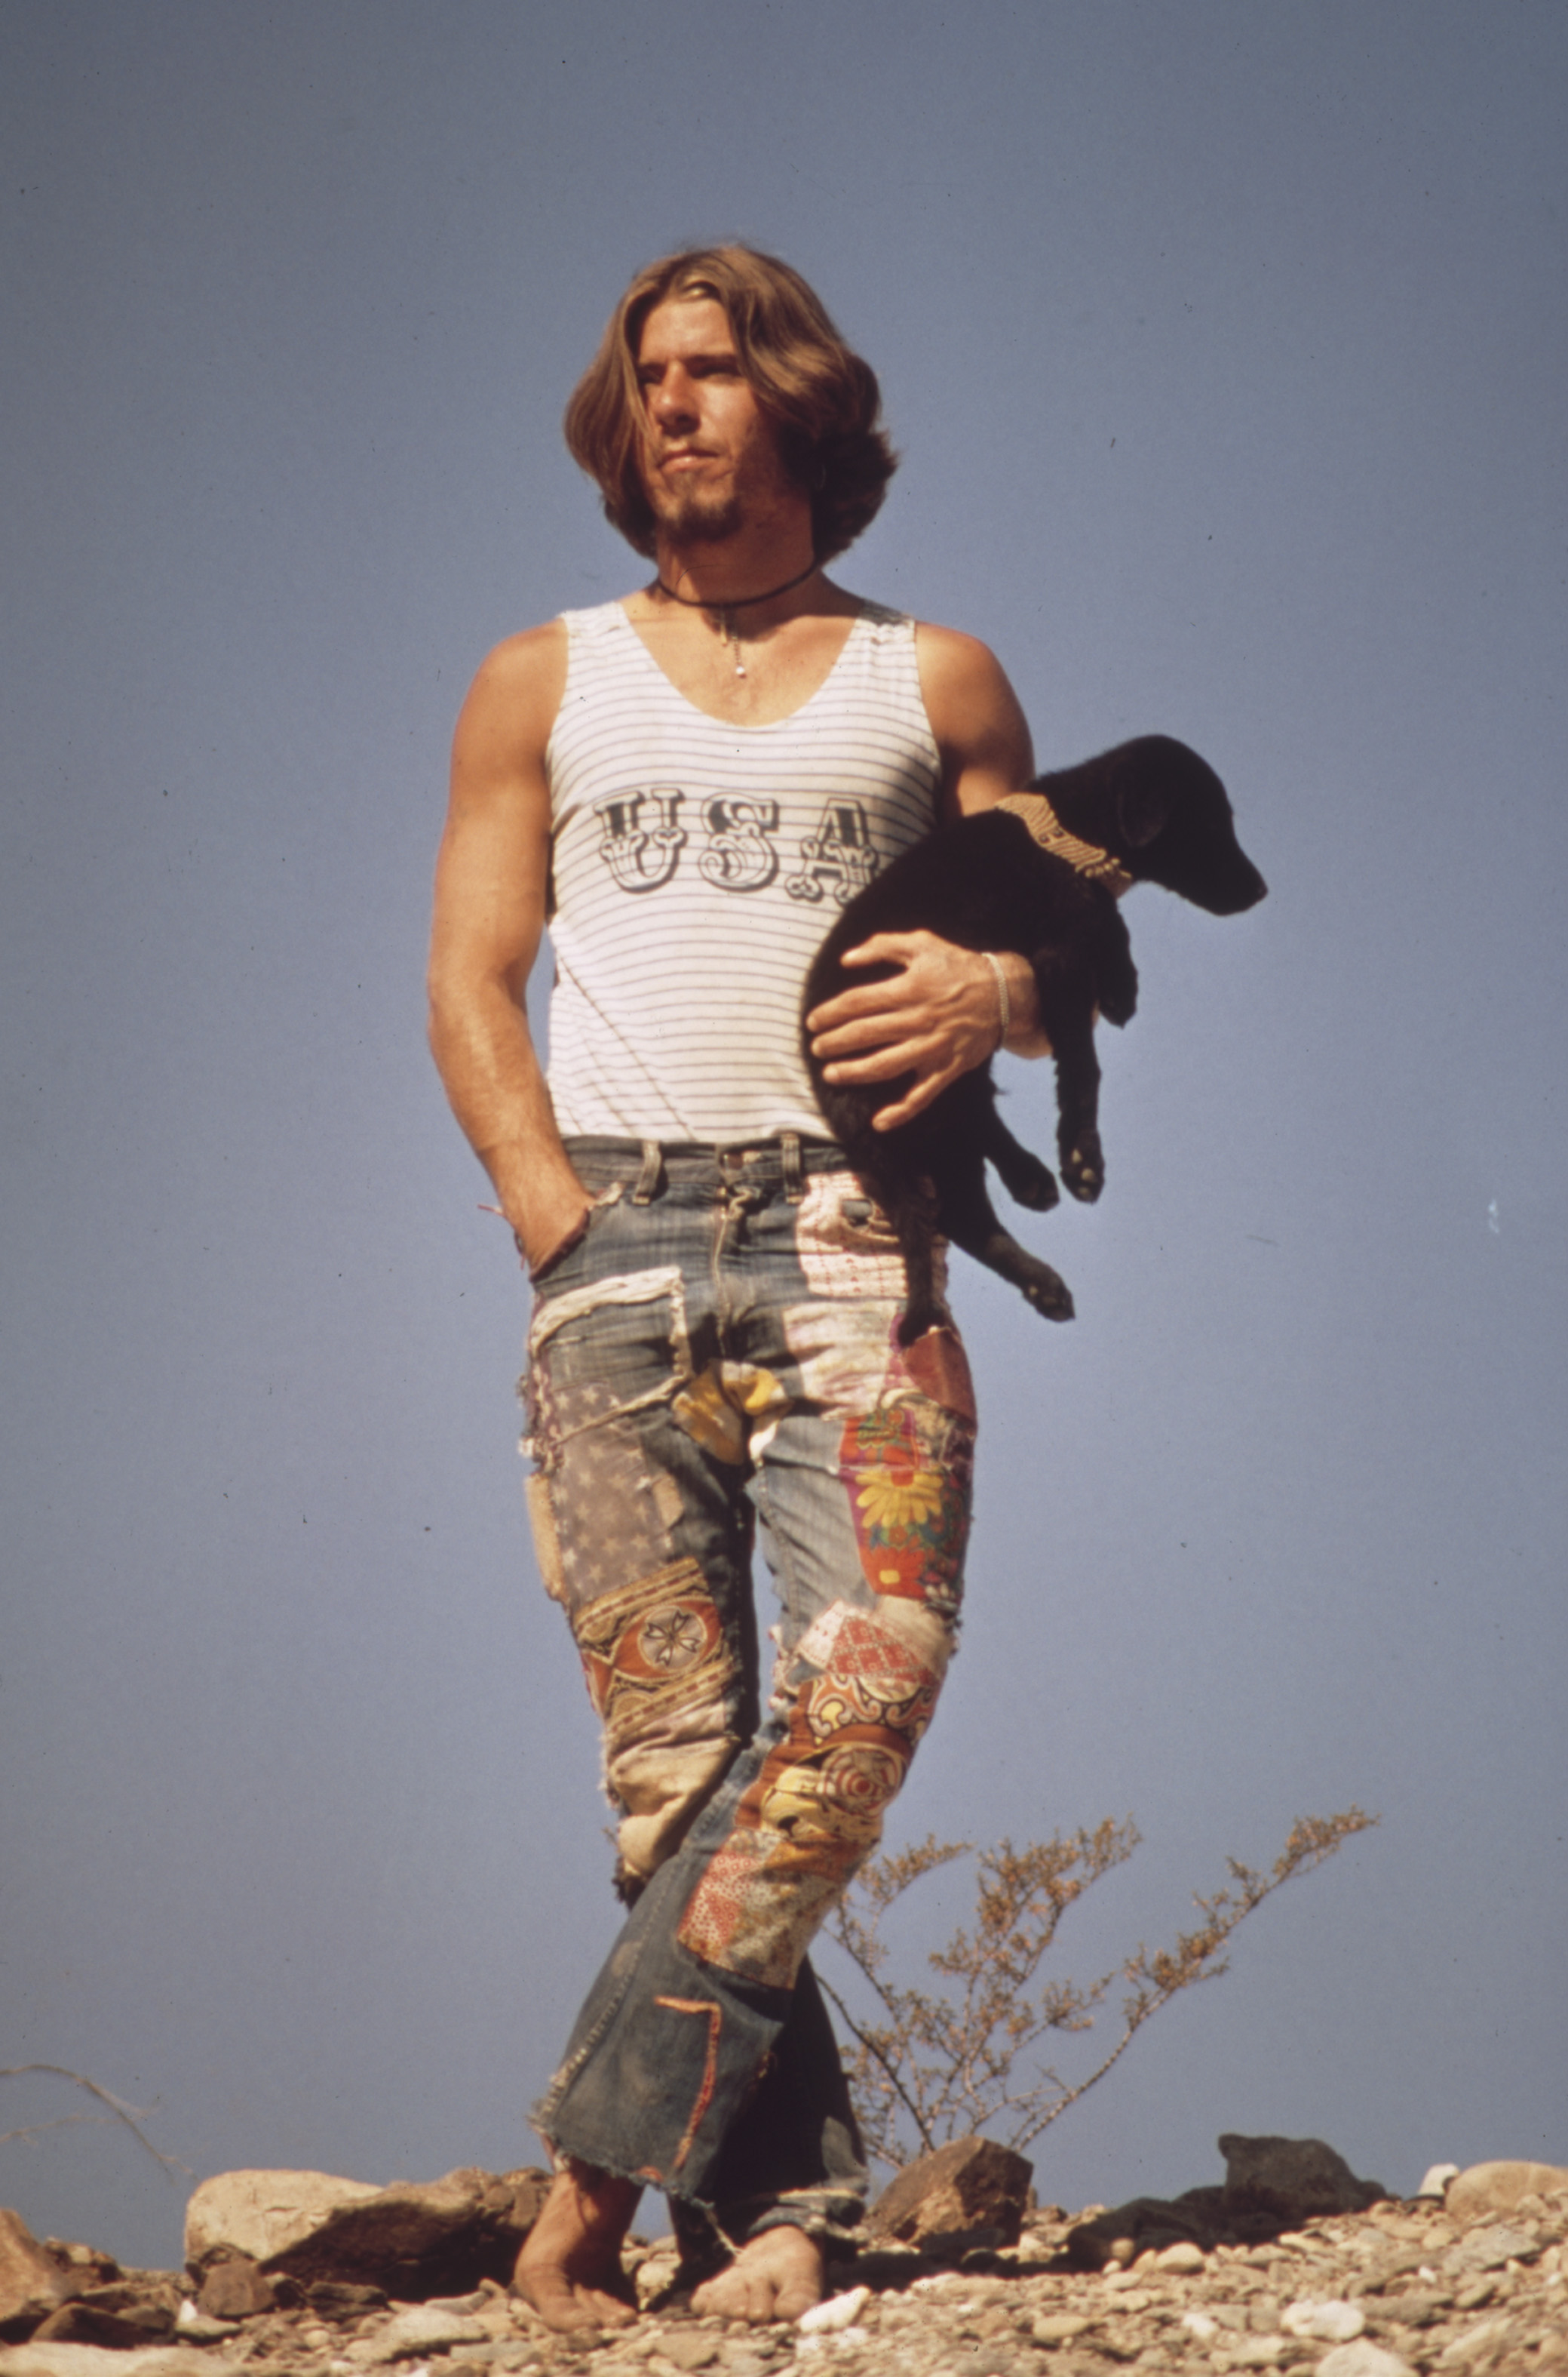
Outline
Today we will:
Start with an introduction to the theory of distant viewing.
Introduce an historic photographic corpus from the 1970s.
Explore popular techniques for enabling search and discovery of photographic collections.
Present and evaluate a new distant viewing method that uses large language models to improve capabilities of digital public interfaces.
See how new class of models connects back to the theoretical stakes of distant viewing.
01 – Distant Viewing | Introduction
Charles O’Rear, Hitchhiker with His Dog, Tripper, On U.S. 66 (May 1972)

Slide 5
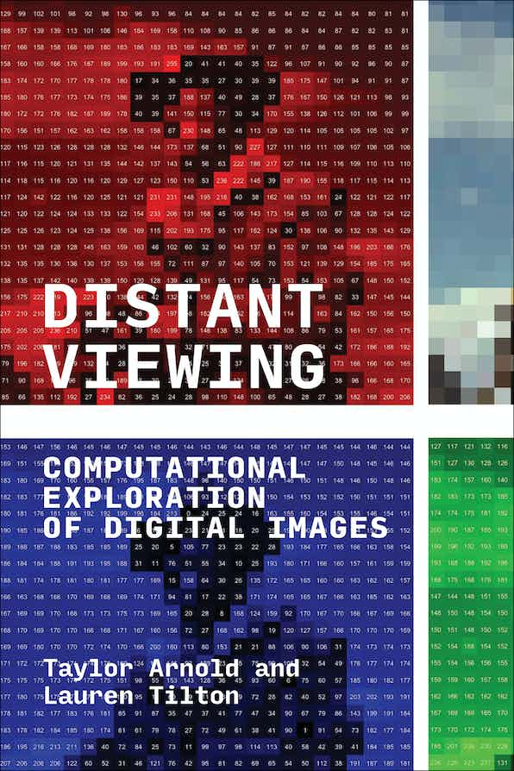
Distant Viewing Book (2023)
For more details about the theory and method of distant viewing, please check out our recently published book Distant Viewing (MIT Press, 2023). It has been released under an OA license and can be freely downloaded from the following link:
https://distantviewing.org/book
Distant Viewing: Computational Exploration of Digital Images
By Taylor Arnold, Lauren Tilton
The MIT Press
DOI: https://doi.org/10.7551/mitpress/14046.001.0001
ISBN electronic: 9780262375160
In Special Collection: CogNet
Publication date: October 2023
01 – Distant Viewing | Introduction

Slide 6
2. Theory + Method
02 – Distant Viewing | Theory + Method

Slide 7
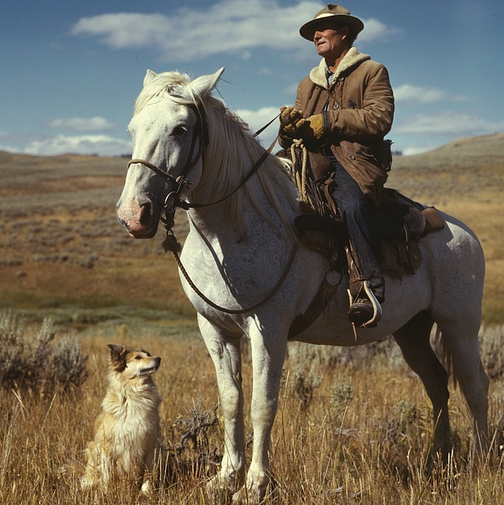
Introduction
Take a moment to look at the image on the right and consider the following questions:
What is this an image of?
What is it doing?
What message(s) does it convey?
How does it convey these messages?
02 – Distant Viewing | Theory + Method
T. Arnold and L. Tilton, (2023) Distant Viewing, MIT Press.

Slide 8
Introduction
We view and interpret images quickly, constantly, and often subconsciously.
Paul Valéry eloquently described the process of interpreting and image as: “looking, in other words forgetting the name of the things that one sees.”
02 – Distant Viewing | Theory + Method
T. Arnold and L. Tilton, (2023) Distant Viewing, MIT Press.

Slide 9
Introduction
We view and interpret images quickly, constantly, and often subconsciously.
Paul Valéry eloquently described the process of interpreting and image as: “looking, in other words forgetting the name of the things that one sees.”
How does this system work? The work of scholars from semiotics, visual culture studies, art history and cognitive science have shown that images form a mimetic system: a method of communication where things (i.e., real-world objects) are represented by symbols (i.e., parts of the image) by having shared characteristics (such as the same shape or color).
02 – Distant Viewing | Theory + Method
T. Arnold and L. Tilton, (2023) Distant Viewing, MIT Press.

Slide 10
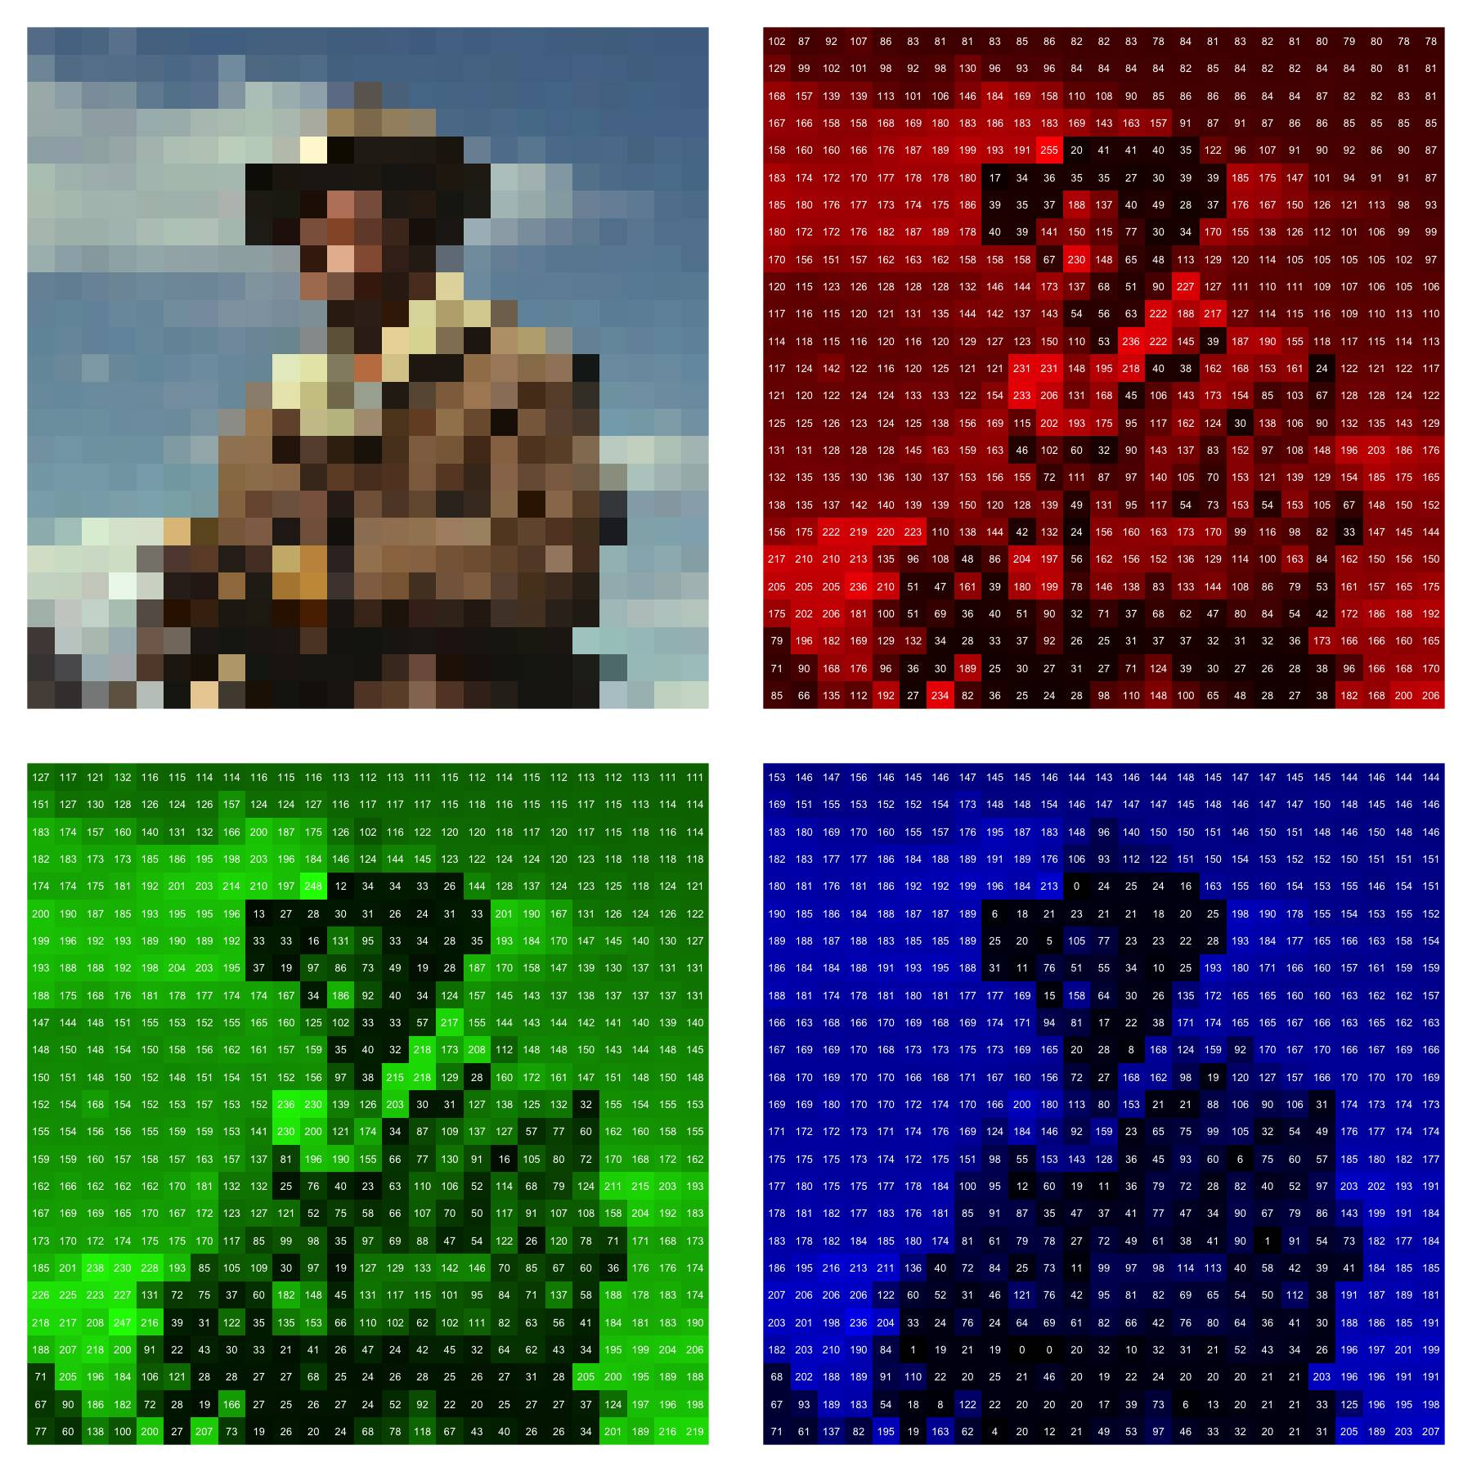
Introduction
The way that computer store and understand images (at least at a surface level) is quite different from the way that humans interpret images. Digital mages are represented as arrays of pixel intensities telling how much red, green, and blue light needs to be shown at a particular point in space to replicate the image.
RED
[,1] [,2] [,3] [,4]
[1,] 0.9568627 0.9490196 0.9176471 0.9294118
[2,] 0.3411765 0.3058824 0.2901961 0.2588235
[3,] 0.3294118 0.3019608 0.2901961 0.2941176
[4,] 0.3450980 0.2823529 0.2784314 0.2627451
GREEN
[,1] [,2] [,3] [,4]
[1,] 0.9921569 1.0000000 1.0000000 1.0000000
[2,] 0.3803922 0.3686275 0.3764706 0.3529412
[3,] 0.3764706 0.3725490 0.3843137 0.4000000
[4,] 0.4039216 0.3647059 0.3803922 0.3725490
BLUE
[,1] [,2] [,3] [,4]
[1,] 1.0000000 1.0000000 1.0000000 1.0000000
[2,] 0.4156863 0.4313725 0.4666667 0.4549020
[3,] 0.4392157 0.4588235 0.4941176 0.5176471
[4,] 0.4862745 0.4705882 0.5098039 0.5254902
02 – Distant Viewing | Theory + Method
T. Arnold and L. Tilton, (2023) Distant Viewing, MIT Press.

Slide 11
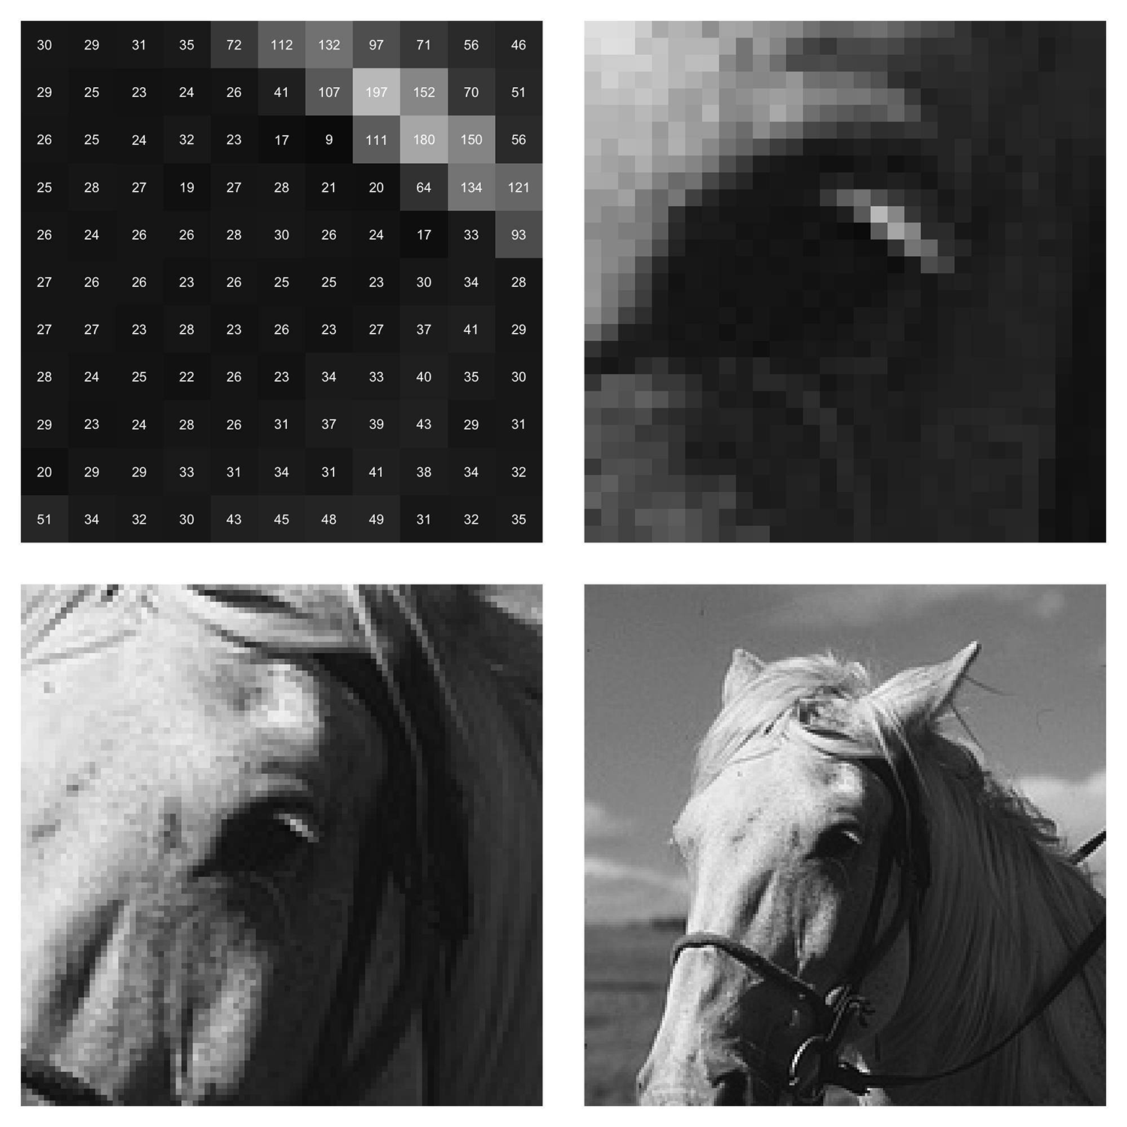
Introduction
The format of digital images reinforces the semiotic properties of visual materials. Pixels convey meaning only when put into context with one another by mimicking the act of viewing objects, people, and environments directly through the human visual system.
What is this an image of?
02 – Distant Viewing | Theory + Method
T. Arnold and L. Tilton, (2023) Distant Viewing, MIT Press.

Slide 12
Introduction
The format of digital images reinforces the semiotic properties of visual materials. Pixels convey meaning only when put into context with one another by mimicking the act of viewing objects, people, and environments directly through the human visual system.
What is this an image of?
02 – Distant Viewing | Theory + Method
T. Arnold and L. Tilton, (2023) Distant Viewing, MIT Press.

Slide 13
Introduction
The format of digital images reinforces the semiotic properties of visual materials. Pixels convey meaning only when put into context with one another by mimicking the act of viewing objects, people, and environments directly through the human visual system.
What is this an image of?
02 – Distant Viewing | Theory + Method
T. Arnold and L. Tilton, (2023) Distant Viewing, MIT Press.

Slide 14
Introduction
The format of digital images reinforces the semiotic properties of visual materials. Pixels convey meaning only when put into context with one another by mimicking the act of viewing objects, people, and environments directly through the human visual system.
What is this an image of?
Notice that e can only understand the “meaning” of the pixels making up the horse’s eye once they are put in context with a larger image. This is much different than the way that, for example, textual data makes meaning.
02 – Distant Viewing | Theory + Method
T. Arnold and L. Tilton, (2023) Distant Viewing, MIT Press.

Slide 15
Distant Viewing: Theory
We have fewer capacious theories for understanding the computational processes that produce ways of viewing at a large scale.
So, we heed media scholar Steve Anderson’s call to interrogate and theorize vision technologies through the lens provided by media and visual culture studies. We zoom in and out through data science and digital humanities.
We also build on the work of scholars across fields such as John Berger, Lisa Cartwright, Stuart Hall, Elizabeth Losh, Tara McPherson, Lev Manovich, Marita Sturken, Hadley Wickham, and Joanna Zylinksa to develop the theory and method.
02 – Distant Viewing | Theory + Method
T. Arnold and L. Tilton, (2023) Distant Viewing, MIT Press.
Notes:
Ex. all of the research focused on miliatry and automation: they are trained around cars, people, buildings, and weapons.

Slide 16
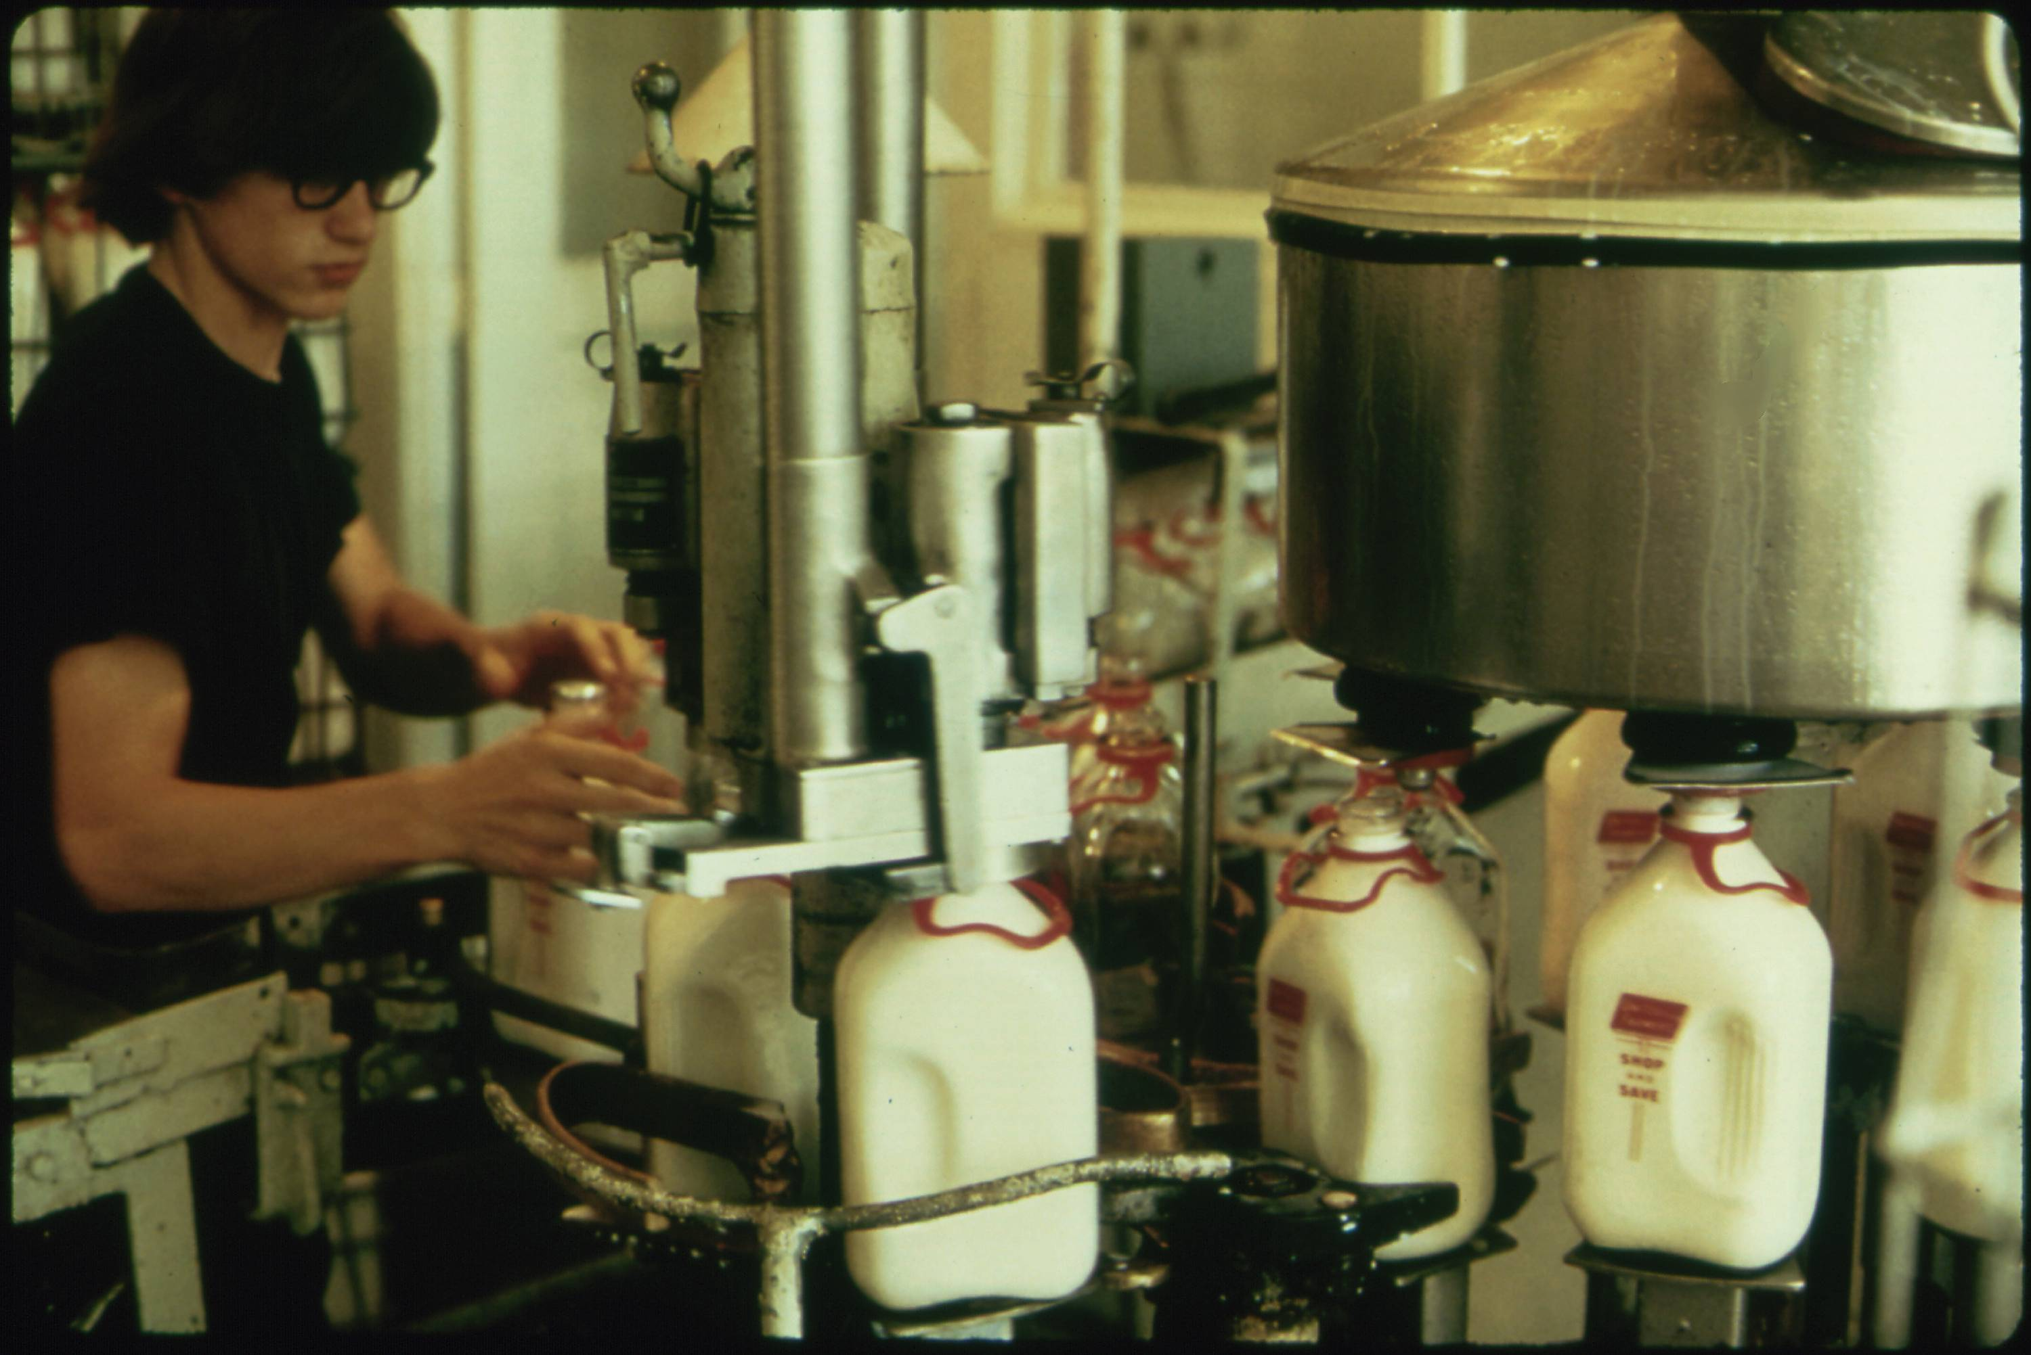
Distant Viewing: Theory
Flip Schulke, Employee of the Donald Dannheim Family who operate a dairy and ice cream store (July 1974).
Distant Viewing is a theory of how the computational exploration of digital images through the application of computer vision works, and why it is needed.
starting image
02 – Distant Viewing | Theory + Method
T. Arnold and L. Tilton, (2023) Distant Viewing, MIT Press.

Slide 17
Distant Viewing: Theory
Flip Schulke, Employee of the Donald Dannheim Family who operate a dairy and ice cream store (July 1974).
Distant Viewing is a theory of how the computational exploration of digital images through the application of computer vision works, and why it is needed.
Mimetic nature of images necessitates that the computational analysis of digital images starts with the extraction of semantic metadata using computer vision.
starting image
annotations
black, brown, white
{ bottle, milk }
indoors
1 person
02 – Distant Viewing | Theory + Method
T. Arnold and L. Tilton, (2023) Distant Viewing, MIT Press.

Slide 18
Distant Viewing: Theory
Flip Schulke, Employee of the Donald Dannheim Family who operate a dairy and ice cream store (July 1974).
Distant Viewing is a theory of how the computational exploration of digital images through the application of computer vision works, and why it is needed.
Mimetic nature of images necessitates that the computational analysis of digital images starts with the extraction of semantic metadata using computer vision.
The process of constructing annotations is a computationally mediated form of “viewing”.
starting image
annotations
black, brown, white
{ bottle, milk }
indoors
1 person
02 – Distant Viewing | Theory + Method
T. Arnold and L. Tilton, (2023) Distant Viewing, MIT Press.

Slide 19
Distant Viewing: Theory
Flip Schulke, Employee of the Donald Dannheim Family who operate a dairy and ice cream store (July 1974).
Distant Viewing is a theory of how the computational exploration of digital images through the application of computer vision works, and why it is needed.
Mimetic nature of images necessitates that the computational analysis of digital images starts with the extraction of semantic metadata using computer vision.
The process of constructing annotations is a computationally mediated form of “viewing”.
The application of computer vision is not a neutral process. It engages in socially mediated ways of seeing and viewing that are encoded into the algorithms and the ways that they are used.
starting image
annotations
black, brown, white
{ bottle, milk }
indoors
1 person
02 – Distant Viewing | Theory + Method
T. Arnold and L. Tilton, (2023) Distant Viewing, MIT Press.

Slide 20
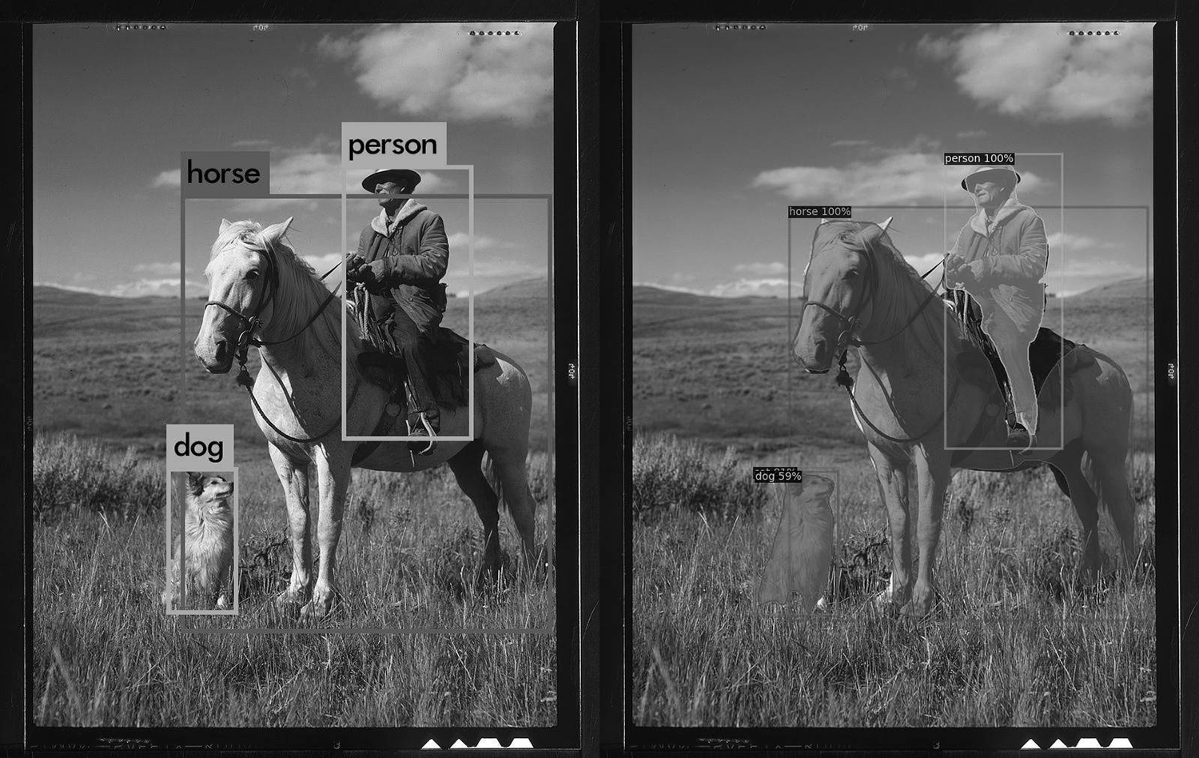
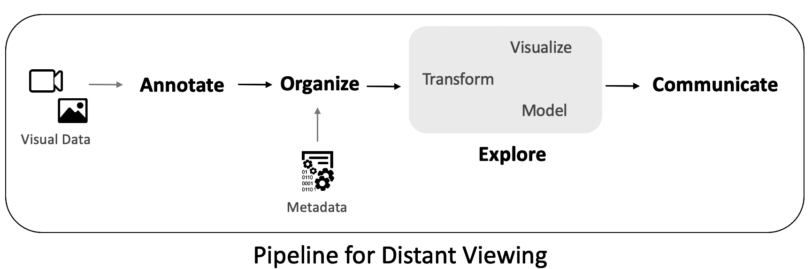
Distant Viewing: Method
The output of several computer vision algorithms. The top row consists of object bounding boxes (YOLO9000) and detected object regions (Mask R-CNN). In the bot- tom row, the detected regions of the COCO Panoptic task are shown, followed by the detected COCO Keypoints.
Finally, the Distant Viewing theory offers an approach to specify and interrogate methods for method for the computational exploration of digital images through the application of computer vision.
Annotate: Create Data with Computer Vision
Organize: Aggregate Annotations & Combine with Metadata
Explore: Understand Data and Address Areas of Inquiry
Communicate: Present Results and Share Data
02 – Distant Viewing | Theory + Method
T. Arnold and L. Tilton, (2023) Distant Viewing, MIT Press.

Slide 21
3. DOCUMERICA
03 – Distant Viewing | DOCUMERICA

Slide 22
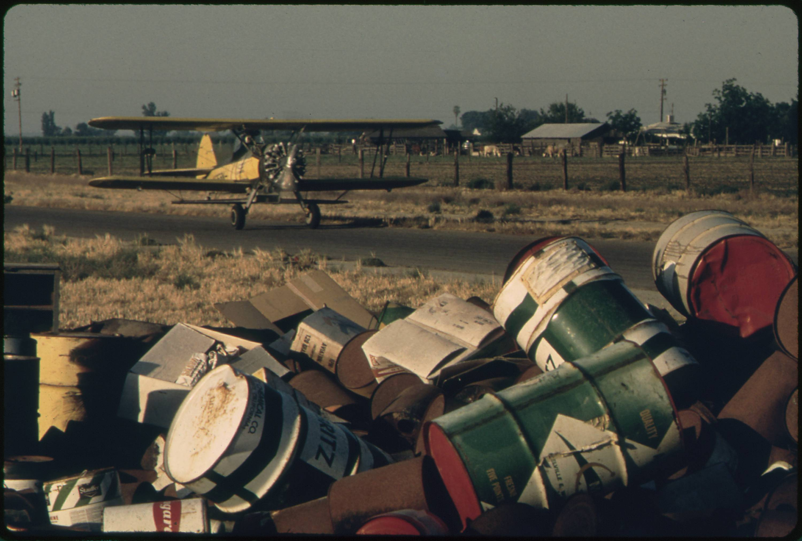
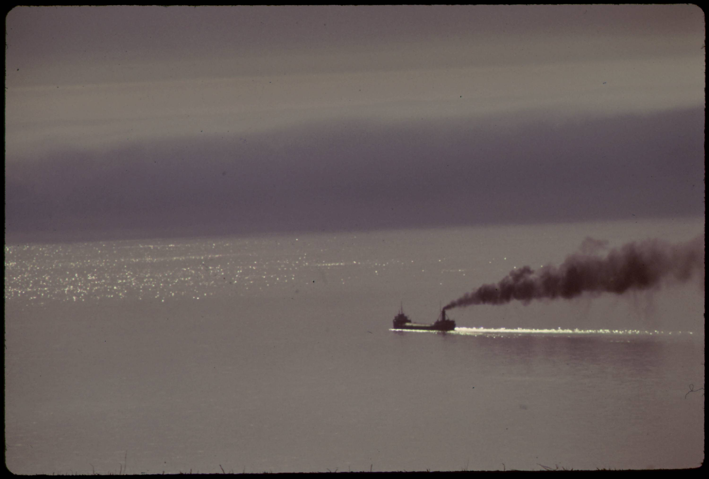
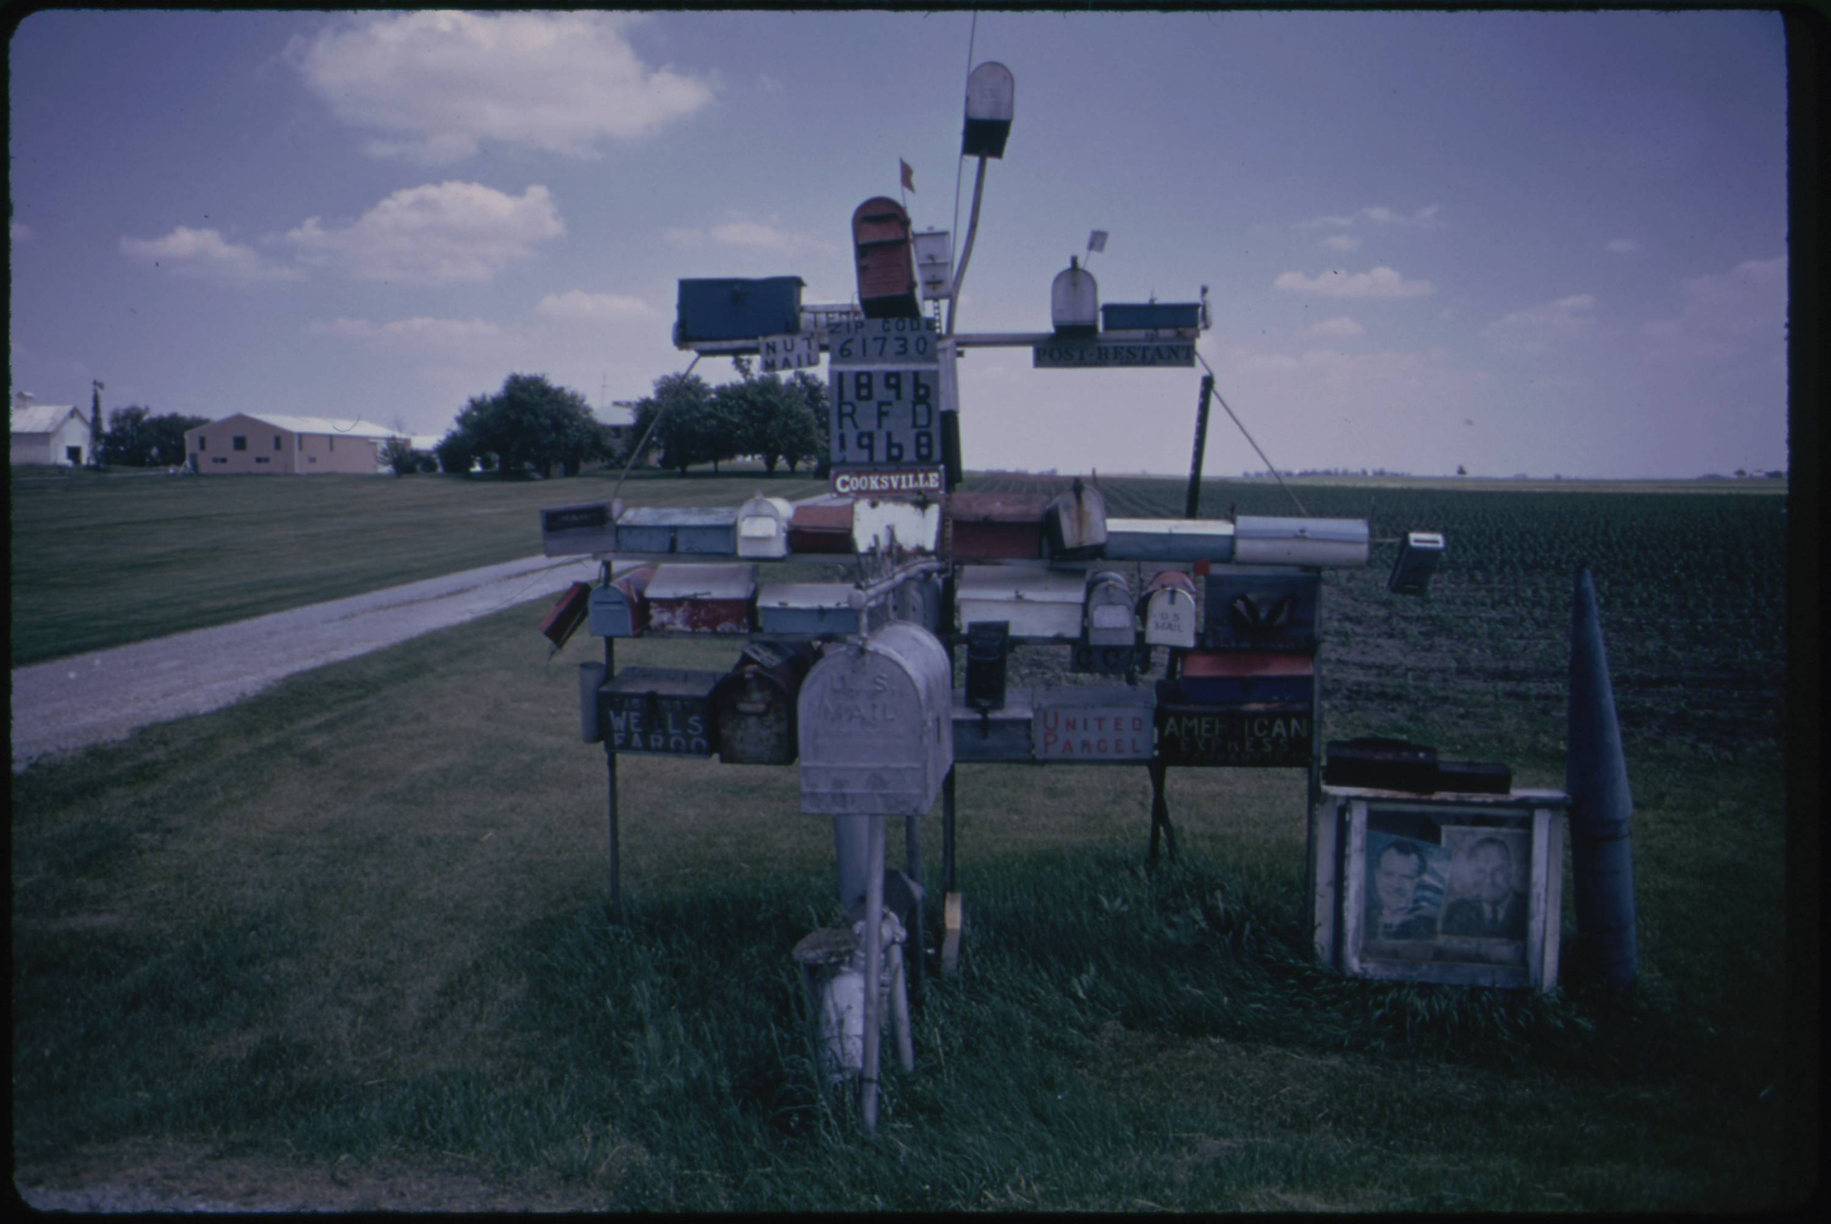
DOCUMERICA
From 1972 and 1978 the U.S. Environmental Protection Agency (EPA) sponsored the DOCUMERIC project to document contemporary environment issues and highlight ongoing work by the agency.
The U.S. National Archies and Records Administration (NARA) has digitized and made available nearly 16,000 images taken by the DOCUMERICA photographers.
Public interest in the collection has recently grown with the increased focus on environmental concerns. While the images are freely accessible from the NARA website and released into the public domain, the ability to understand the scope of the collection in its current form is limited.
We are interested in creating a public interface to allows anyone to explore the many dimensions of the collection. How can we using distant viewing approaches to help organize and create generous interfaces for this important photographic archive?
Gene Daniels, Discarded Pesticide Cans (May 1972).
Donald Emmerich, Ore Carrier Heads into Lake Superior (June 1973).
Arthur Greenberg, Excentric Mailbox Display (June 1973).
03 – Distant Viewing | DOCUMERICA

Slide 23
4. Three "Classic" Approaches
04 – Distant Viewing | Classic Approaches

Slide 24
Approach 1: Use the Metadata
One possibility is to built a public interface around existing metadata. This can be a powerful technique, particularly when rich metadata is already available and aligns well with the kinds of exploration and discovery that users of the collection are interested in.
The DOCUMERICA corpus includes some limited but fairly consist metadata, but most photos do include a location (at the level of a town),date (month and year), and the name of the photographer. Most images have captions; some of these are several sentences, whereas many only include a few key terms.
July 1974
Flip Schulke
New Ulm, Minnesota
04 – Distant Viewing | Classic Approaches

Slide 25
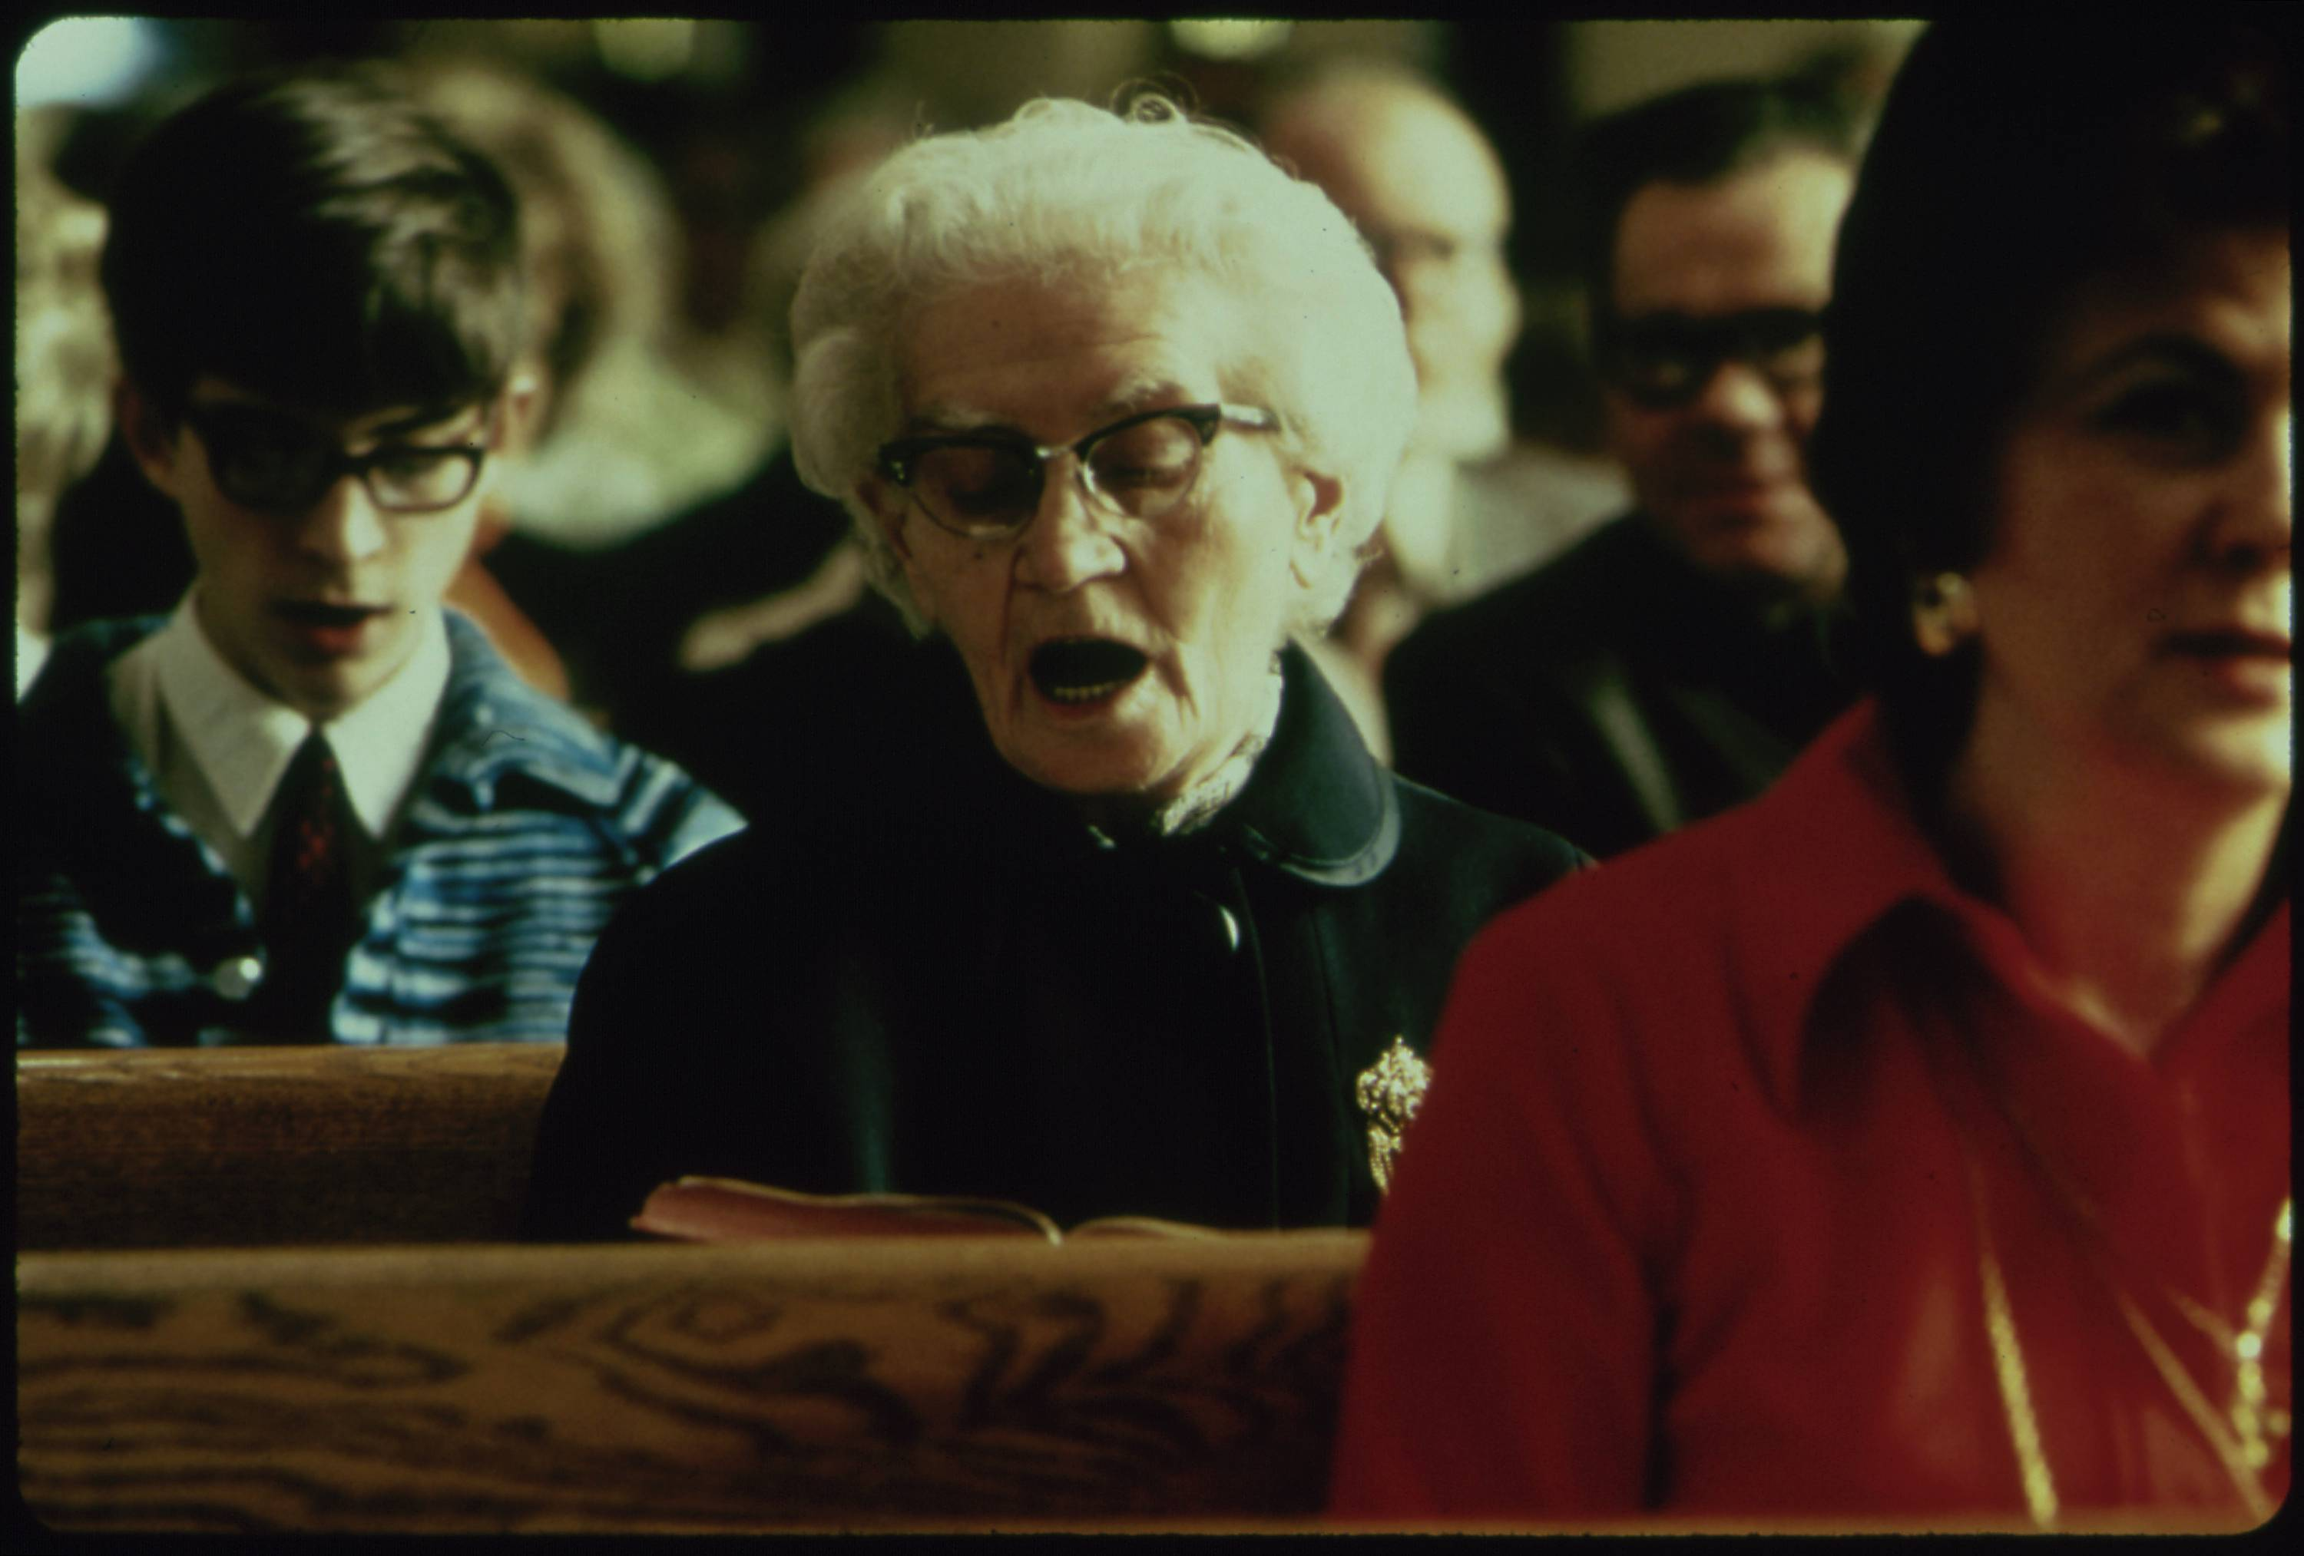
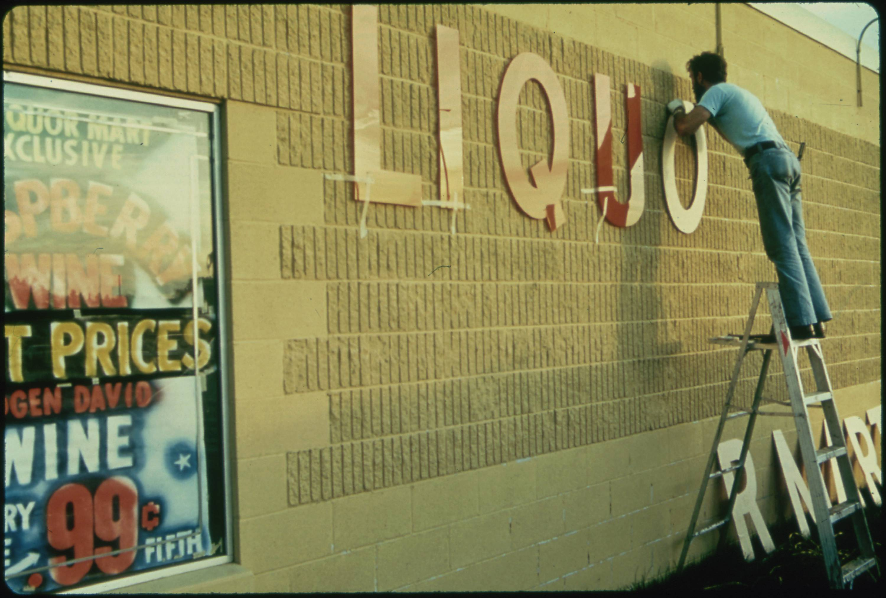
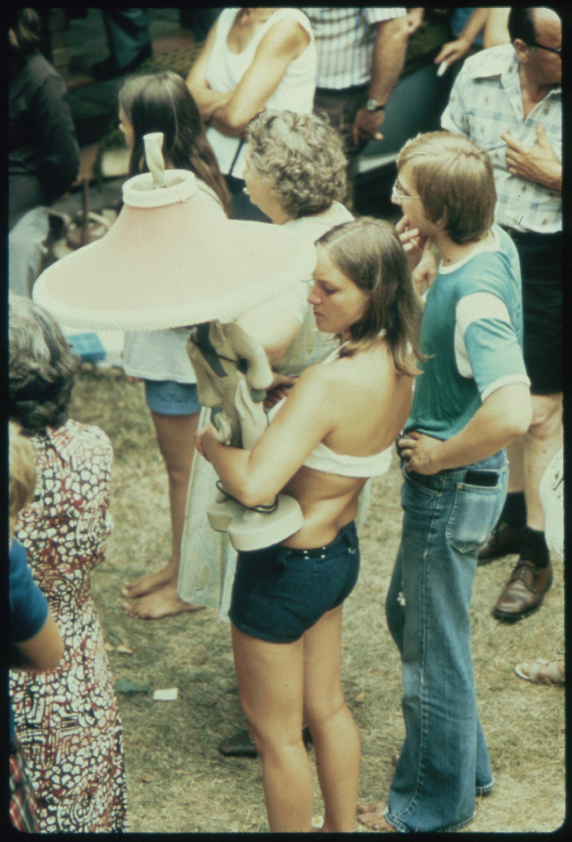
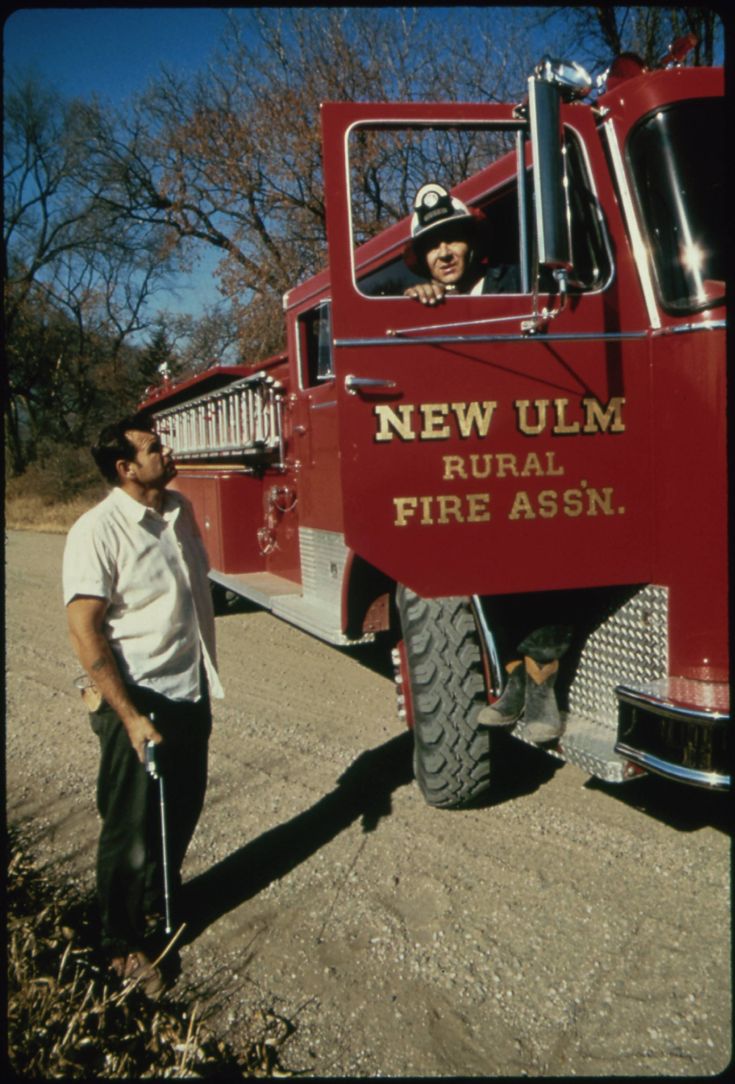
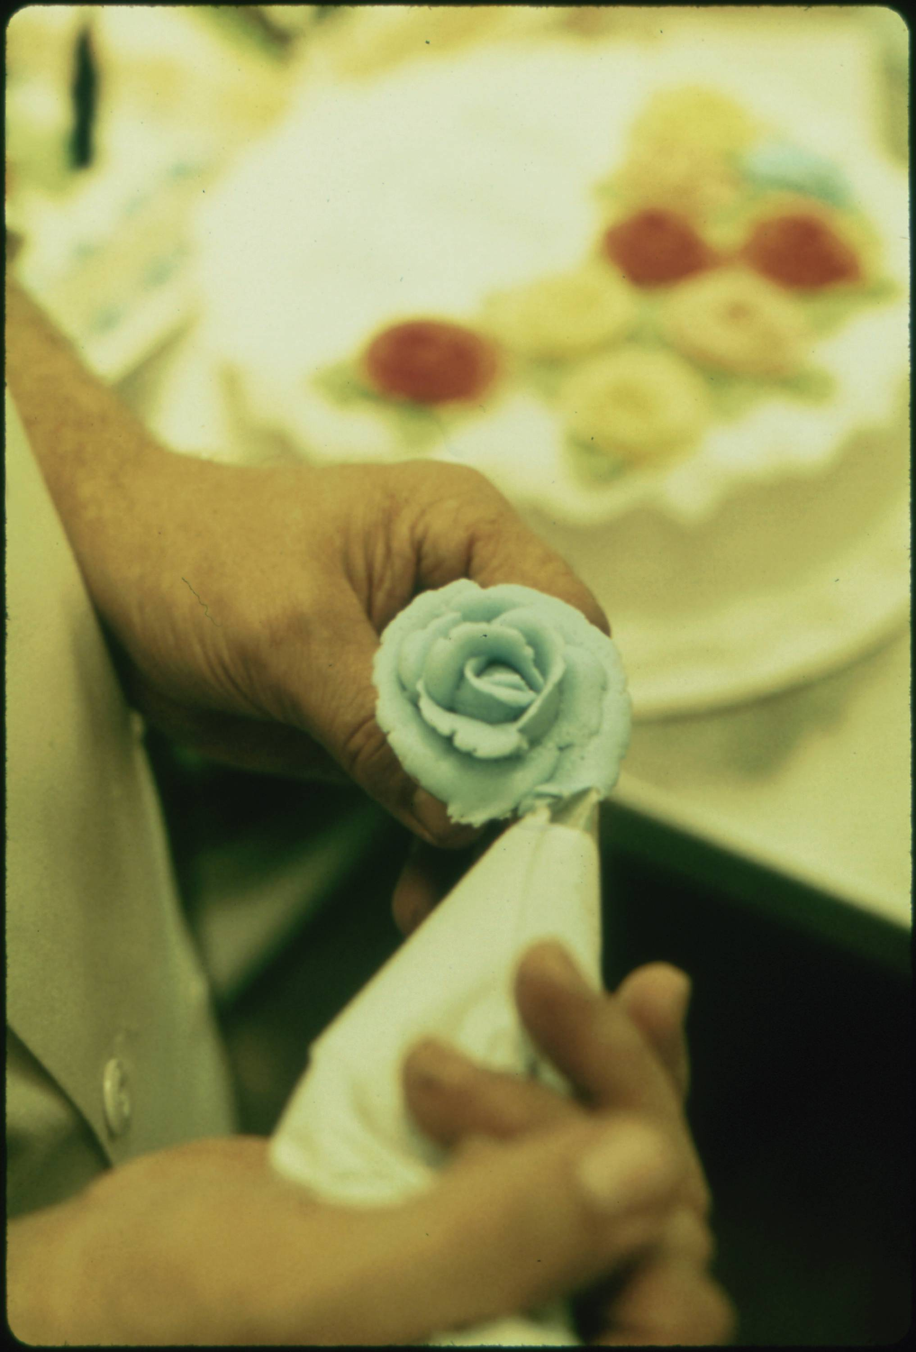
Approach 1: Use the Metadata
For example, here are the other images that have the same photographer, location, and date as our starting image. It seems that Flip Schulke took a variety of images throughout the town of Ulm, Minnesota during his visit in July 1074.
Flip Schulke, Five Photos from Ulm, Minnesota, Documerica Project (July 1974).
04 – Distant Viewing | Classic Approaches

Slide 26
Approach 1: Use the Metadata
Advantages
Relatively easy to integrate into a public interface.
Simple to explain, understand, and regulate.
Can be used with nearly any kind of archive.
Avoids some potential difficulties that government archives have with creating/displaying original information.
Difficulties
Can only be used with collections that have rich metadata.
Locked into the archival logic of the collection.
Metadata may be too granular or too coarse for specific applications.
Does not use the visual component of the images in a direct way.
Flip Schulke, Five Photos from Ulm, Minnesota, Documerica Project (July 1974).
04 – Distant Viewing | Classic Approaches

Slide 27
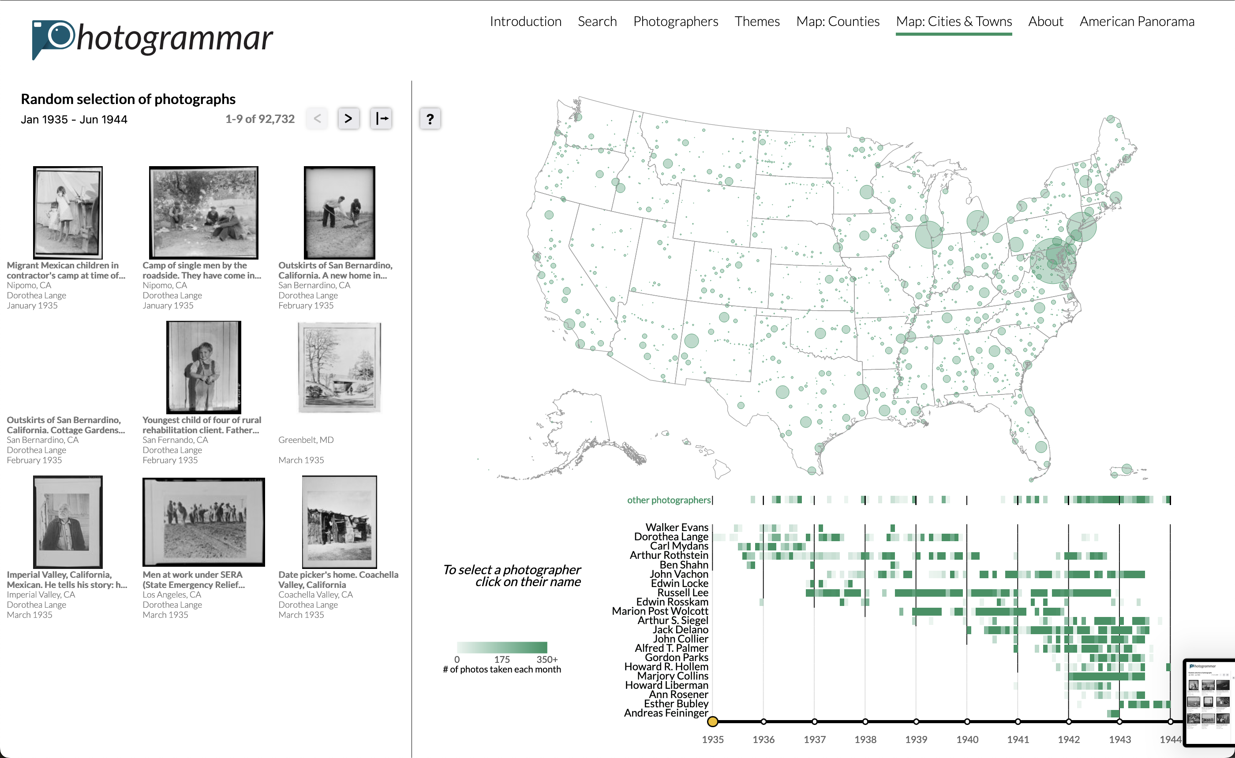
Approach 1: Use the Metadata
Until the past decade, using metadata to organize a collection was more-or-less the only general approach.
The first and second iterations of our public project Photogrammar to visualize the over 170k photographs of the FSA-OWI were all created with metadata as the only organizational logic.
We and others learned a lot about the collection through exploring the spatial, temporal, thematic, material, and other facets of metadata available in the collection.
https://photogrammar.org
T. Arnold, P. Leonard and L. Tilton. (2017) "Knowledge Creation Through Recommender Systems." Digital Scholarship in the Humanities, 32.3: 151-157.
04 – Distant Viewing | Classic Approaches

Slide 28
Approach 2: Supervised ML with Computer Vision
A second approach that have become increasingly possible is the application of computer vision algorithms to tag images with specific features using pre-built models.
For example, object detection can identify with a high degree of accuracy objects within the image of a photograph from a set of pre-defined categories. In our example image, one computer vision algorithm was able to detect the presence of at least one bottle in the frame.
The detected objects can be used just as with the archival metadata. This includes allowing for faceted search and creating recommendations that link one photo to other recommendations based on similar objects.
{ bottle }
04 – Distant Viewing | Classic Approaches

Slide 29
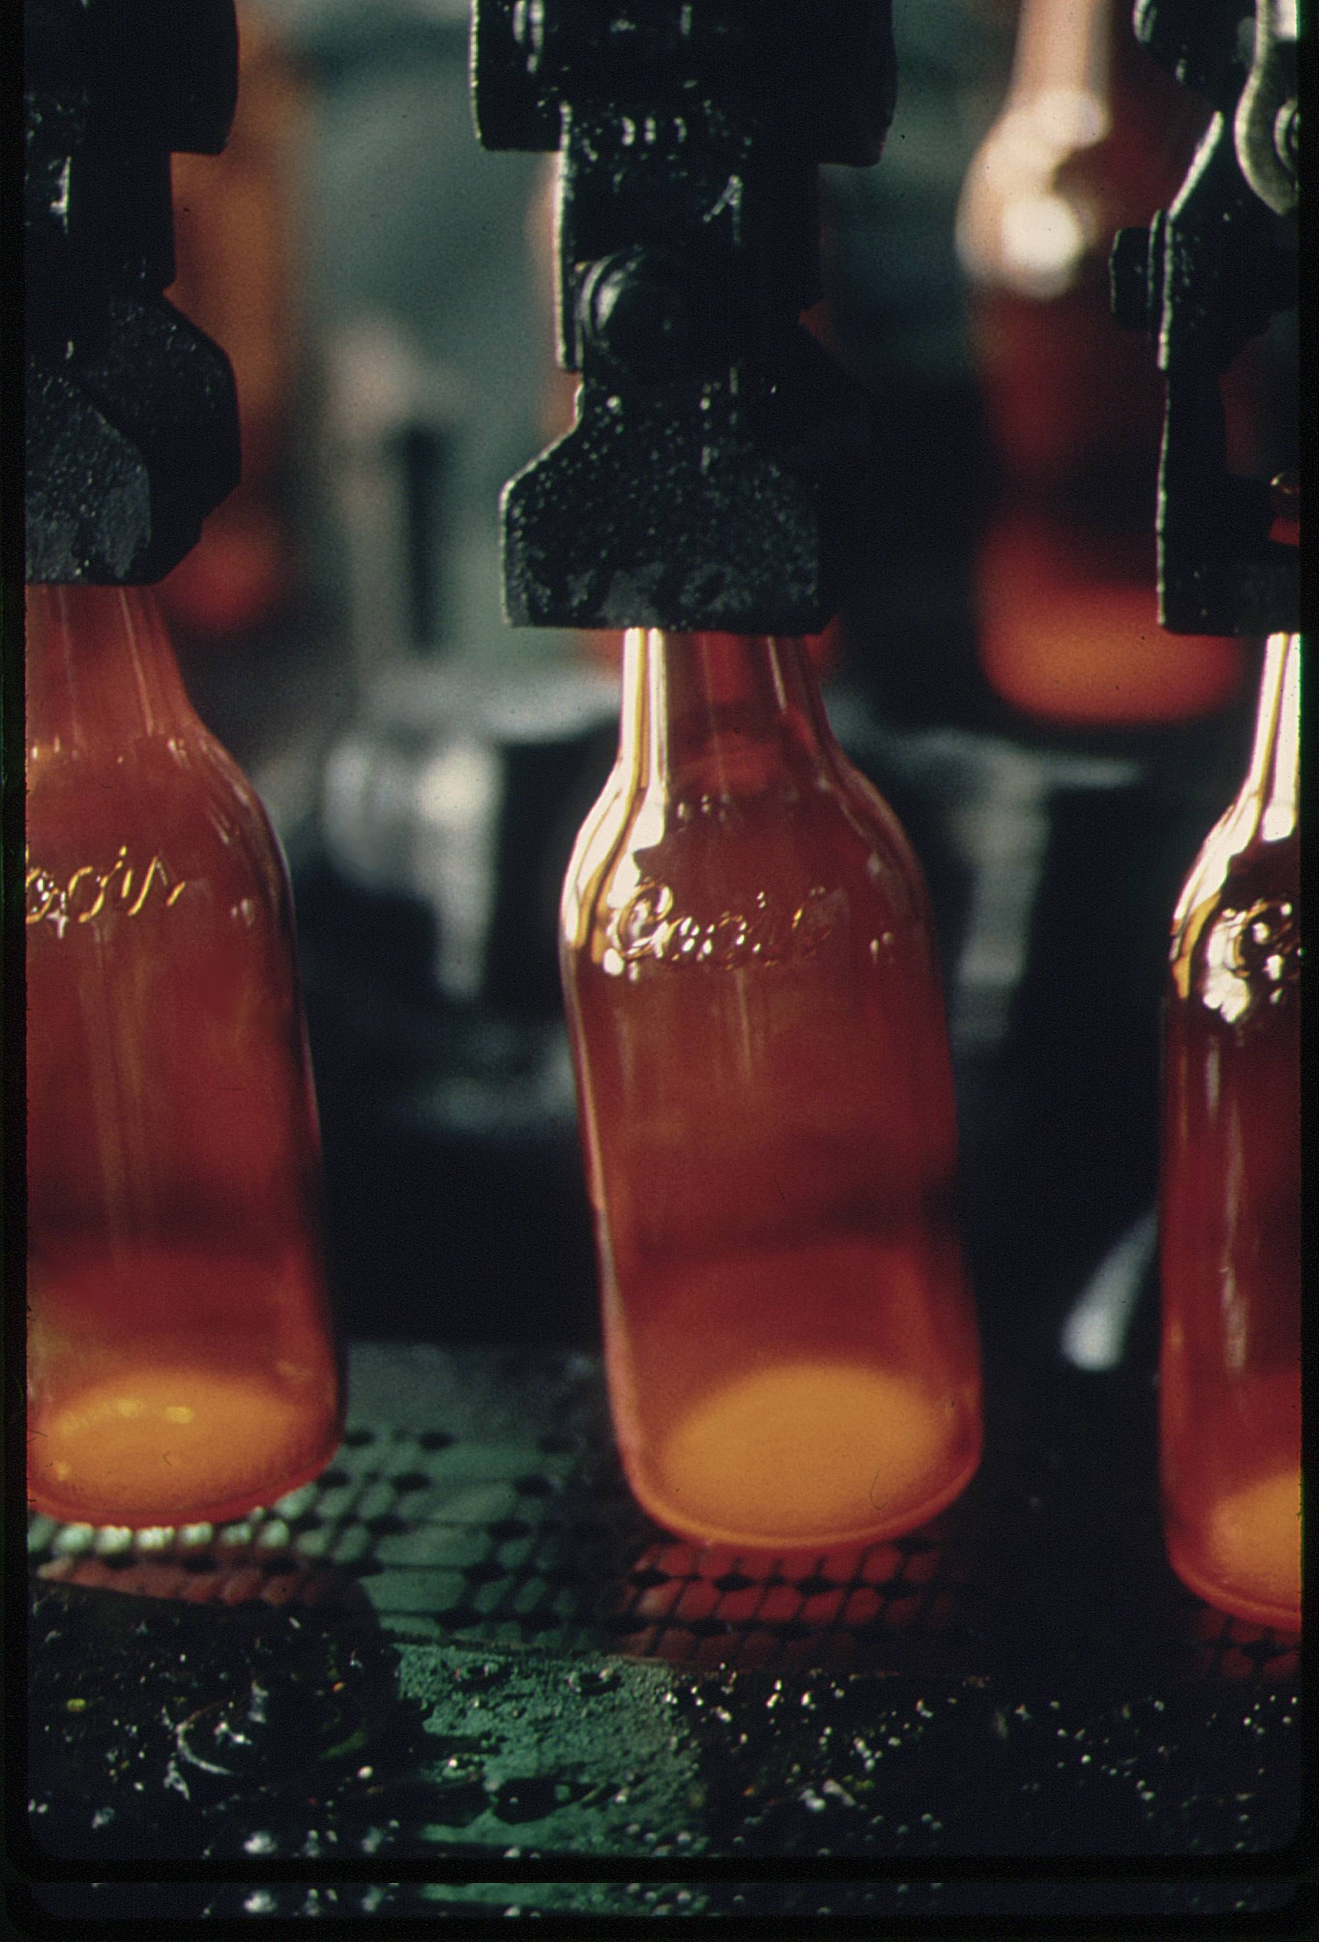
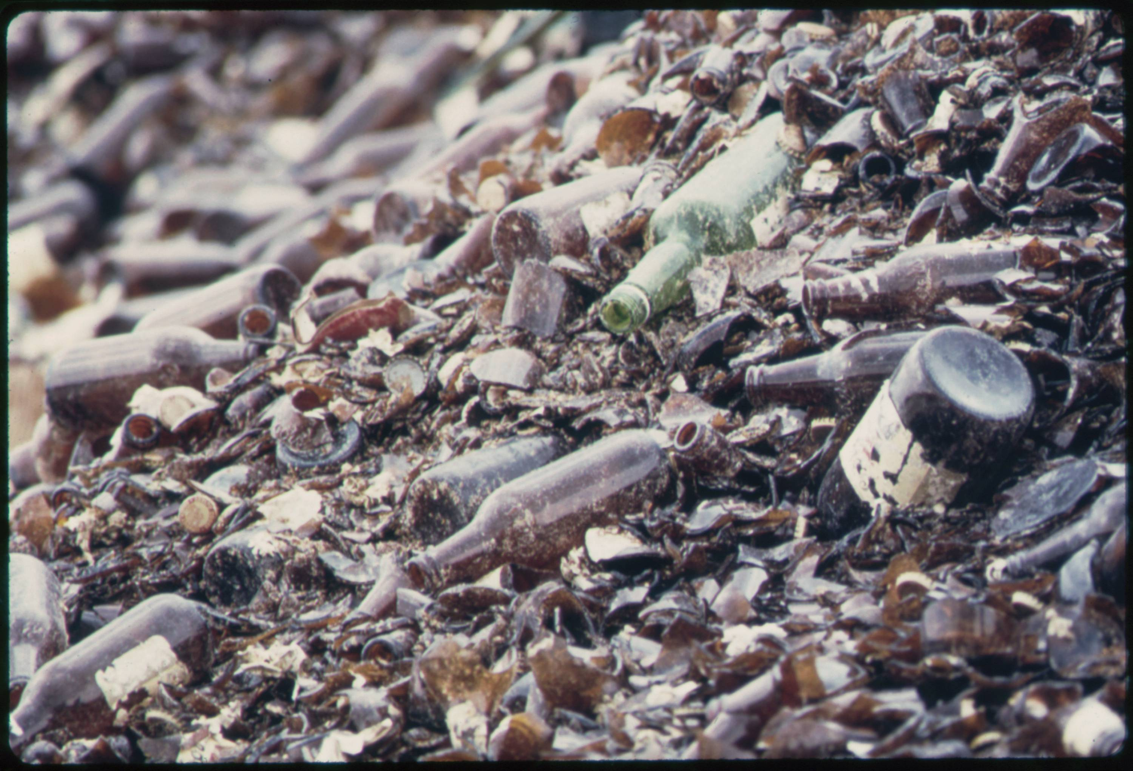
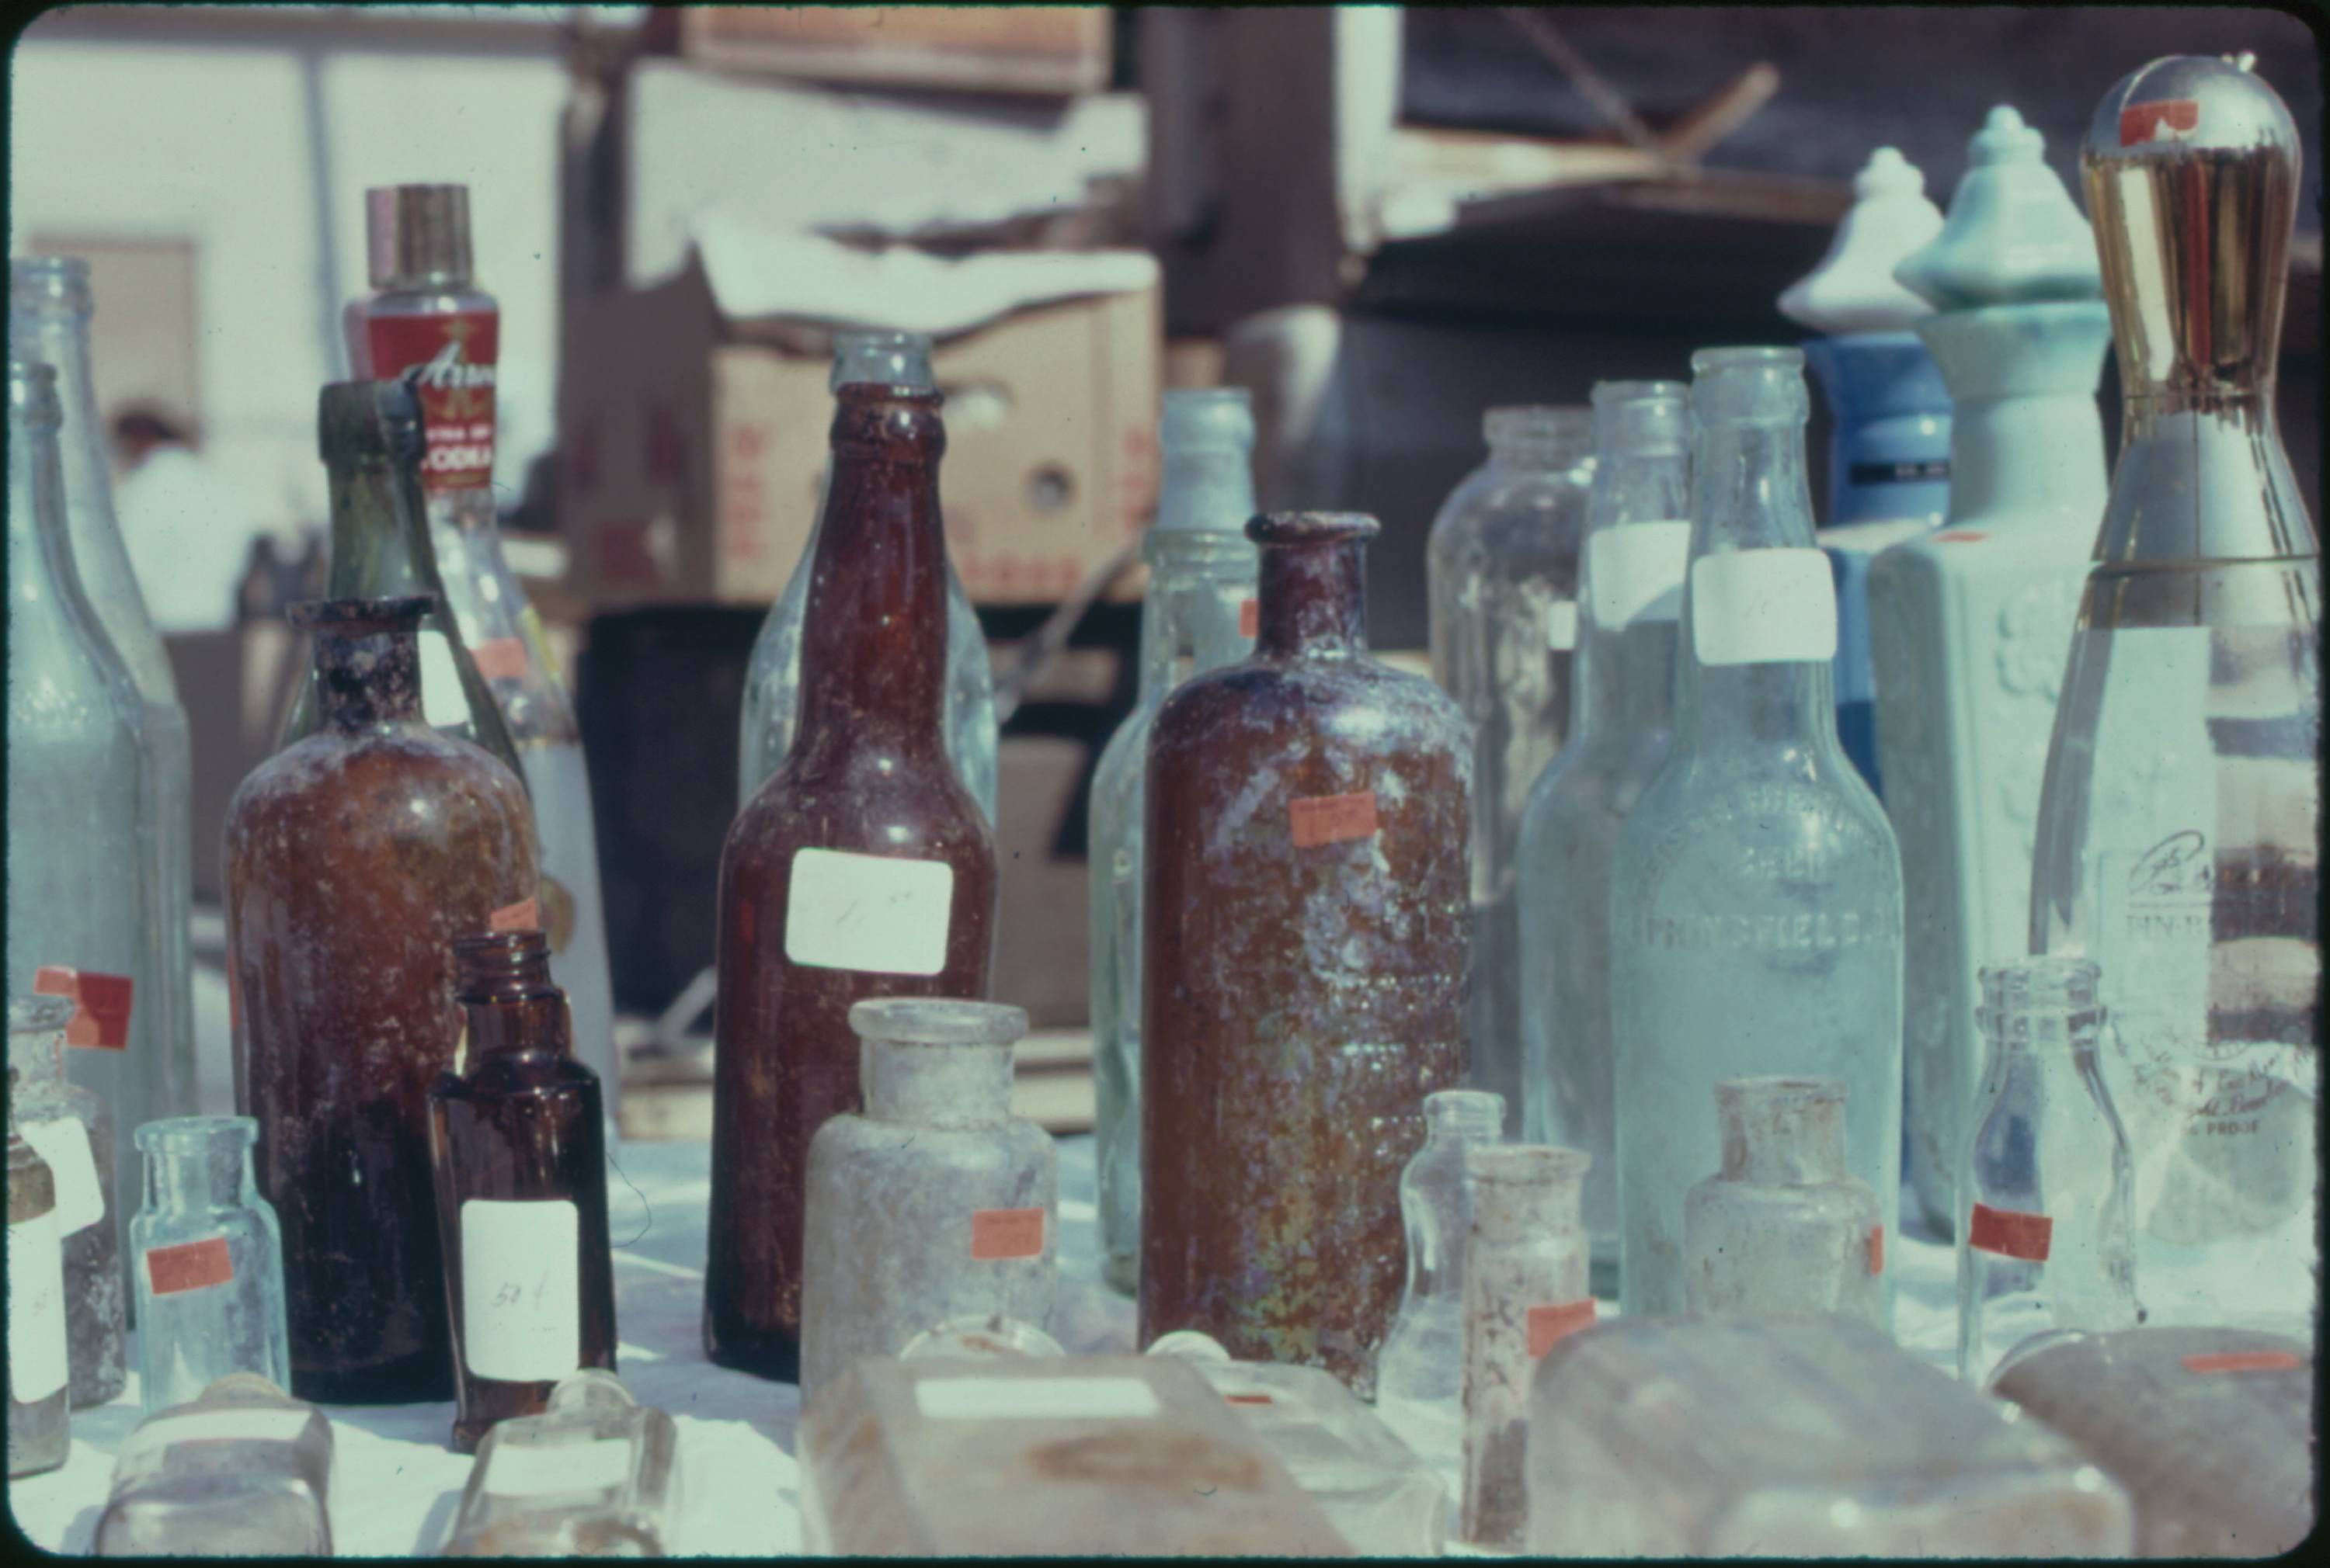

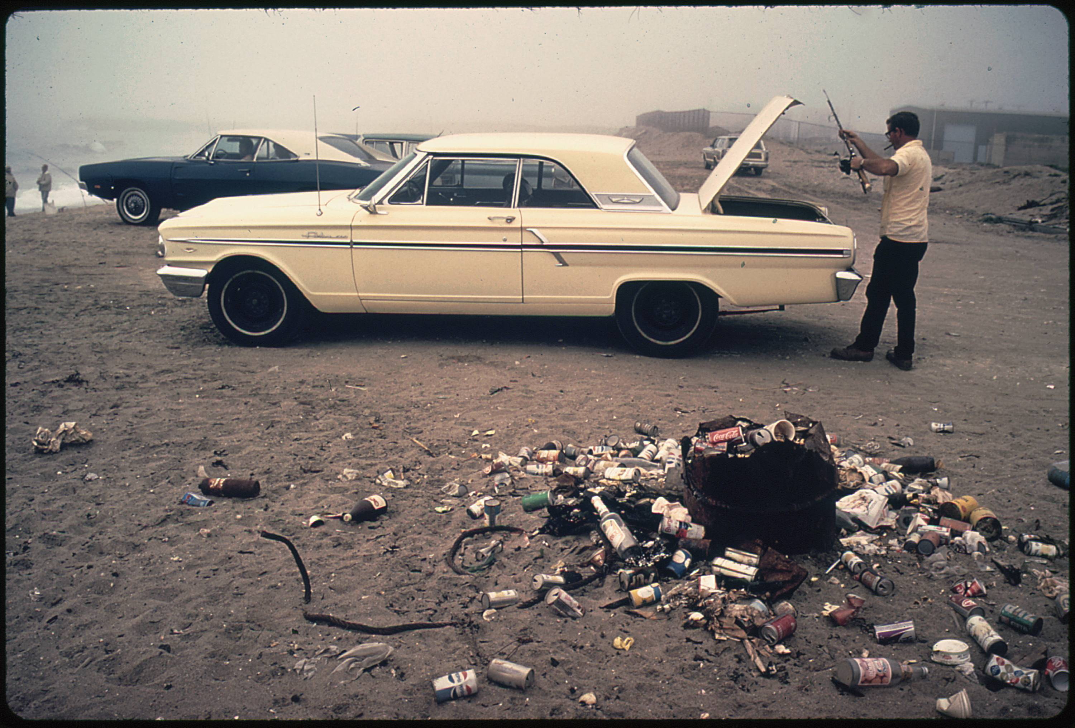
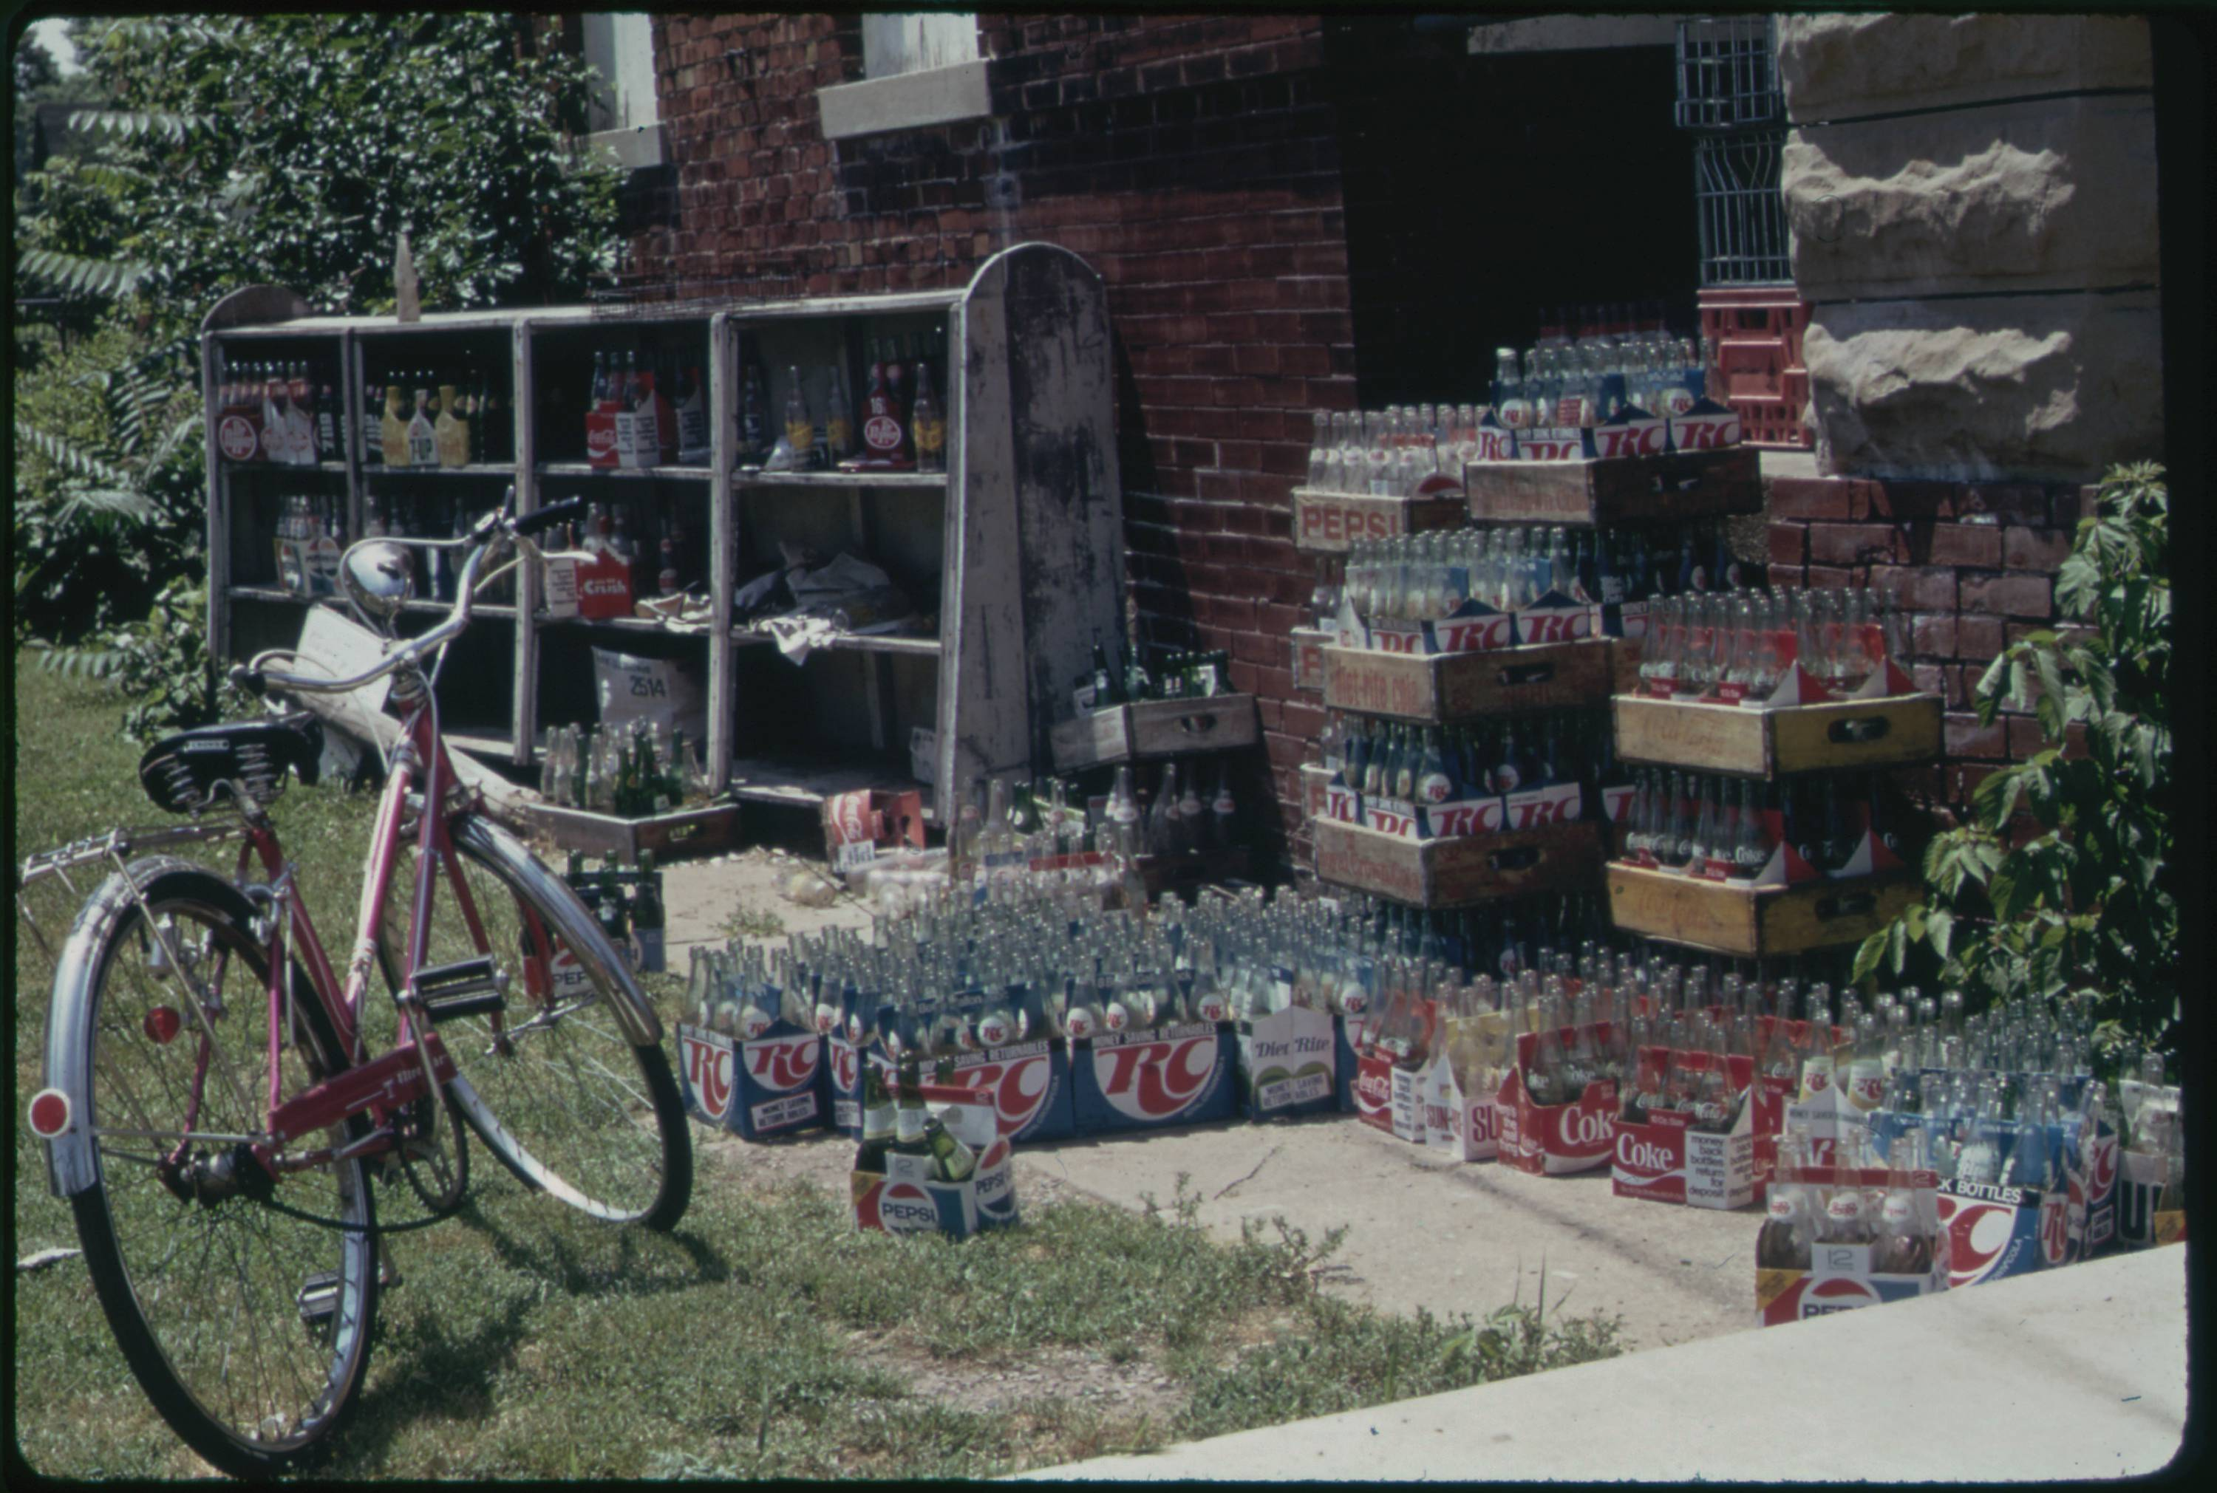
Approach 2: Supervised ML with Computer Vision
Using our example image, here are the six images in which our computer vision algorithm also detected bottles with a high probability.
Notice that this has found six interesting uses of bottles in different formats: a recycle plant, trash piles, medicine containers, and as another part of the supply chain being delivered to a store.
04 – Distant Viewing | Classic Approaches

Slide 30
Approach 2: Supervised ML with Computer Vision
Advantages
Can be applied to collections with no or limited archival metadata, regardless of size.
Allows integration new kinds of annotation that can cut across extant archival categories.
Difficulties
Most models out-of-the-box are trained on photographs and do not work well on other inputs.
Need to explain and contextualize the created labels, which may contain errors or produce problematic connections.
Existing tags do not usually align with the interesting connections within an archive.
Creating new models can be difficult and time intensive.
For end-users, the outputs are as (if not more) restrictive that metadata categories.
04 – Distant Viewing | Classic Approaches

Slide 31


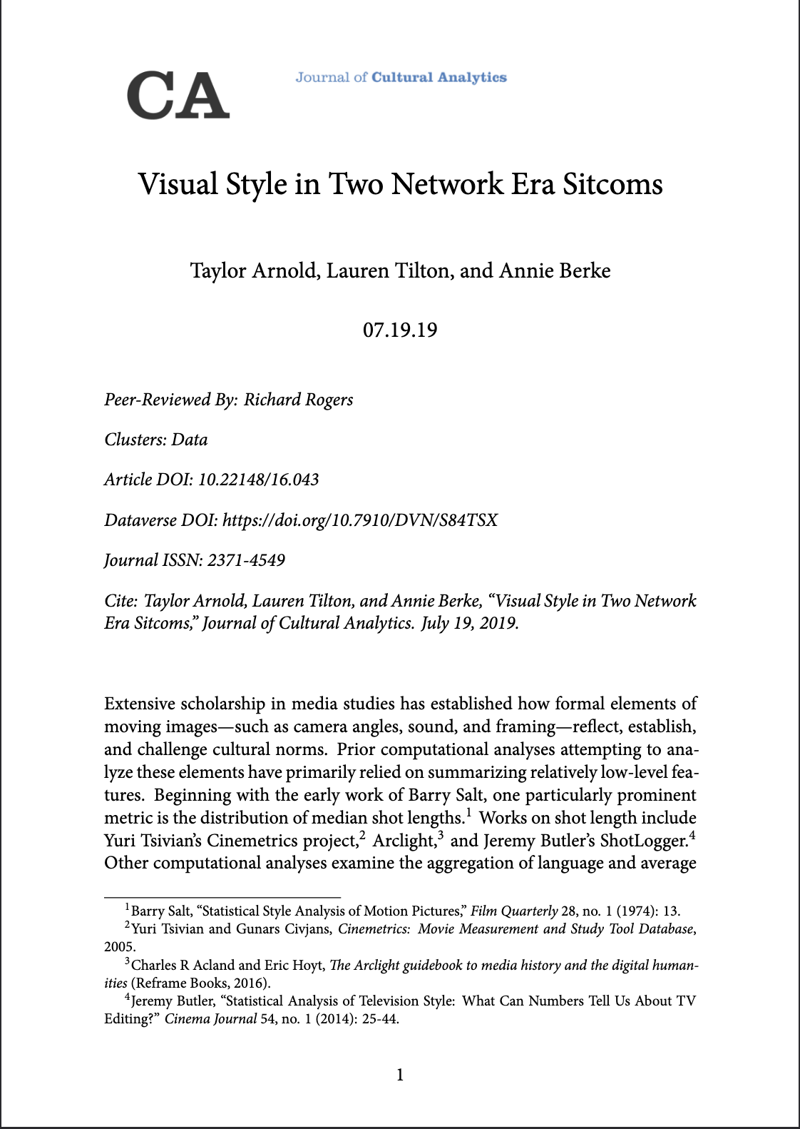
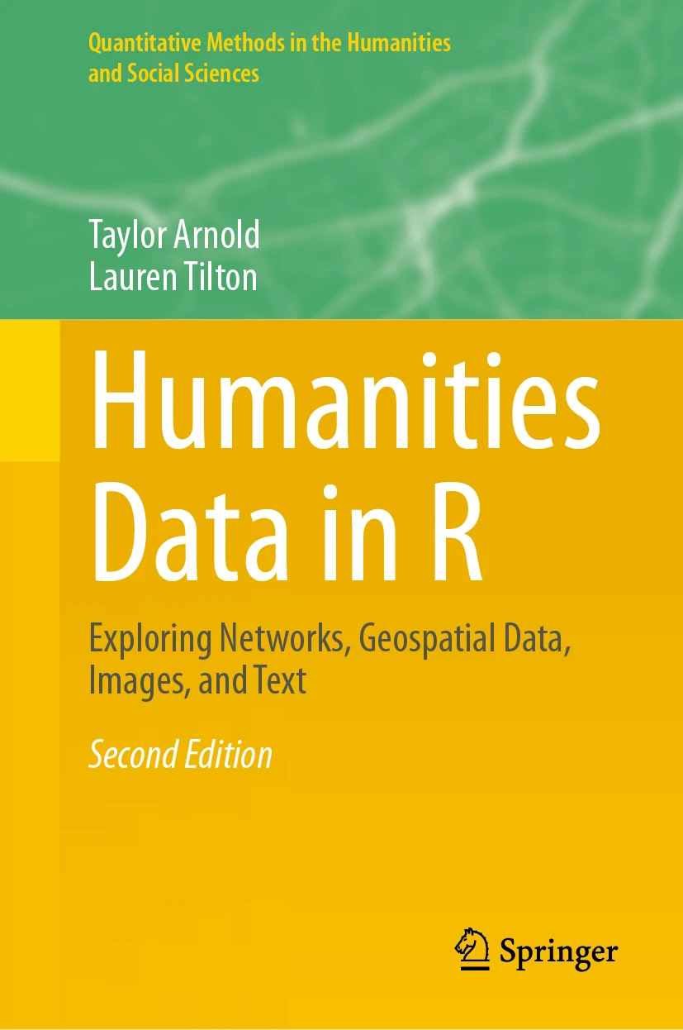
Approach 2: Supervised ML with Computer Vision
We have not integrated explicit tags using supervised machine learning algorithms into our public digital interfaces such as Photogrammar.
Our experience is that many algorithms, such as face detection and image segmentation, are too coarse to be of much use in a digital interface (every category would return thousands of images). In contrast, even object detection models with many categories still contain only a small subset of available object types.
However, these models are great for many other applications of distant viewing; the coarseness is a benefit when doing aggregative analyses. We make extensive use algorithms such as face detection in many research applications.
04 – Distant Viewing | Classic Approaches

Slide 32
Approach 3: Image Embedding
Image embedding algorithms associate an image with a sequence of numbers. The individual numbers have no direct meaning. Instead, the numbers have a relative connection to one another. Images that share common features will have similar sequences of numbers.
Image embeddings can be used to create recommendation systems for digital projects. These allow visitors to follow paths through an archive according to similar visual features.
We can also use embeddings to cluster the images and recommend different parts of the collection that may be of interest to different communities.
246, 170, 58, 175, 215, 117, 35, 63, 134, 218, 167, 126, 141, 236, 231, 165, 192, 177, 153, 44, 135, 196, 252, 28, 172, …..
04 – Distant Viewing | Classic Approaches

Slide 33

Approach 3: Image Embedding
Most image embedding algorithms are adapted from other computer vision models. For example, the diagram on the right shows the VGG19 model for detecting objects from 1000 different categories. This is a deep learning model that slowly changes each input image (left) into a sequence of probabilities (right).
A particularly interesting thing about deep learning models is that the interior steps tend to capture general features (e.g., texture, shape, and color) that go beyond the specific task at hand.
In particular, the numbers in the penultimate or antepenultimate step can typically be used as an image embedding.
T. Arnold and L. Tilton. (2021) "Depth in Deep Learning: Knowledgeable, Layered, and Impenetrable." In: Redrobe, K. and Scheible, J. (Eds.) Deep Mediations. University of Minnesota Press.
04 – Distant Viewing | Classic Approaches

Slide 34
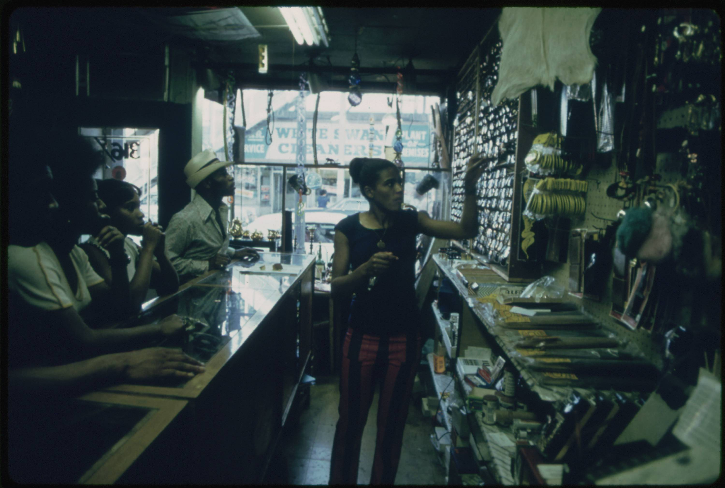
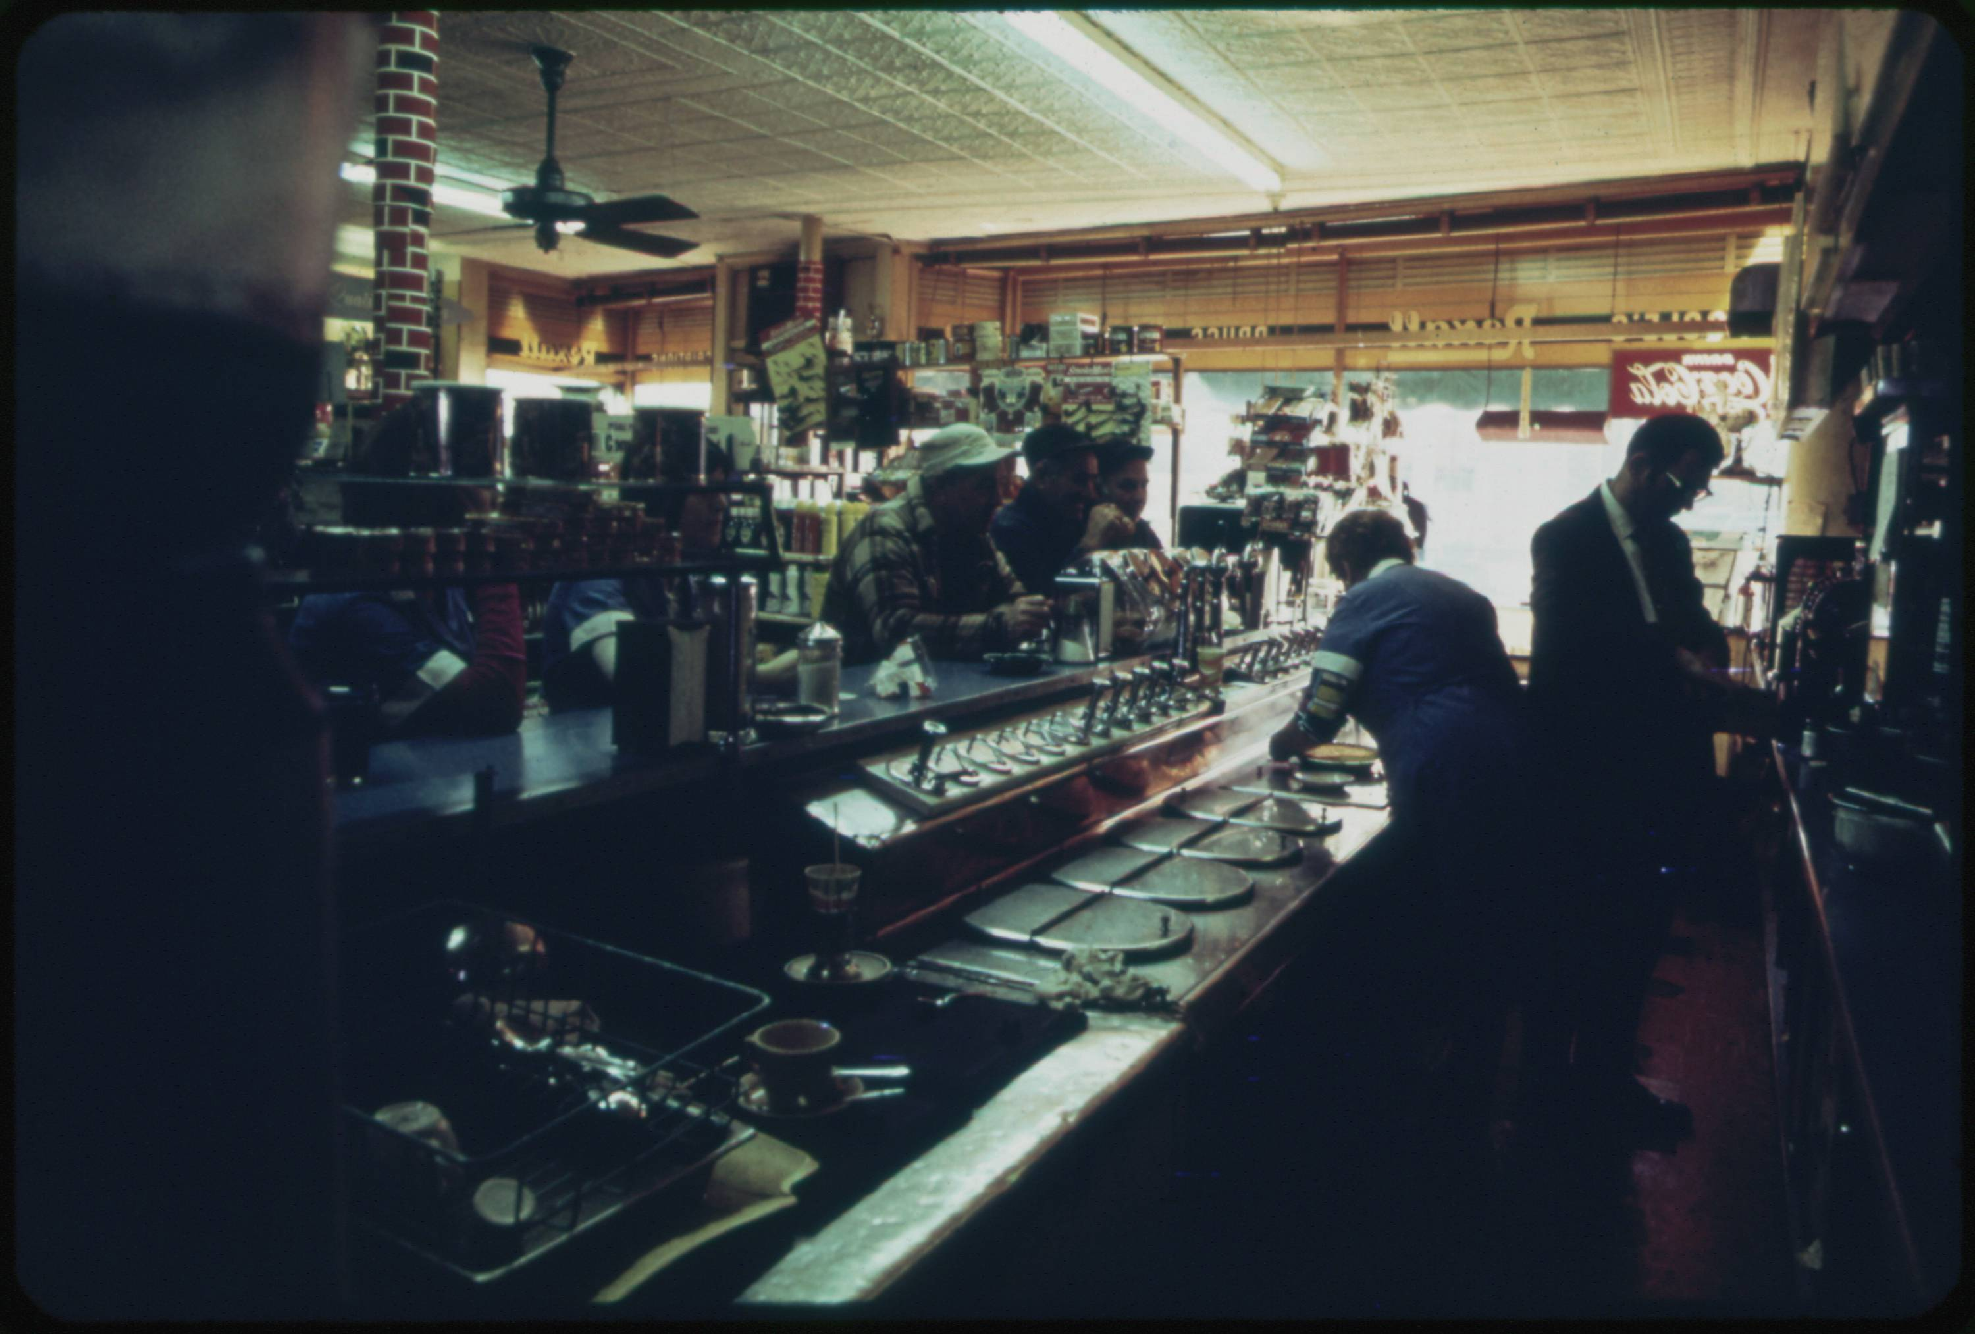
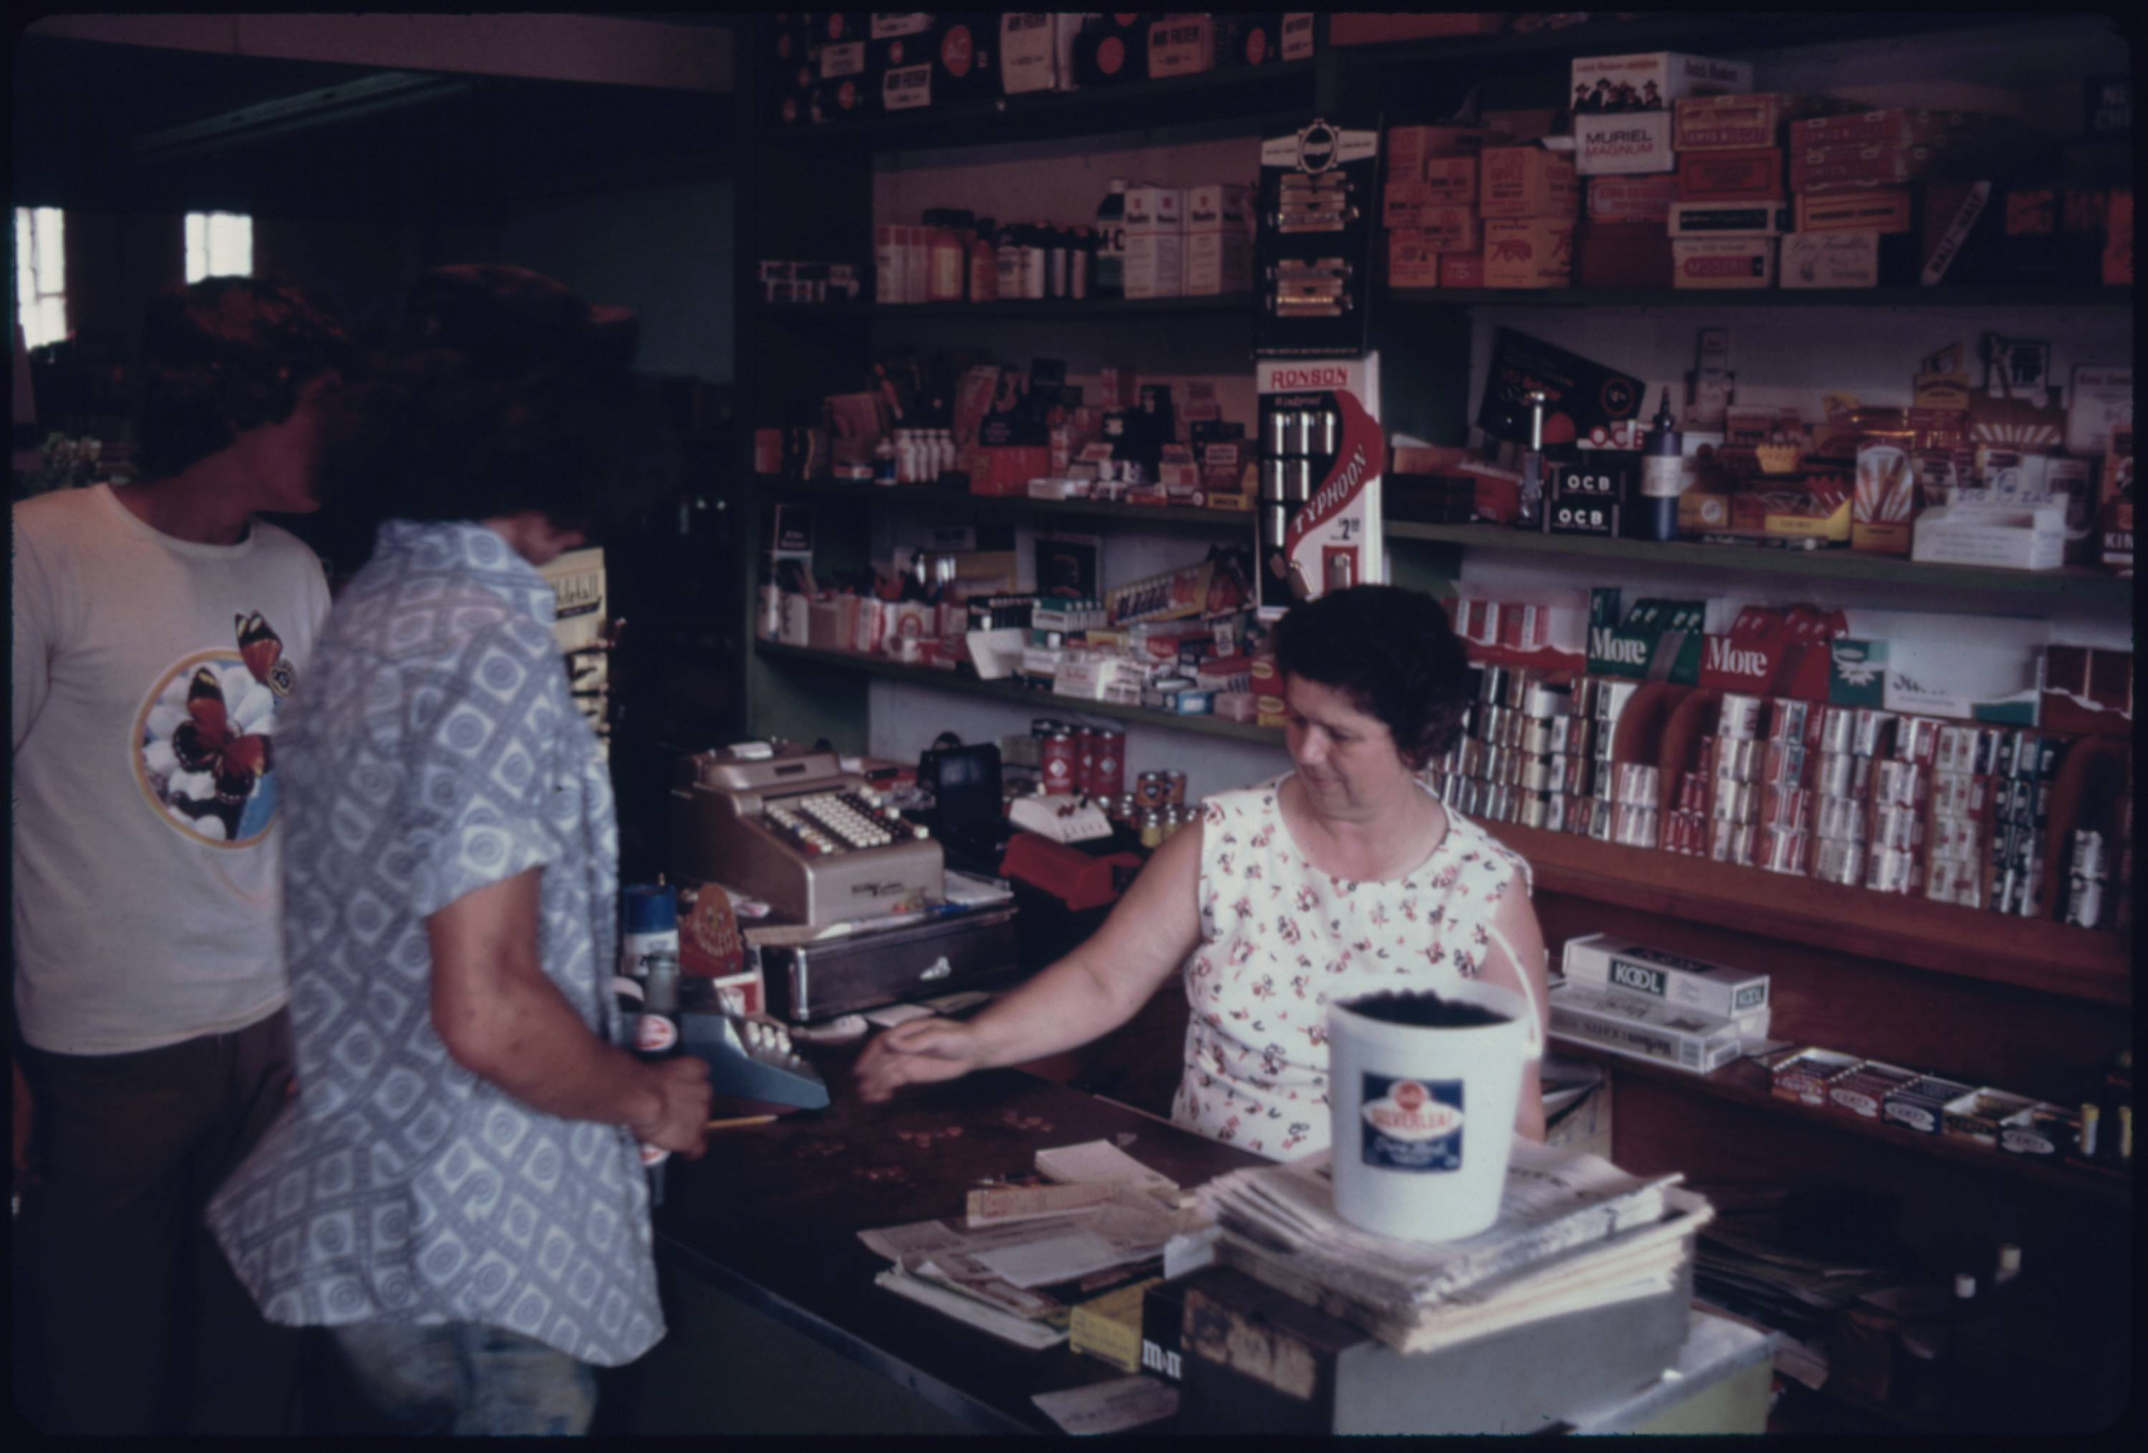
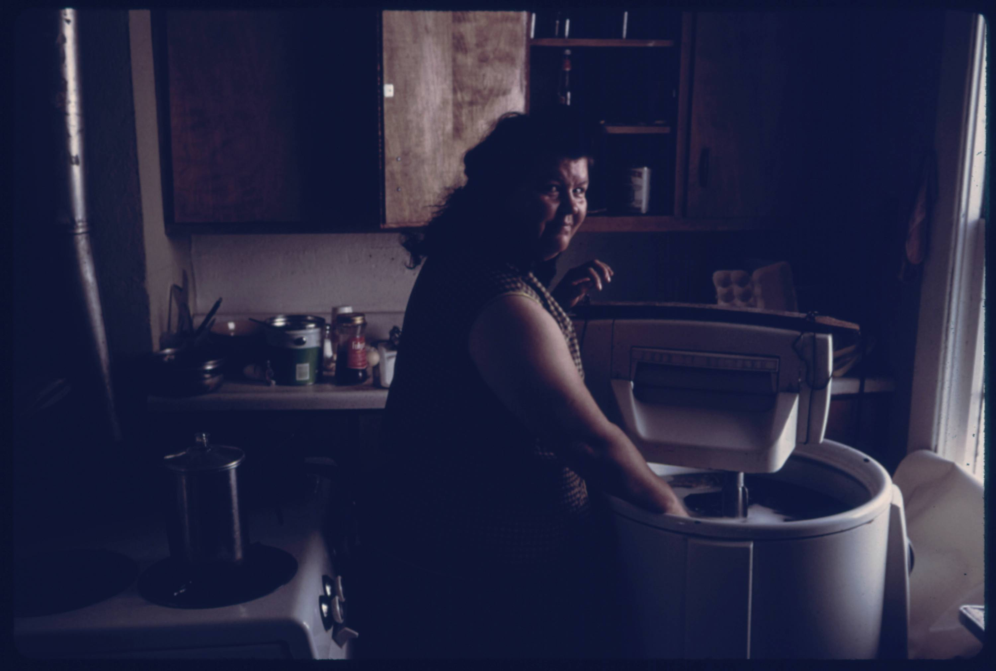
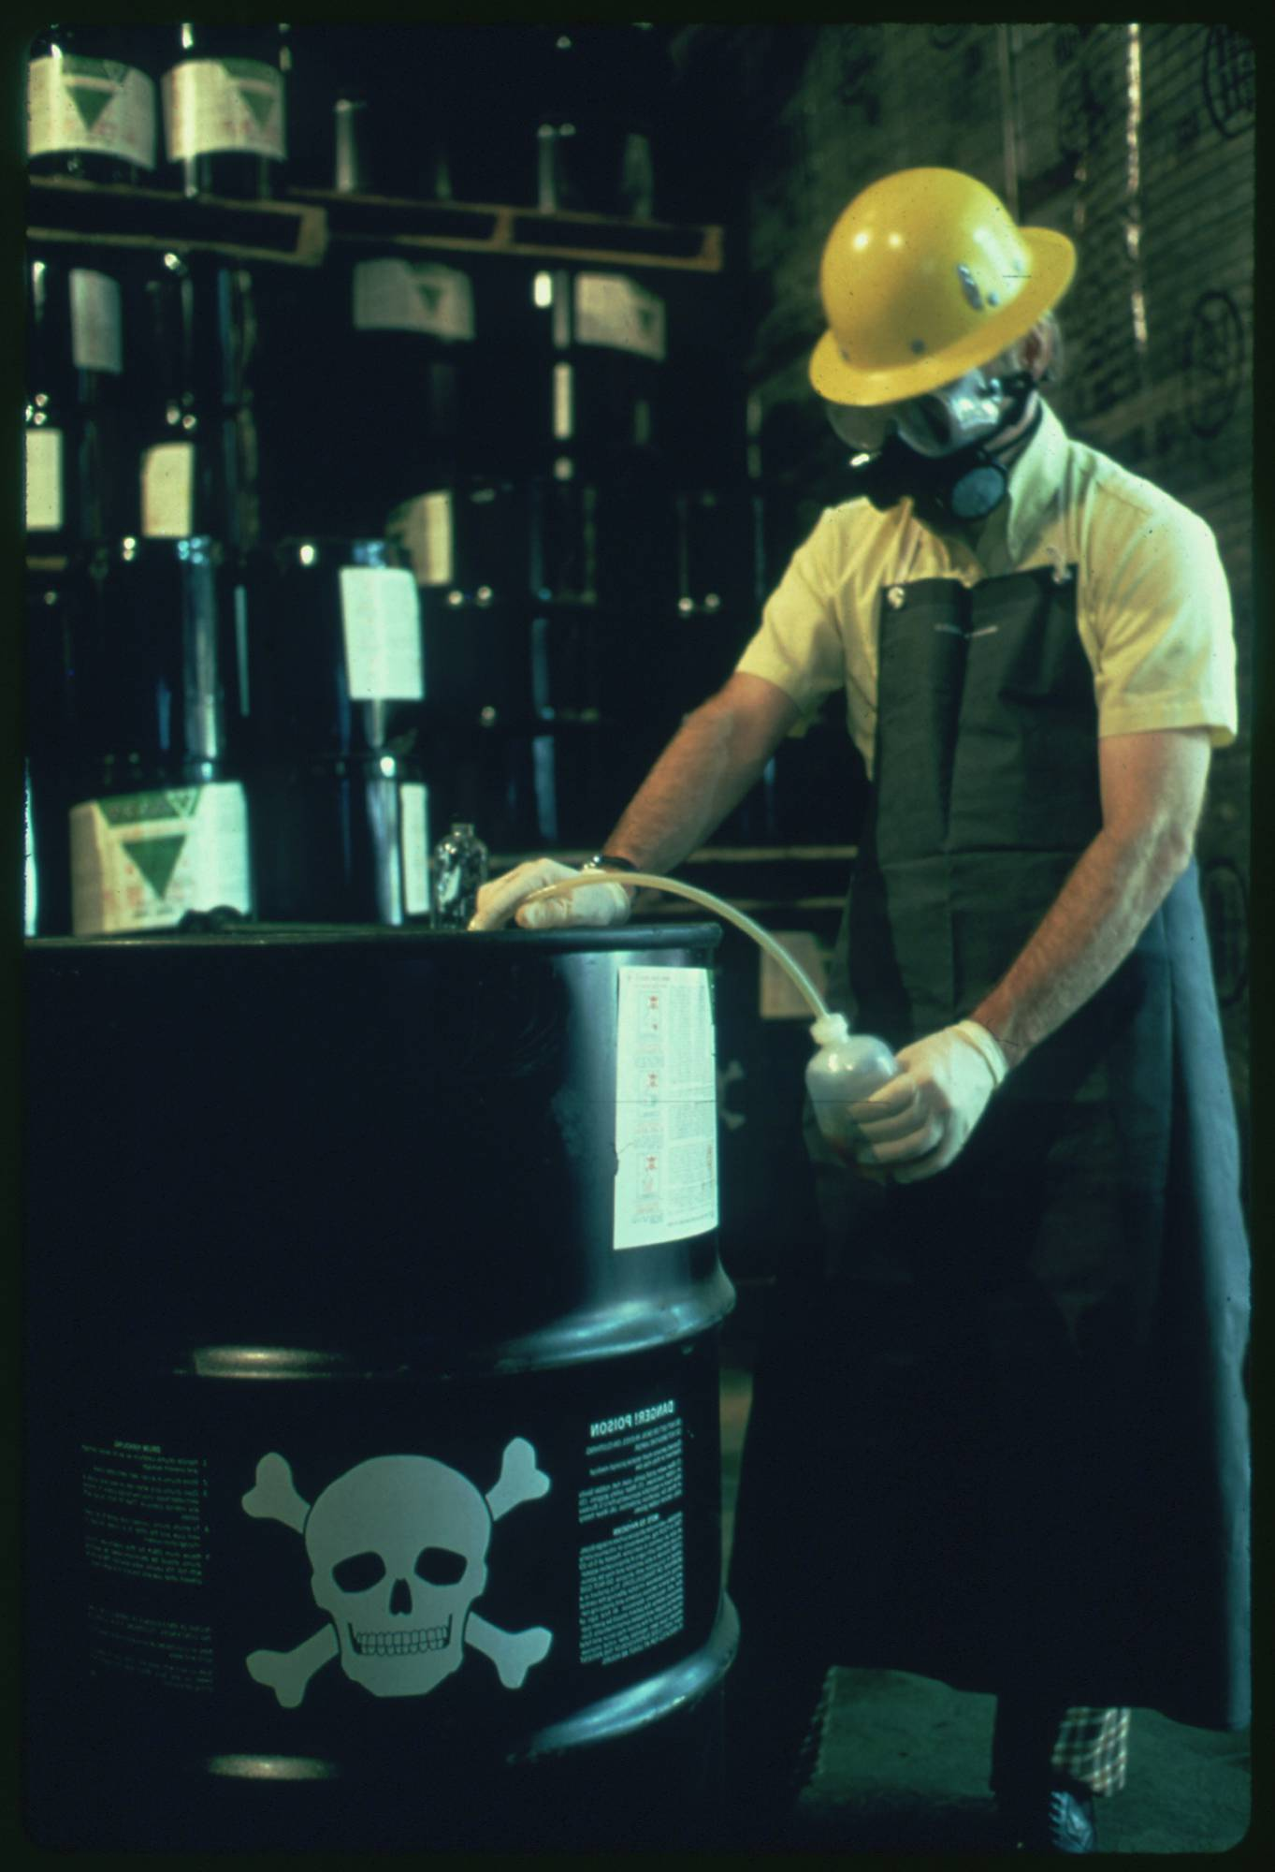
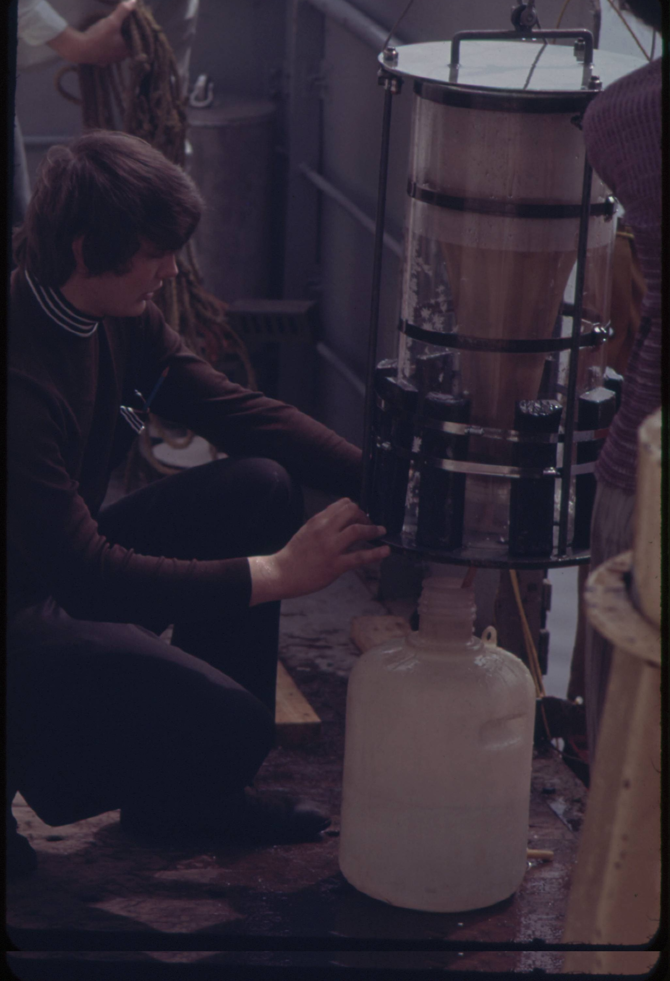
Approach 3: Image Embedding
Here are the six images that have the most similar set of embedding to our example image using the penultimate layer of the VGG19 model.
04 – Distant Viewing | Classic Approaches

Slide 35
Approach 3: Image Embedding
Advantages
Can be applied to any collection without need for existing archival metadata or a model specifically designed for a collection.
Adaptable across different collections.
Will cut across existing categories and find connections that have not been explicitly coded for.
Difficulties
No clear way to explain or control the connections and/or clusters.
Can create problematic or odd connections (for example, the link between milk production and radioactive waste).
Embeddings are usually made from object detection algorithms and have difficulty finding certain kinds of connections.
Can be influenced by the photo orientation and resolution.
04 – Distant Viewing | Classic Approaches

Slide 36
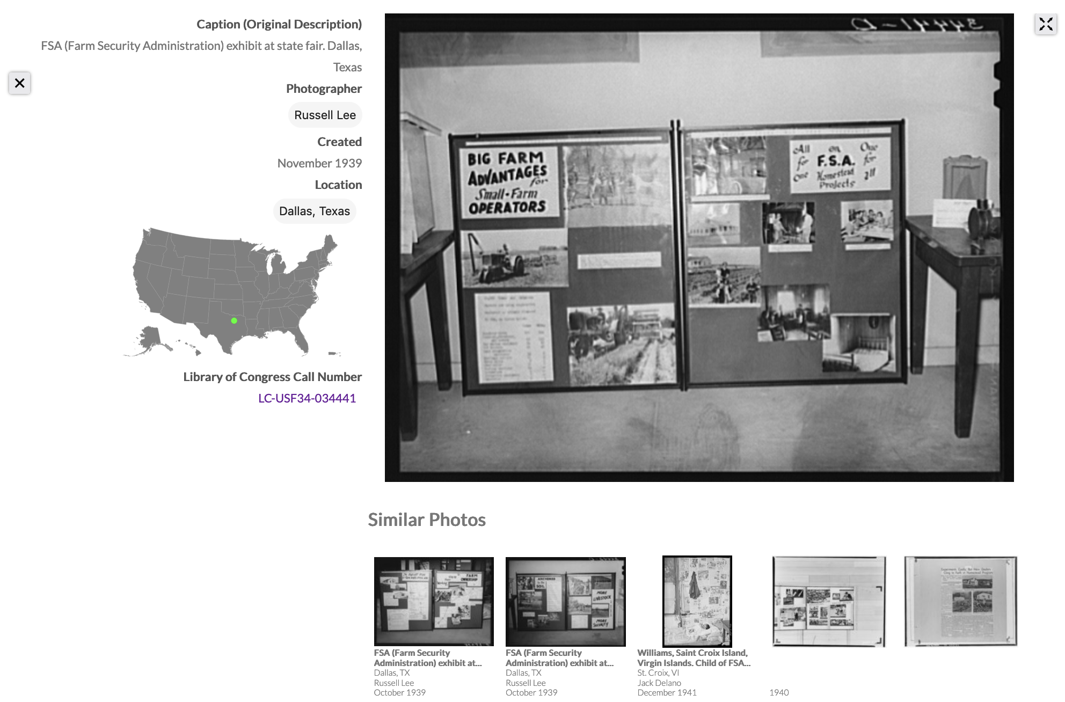
Approach 3: Image Embedding
We found image embeddings to be a great additional way of exploring the FSA-OWI photographs. The most recent major revision of Photogrammar (Version 3.0, 2021) includes visual recommendations for each of the photographs in the collection.
T. Arnold and L. Tilton. (2019) "Distant Viewing: Analyzing Large Visual Corpora." Digital Scholarship in the Humanities
04 – Distant Viewing | Classic Approaches

Slide 37
5. Multimodal Large Language Models (MLLMs)
05 – Distant Viewing | MLLMs

Slide 38




Multimodal Large Language Models (MLLMs)
Large language models (LLMs) have received a considerable amount of hype and press over the past two years. More recent model versions have included multimodal LLMs (MLLMs), which allow for combining text and image inputs and outputs.
Several MLLMs are currently available, including the most well-known efforts integrated into OpenAI’s ChatGPT, Google’s Gemini, and Anthropic’s Claude.
Several open models such as LLaVA (built on top of LLAMA-3) indicate that versions of MLLMs should be become/remain available for all users.
05 – Distant Viewing | MLLMs

Slide 39
MLLM Example (GPT-4 Turbo)
Let’s take our example image from the DOCUMERICA collection to understand some of the possibilities of these models.
We selected ChatGPT’s GPT-4 Turbo model as it was the generally considered the most powerful available at the time of our project (May 2024).
We provide the image along with a prompt suggesting the information that we would like the model to return.
Prompt: Provide a detailed plain-text description of the objects, activities, people, background and/or composition of this photograph.
05 – Distant Viewing | MLLMs

Slide 40
MLLM Example (GPT-4 Turbo)
Response: This photograph captures a scene inside an industrial or agricultural processing facility, possibly a dairy. The image focuses on a female worker engaged in operating machinery used for filling milk bottles. She is wearing glasses and a black top, and appears to be adjusting or handling the bottles or the machine. The worker is surrounded by a complex arrangement of stainless steel machinery and equipment. On the right side of the frame, there's a large metal vat or container, possibly holding milk or another liquid, with its lid partially visible. In the foreground, we see a series of white plastic milk bottles, each adorned with a red label. These bottles are lined up on a conveyor belt or a filling station, which seems to be part of a mechanized assembly line designed for packaging. The machinery includes various knobs, valves, metal structures, and hoses participating in the bottling process. The interior setting is lit with what appears to be fluorescent lighting, adding a utilitarian ambience to the workspace. The overall scene conveys a moment of daily operations wherein the worker is focused on ensuring the efficiency and correctness of the bottling process.
Prompt: Provide a detailed plain-text description of the objects, activities, people, background and/or composition of this photograph.
05 – Distant Viewing | MLLMs

Slide 41
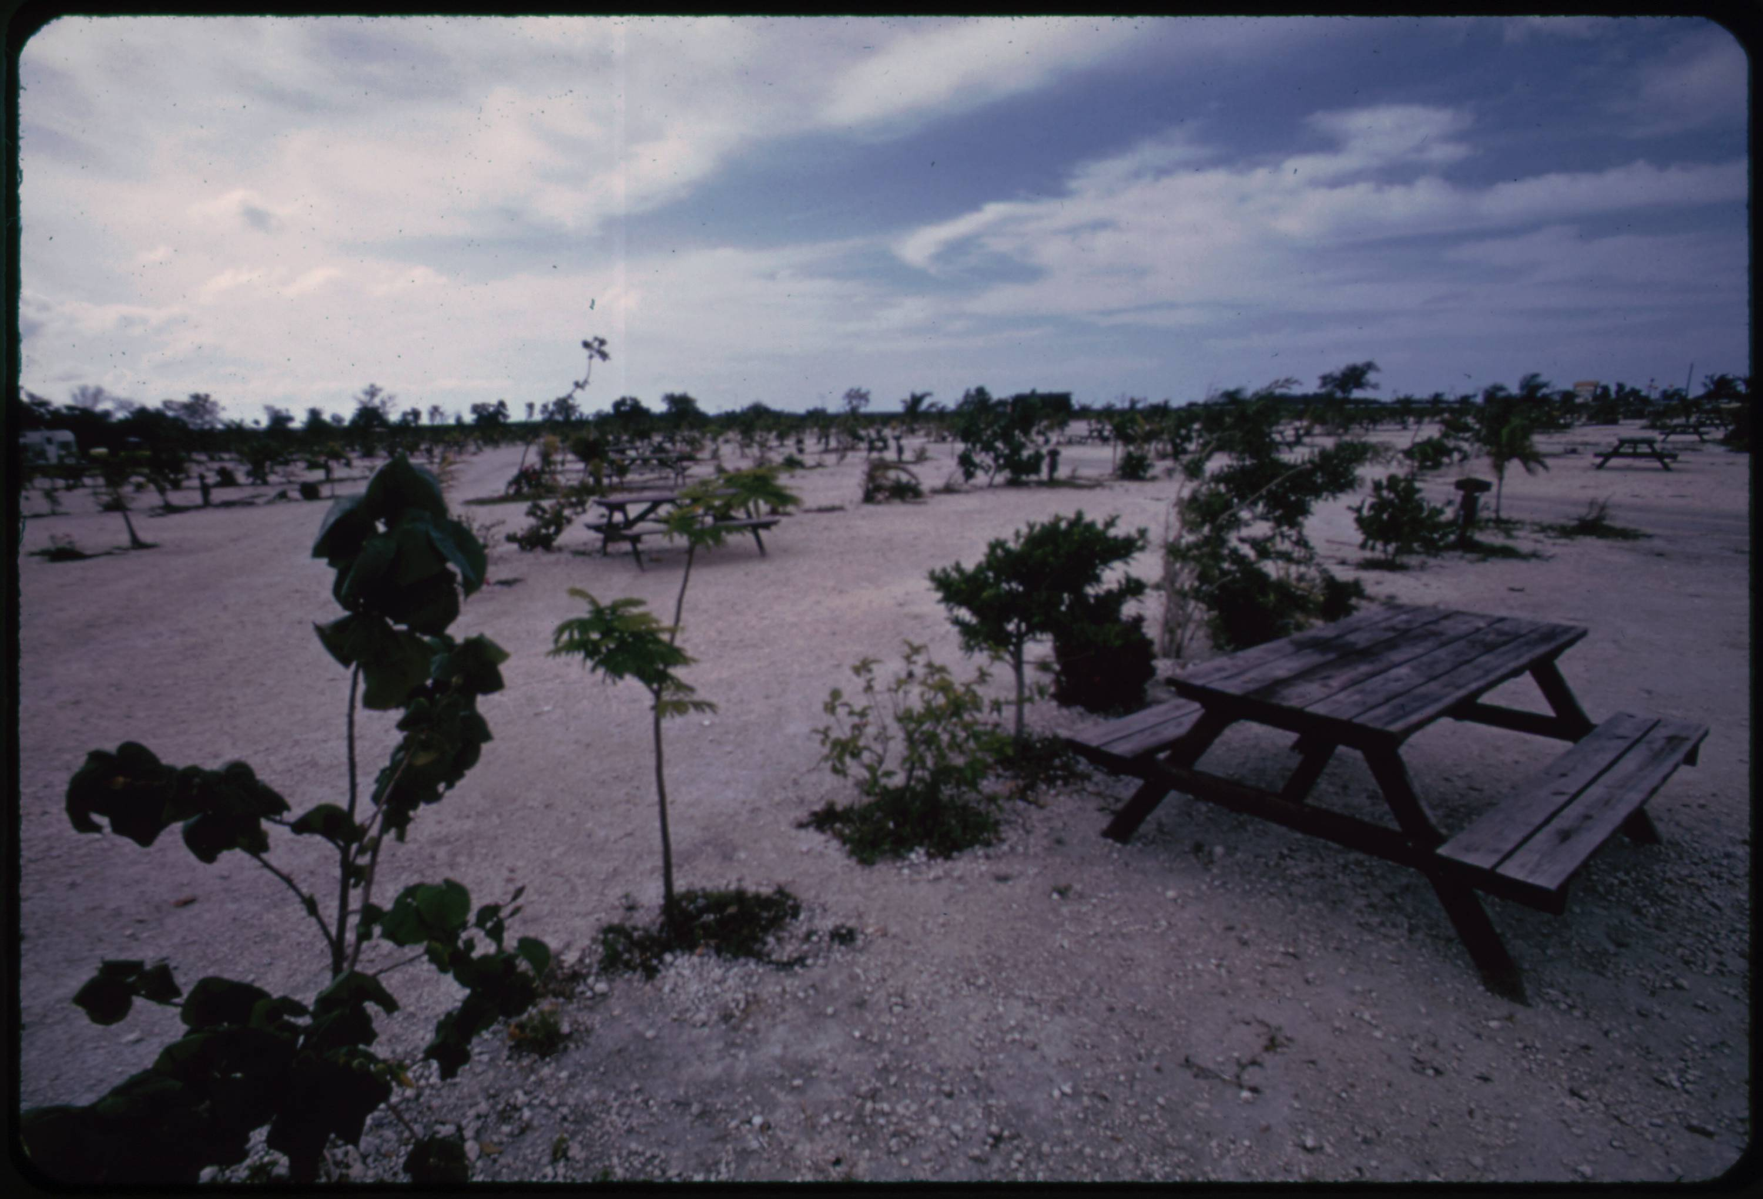
MLLM Example (GPT-4 Turbo)
Response: This photograph captures an open outdoor scene in a flat, barren park-like area with sparse vegetation. In the foreground, a wooden picnic table is situated prominently. The surface on which the table rests appears to be gravel, and it is located near a few scattered small bushes and very young trees. Beyond the picnic table, the landscape opens into a wider, desolate area that features numerous similar young trees and scattered bushes, all of which are relatively small and sparse, suggesting relatively young plantings in a possibly harsh environment. The soil looks rocky, further implying tough growing conditions. The sky above is cloudy, contributing to a somewhat gloomy or overcast ambiance. Overall, the setting appears to be a designed park area undergoing early stages of development, with the focus on newly planted vegetation in an otherwise empty, flat terrain
Prompt: Provide a detailed plain-text description of the objects, activities, people, background and/or composition of this photograph.
05 – Distant Viewing | MLLMs

Slide 42
6. A New Approach
06 – Distant Viewing | New Approach

Slide 43
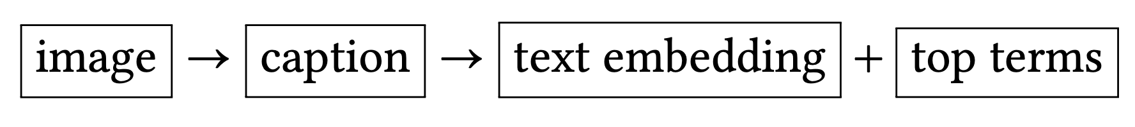
Using MLLMs For Search and Discovery
MLLMs provide a new approach to opening digital visual archives for increased search and discovery. We can create annotations by passing pairs of images and prompts together and storing the output.
The output can then by converted into text-based embeddings (created and used similarly to image embeddings) as well as top terms (using something such as TF-IDF and used like tags from archival metadata or supervised learning).
107, 230, 13, 85, 124, 65, 191, 221, 150, 6, 223, 242, 11, ….
text embedding
{ dairy, milk, glasses, machinery, worker, machinery }
image
top-terms
This photograph captures a scene inside an industrial dairy. The image focuses on a female worker engaged in operating machinery used for filling milk bottles….
caption
06 – Distant Viewing | New Approach

Slide 44
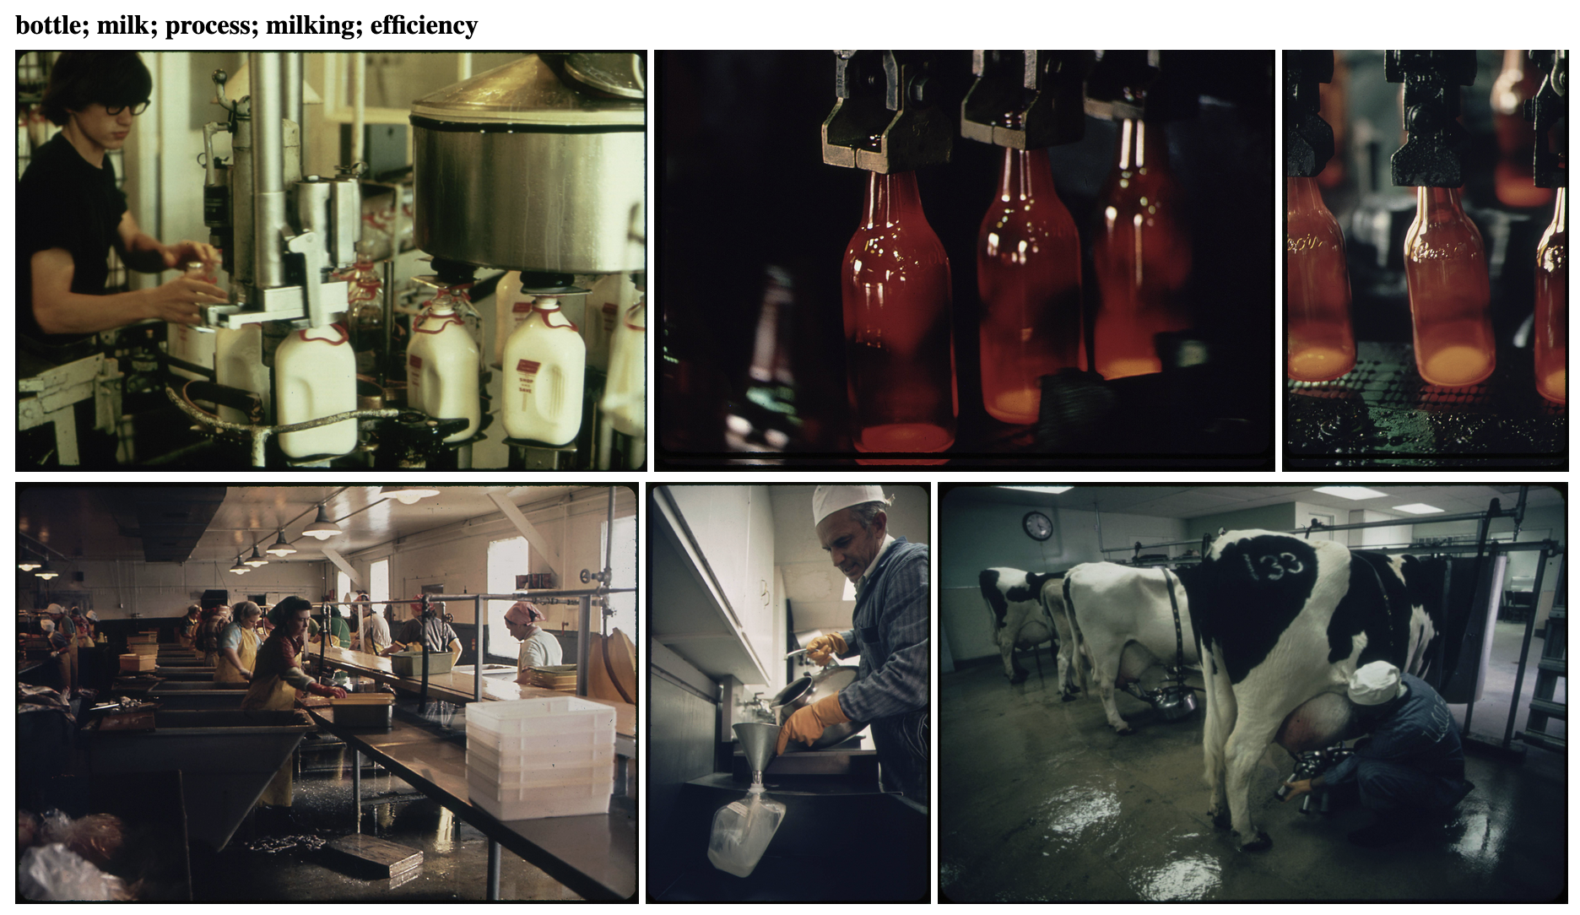
Using MLLMs For Search and Discovery
Here is our reference image along with the five images have the closest embedding based on the textual embedding of their automatically created captions.
Take note of the differences between the kinds of connections made here and those found in those using only image-based recommendations. The text recommendations find deeper semantic connections, such as the milking of cows and the bottling of milk, that would not come from the image-based approach.
06 – Distant Viewing | New Approach

Slide 45
Using MLLMs For Search and Discovery
Here is our reference image along with the five images have the closest embedding based on the textual embedding of their automatically created captions.
Take note of the differences between the kinds of connections made here and those found in those using only image-based recommendations. The text recommendations find deeper semantic connections, such as the milking of cows and the bottling of milk, that would not come from the image-based approach.
We can even use the captions to determine a label for for the recommendations.
06 – Distant Viewing | New Approach

Slide 46
Using MLLMs For Search and Discovery
Advantages
Can be used on any collection without the need for existing metadata.
The automatic captions can be used as both search and recommendation system.
Able to explain the connections between images.
Can filter/edit the text to try to avoid certain kinds of connections.
Can open the captions for inquiry or hide them to avoid exposing false-inferences.
Works on a variety of inputs, including art works and printed materials.
Continued Questions and Challenges
Questions about biases in the data (often not public).
Determining good prompts and models to use for specific applications.
Cost associated with non-public APIs or need to acquire large computing resources for public models.
06 – Distant Viewing | New Approach

Slide 47
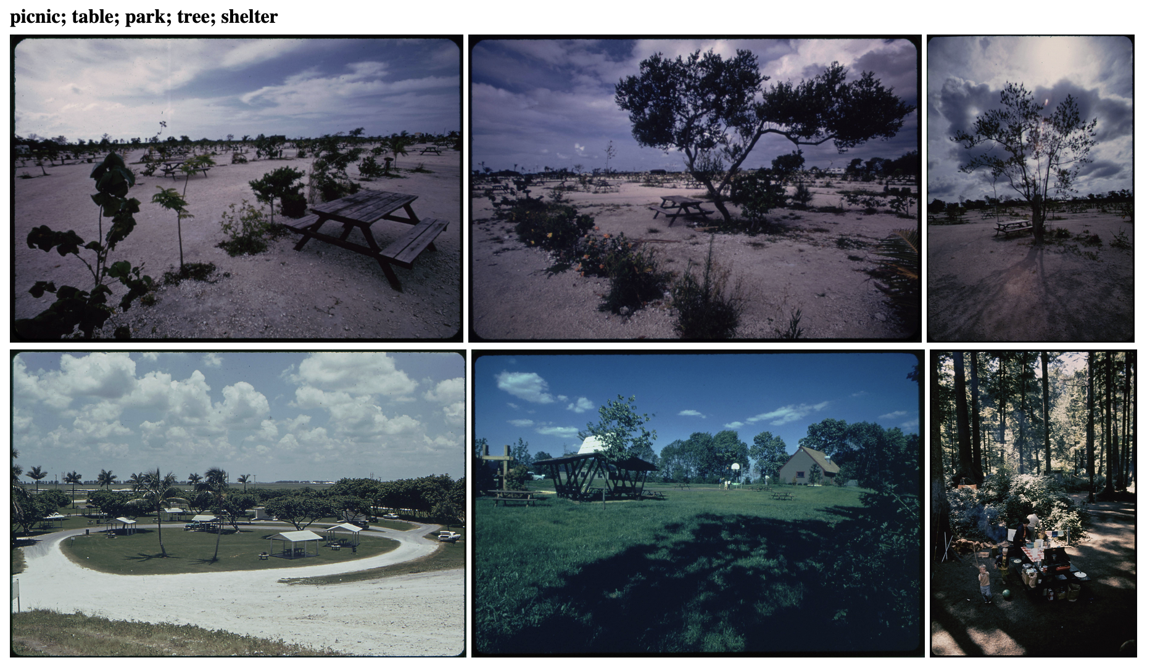
Using MLLMs For Search and Discovery
For comparison, here are the recommendations for the second example image. Notice that the first three are from the same series, with different angles of the same table.
06 – Distant Viewing | New Approach

Slide 48
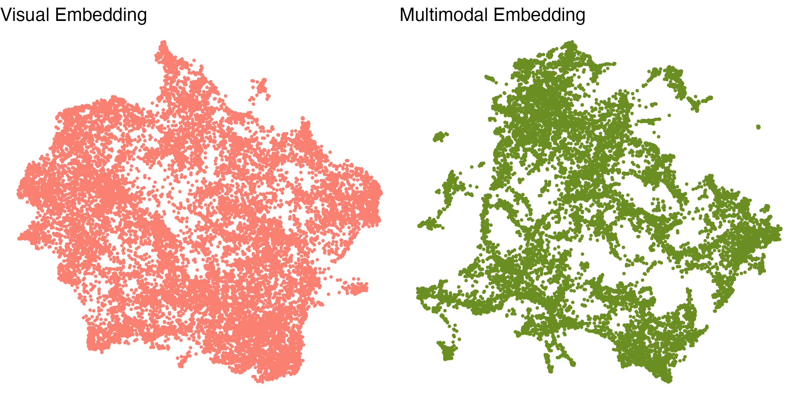
Using MLLMs For Search and Discovery
We can visualize the recommendations made by a model by using a dimensionality reduction algorithm. Here, we apply the UMAP algorithm to the images from DOCUMERICA, with images having similar embeddings being placed close to one another for each of our two models.
Notice the different structures of the two models, indicating that there are important fundamental differences between the two embedding approaches.
06 – Distant Viewing | New Approach

Slide 49
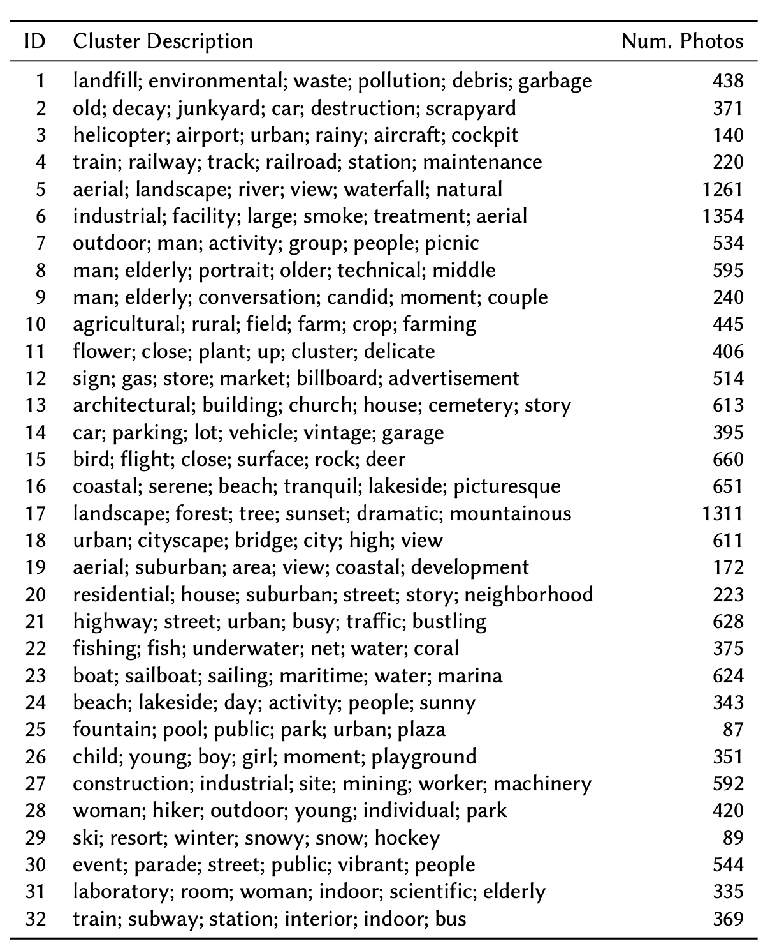
Explainable Clusters and Tags
We can perform clustering on the connections made with each of our models. However, only the MLLM model provides top-terms that we can then use then use to label each of the clusters.
On the right, we have 32 clusters along with the top identifying terms for the multimodal embedding of the DOCUMERICA collections.
These clusters could be exposed as an interface in a digital public project to immediately show visitors the breadth of topics available within the visual archive.
06 – Distant Viewing | New Approach

Slide 50
7. Quantitative Evaluation
07 – Distant Viewing | Quantitative Evaluation

Slide 51
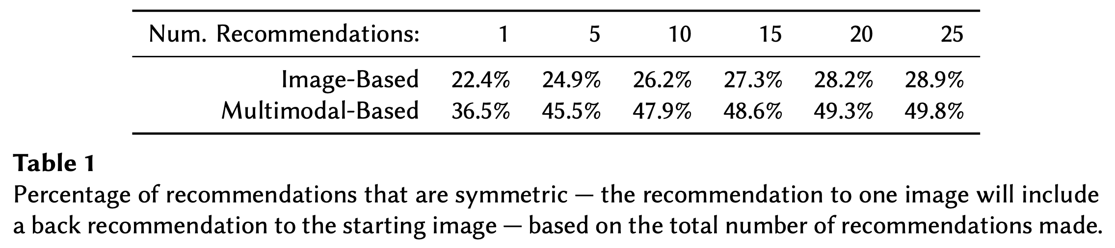
Symmetric Recommendations
In addition to the potential that we see from looking at a few example, it’s useful to also do some quantitative analysis of the results to compare the image-based and multimodal-based embeddings.
Here, we see the proportions of recommendations that are symmetric, seeing that the multimodal-based recommendations more consistently match in two dimensions. For 15-25 recommendations, the probability of having a symmetric link is about double that of the image-based method.
07 – Distant Viewing | Quantitative Evaluation

Slide 52
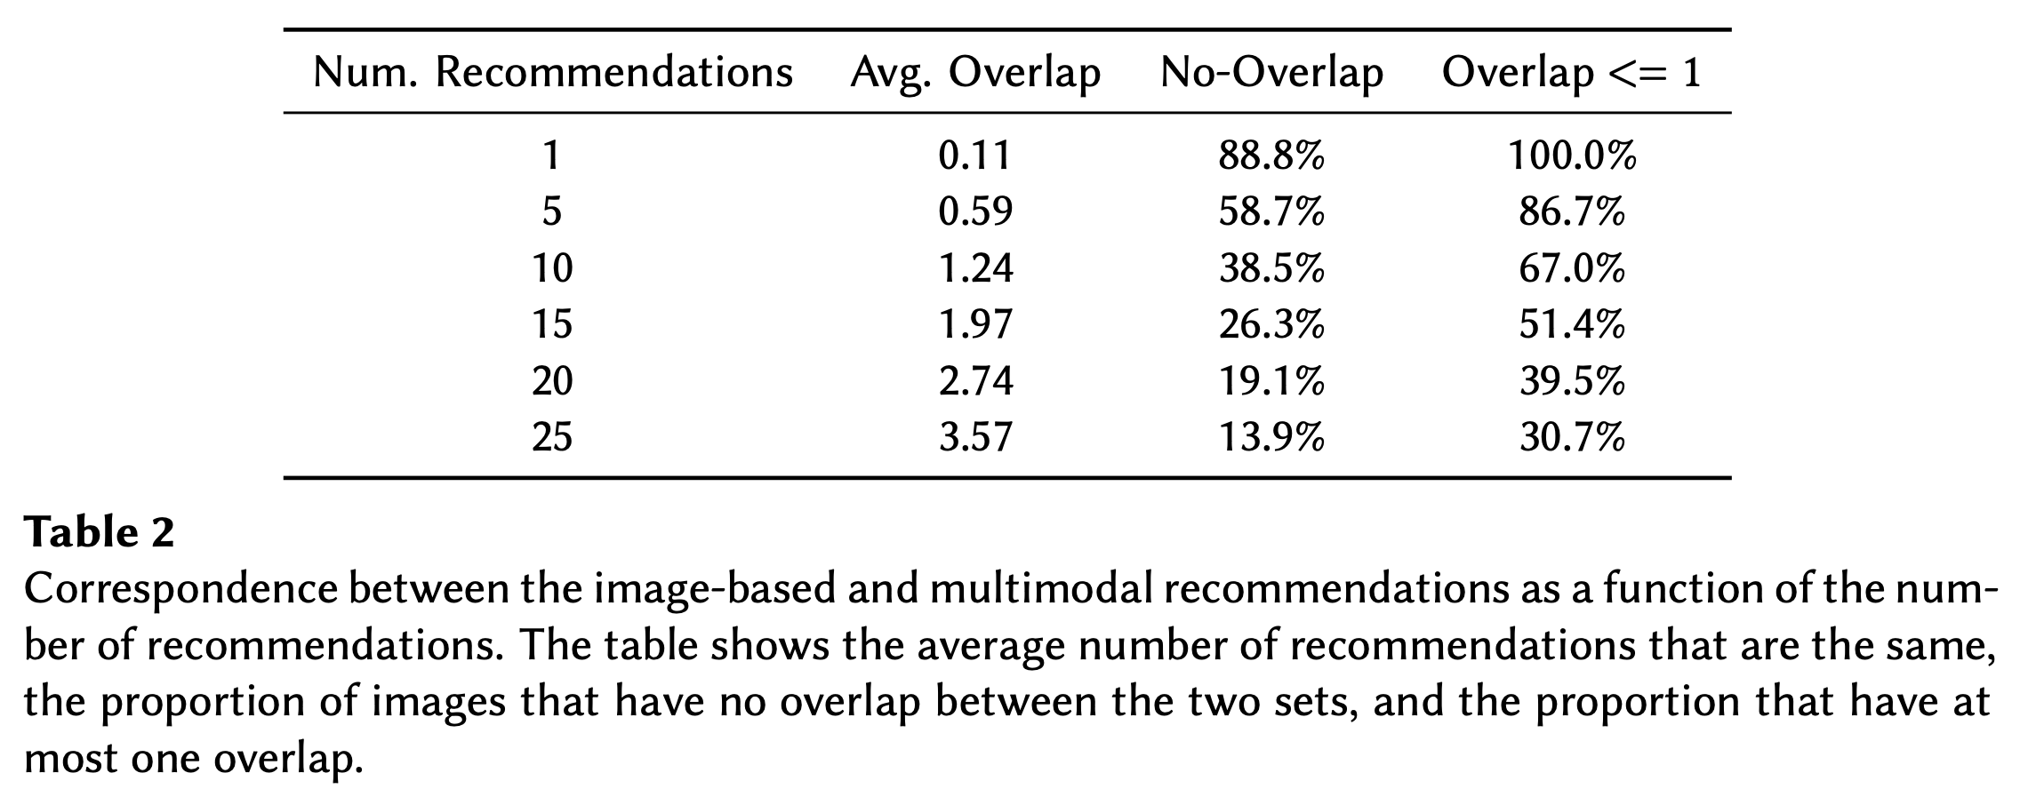
Comparing Image- and Multimodal-Embeddings
We can also see the overlap between the visual and multimodal recommendations. We would hope, and in fact see, that there is some overlap (good, because we know the visual recommendations do find interesting links) but that the multimodal approach mostly offers different links than those based on only images (indicating that this is an importantly different technique from previous methods).
07 – Distant Viewing | Quantitative Evaluation

Slide 53
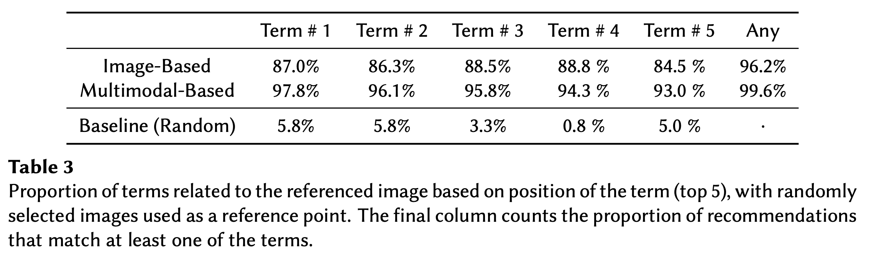
Explainable Recommendations
Finally, let’s see how much the tags associated with each of the sets of recommendations relates to the images. Here, we took a set of 100 recommendations and manually determined which links were valid.
We see that the the generated tags are useful for describing both image-based* and multimodal-based recommendations.
* The image-based tags use recommendations from the image embeddings but keywords from the multimodal model. These are not available with a visual-only approach.
07 – Distant Viewing | Quantitative Evaluation

Slide 54
8. Materiality + Color
08 – Distant Viewing | Revisting Materiality

Slide 55
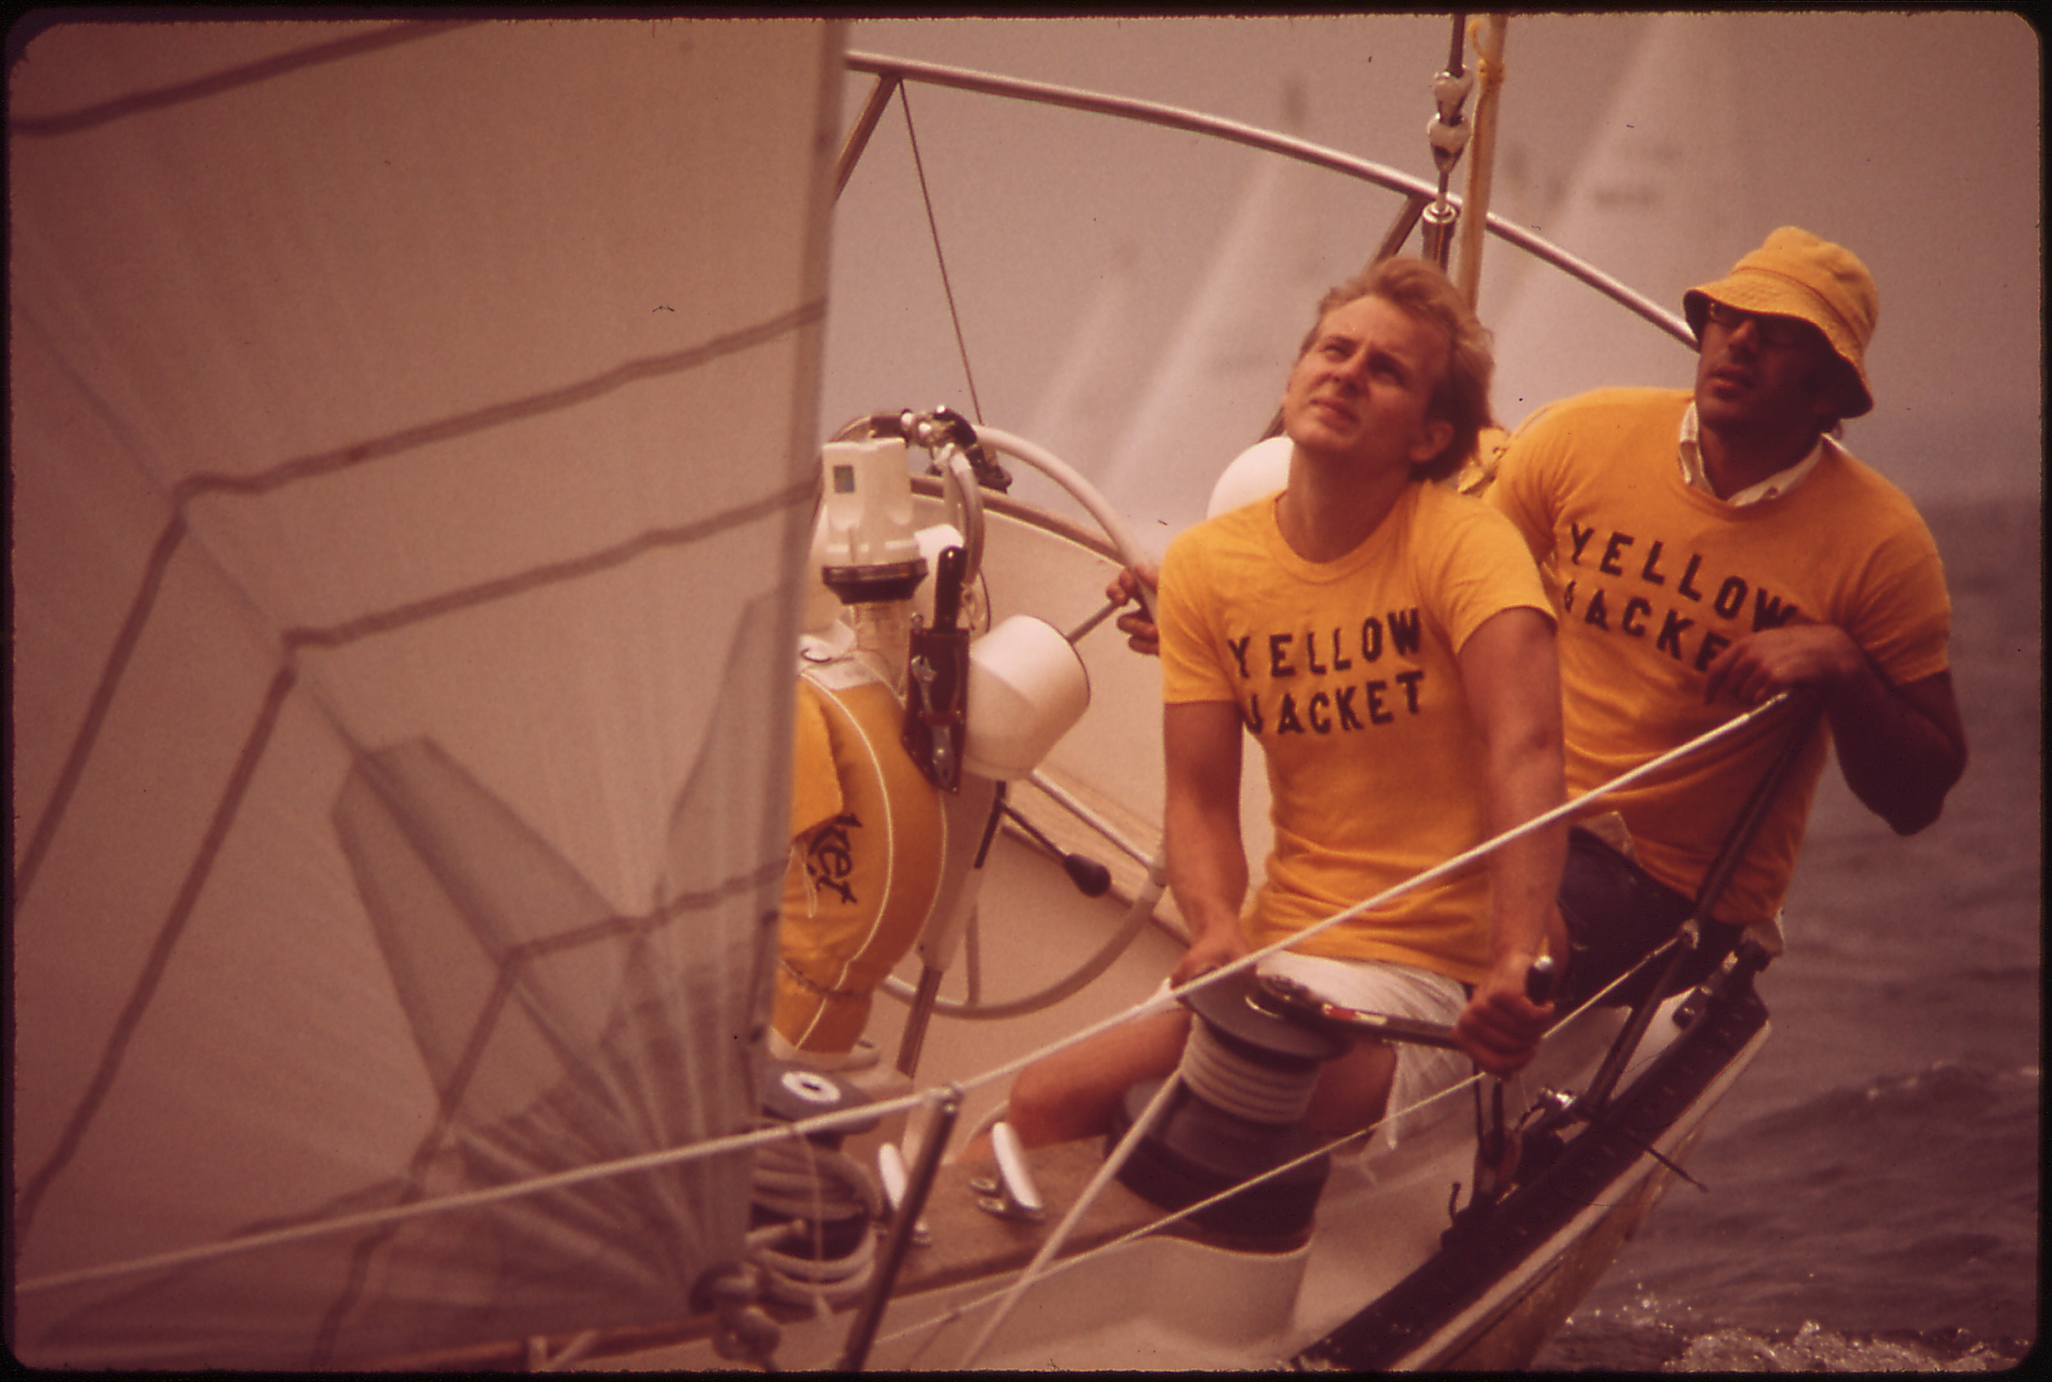
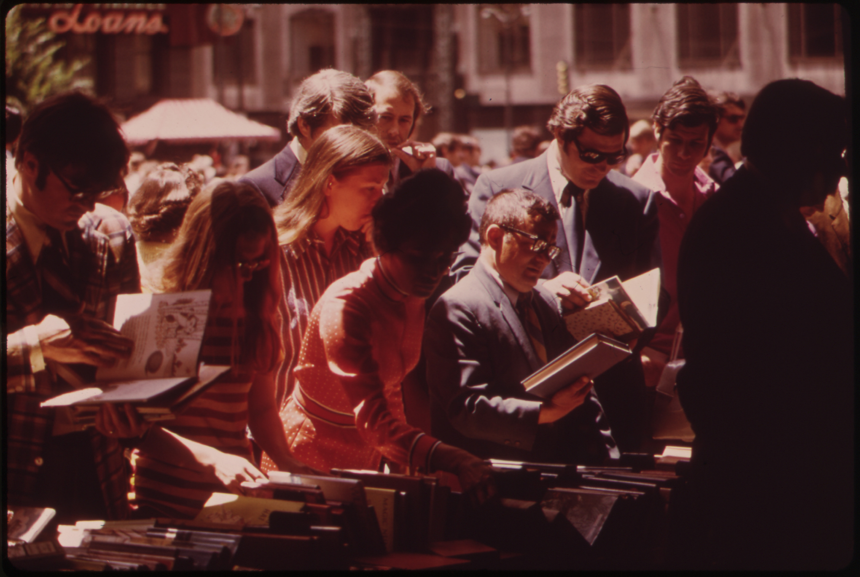
Revisiting the DOCUMERICA Archive
The workflow of an analysis between close and distant, material and digital is not always predictable.
We are working on a new project focused on the 16k images taken the US Environmental Protection Agency in the 1970s under the name DOCUMERICA. The slides that were digitized by the National Archives were heavily damaged, causing a consistent red-shift to each of the images.
08 – Distant Viewing | Materiality + Color

Slide 56
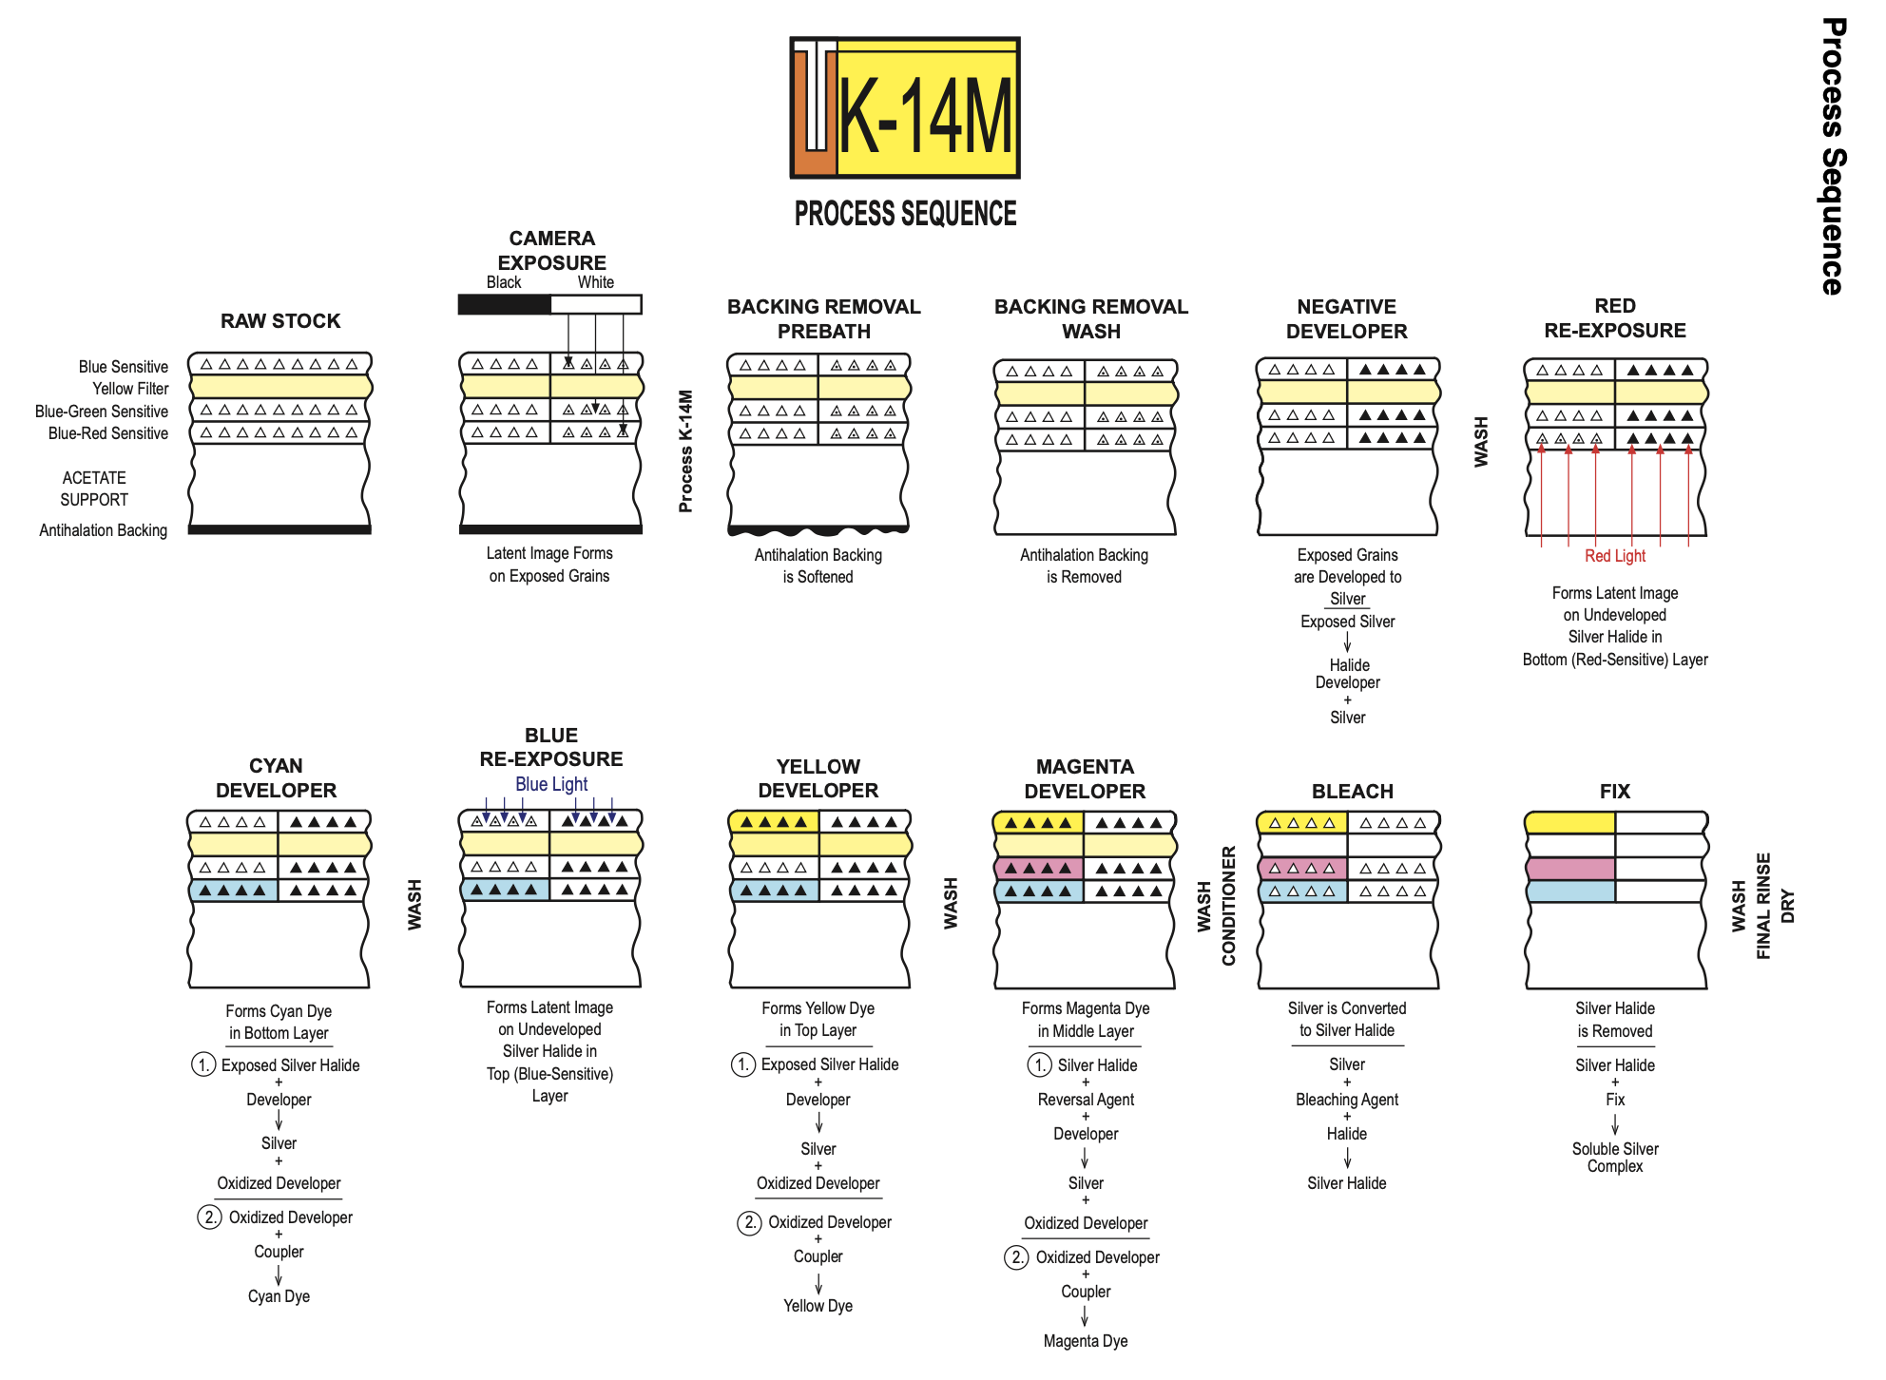
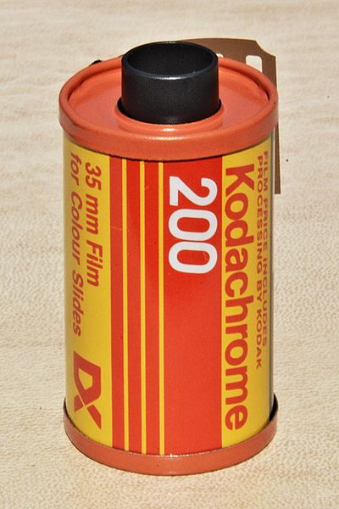
Revisiting the DOCUMERICA Archive
What if we consider the materiality of the slides themselves through the underlying chemistry of the Kodachrome and Ektachrome photographic slides? Is there any way to address this aesthetic issue?
"Kodachrome 200 - Film for colour slides", Wikimedia Commons, CC-BY 3.0.
Image supplyed by the Eastman Kodak Company in a the technical guide to processing Kodachrome flim using the K-14M photographic process (2003).
08 – Distant Viewing | Materiality + Color

Slide 57
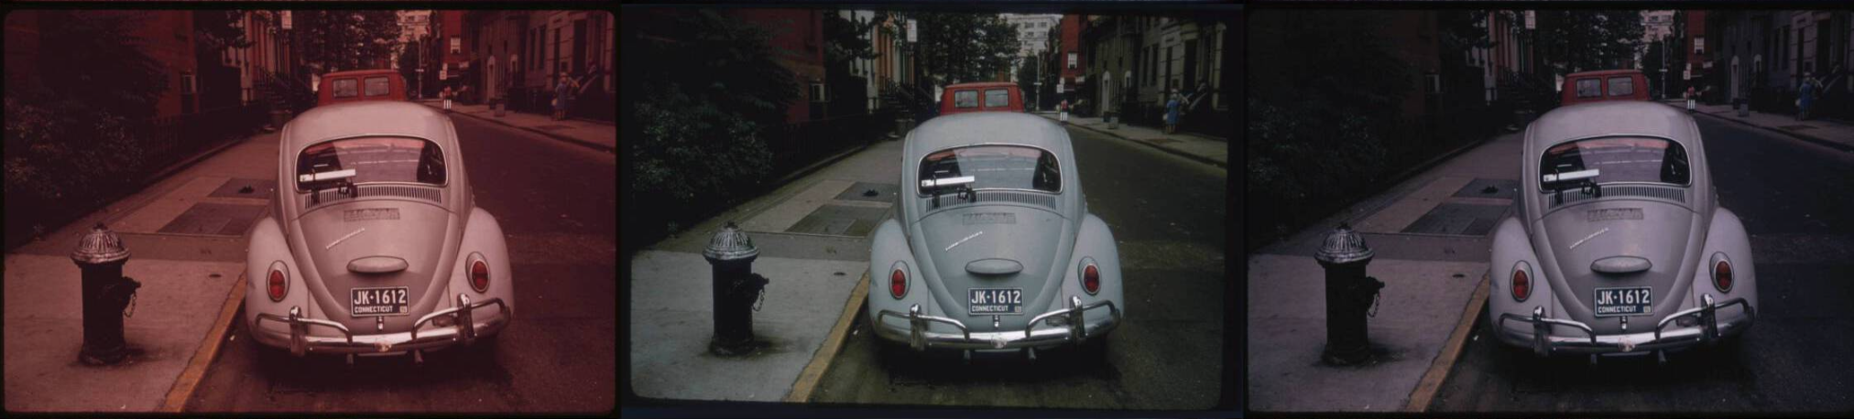
Revisiting the DOCUMERICA Archive
To address this, we manually scanned 22 undamaged slides. We used the scanned images to develop a modified color-matching histogram technique based on the chemistry of the slides that can be algorithmically applied to the entire corpus of digital scans.
Left to right: (1) digital scan on NARA website, (2) manually re-scanned slide, and (3) automatically corrected version.
T. Arnold and L. Tilton, (2024) “Automated Image Color Mapping for a Historic Photographic Collection”, CHR Proceedings.
Learning CMY histrogram transformations from a training set of 22 manually re-scanned slides.
08 – Distant Viewing | Materiality + Color

Slide 58
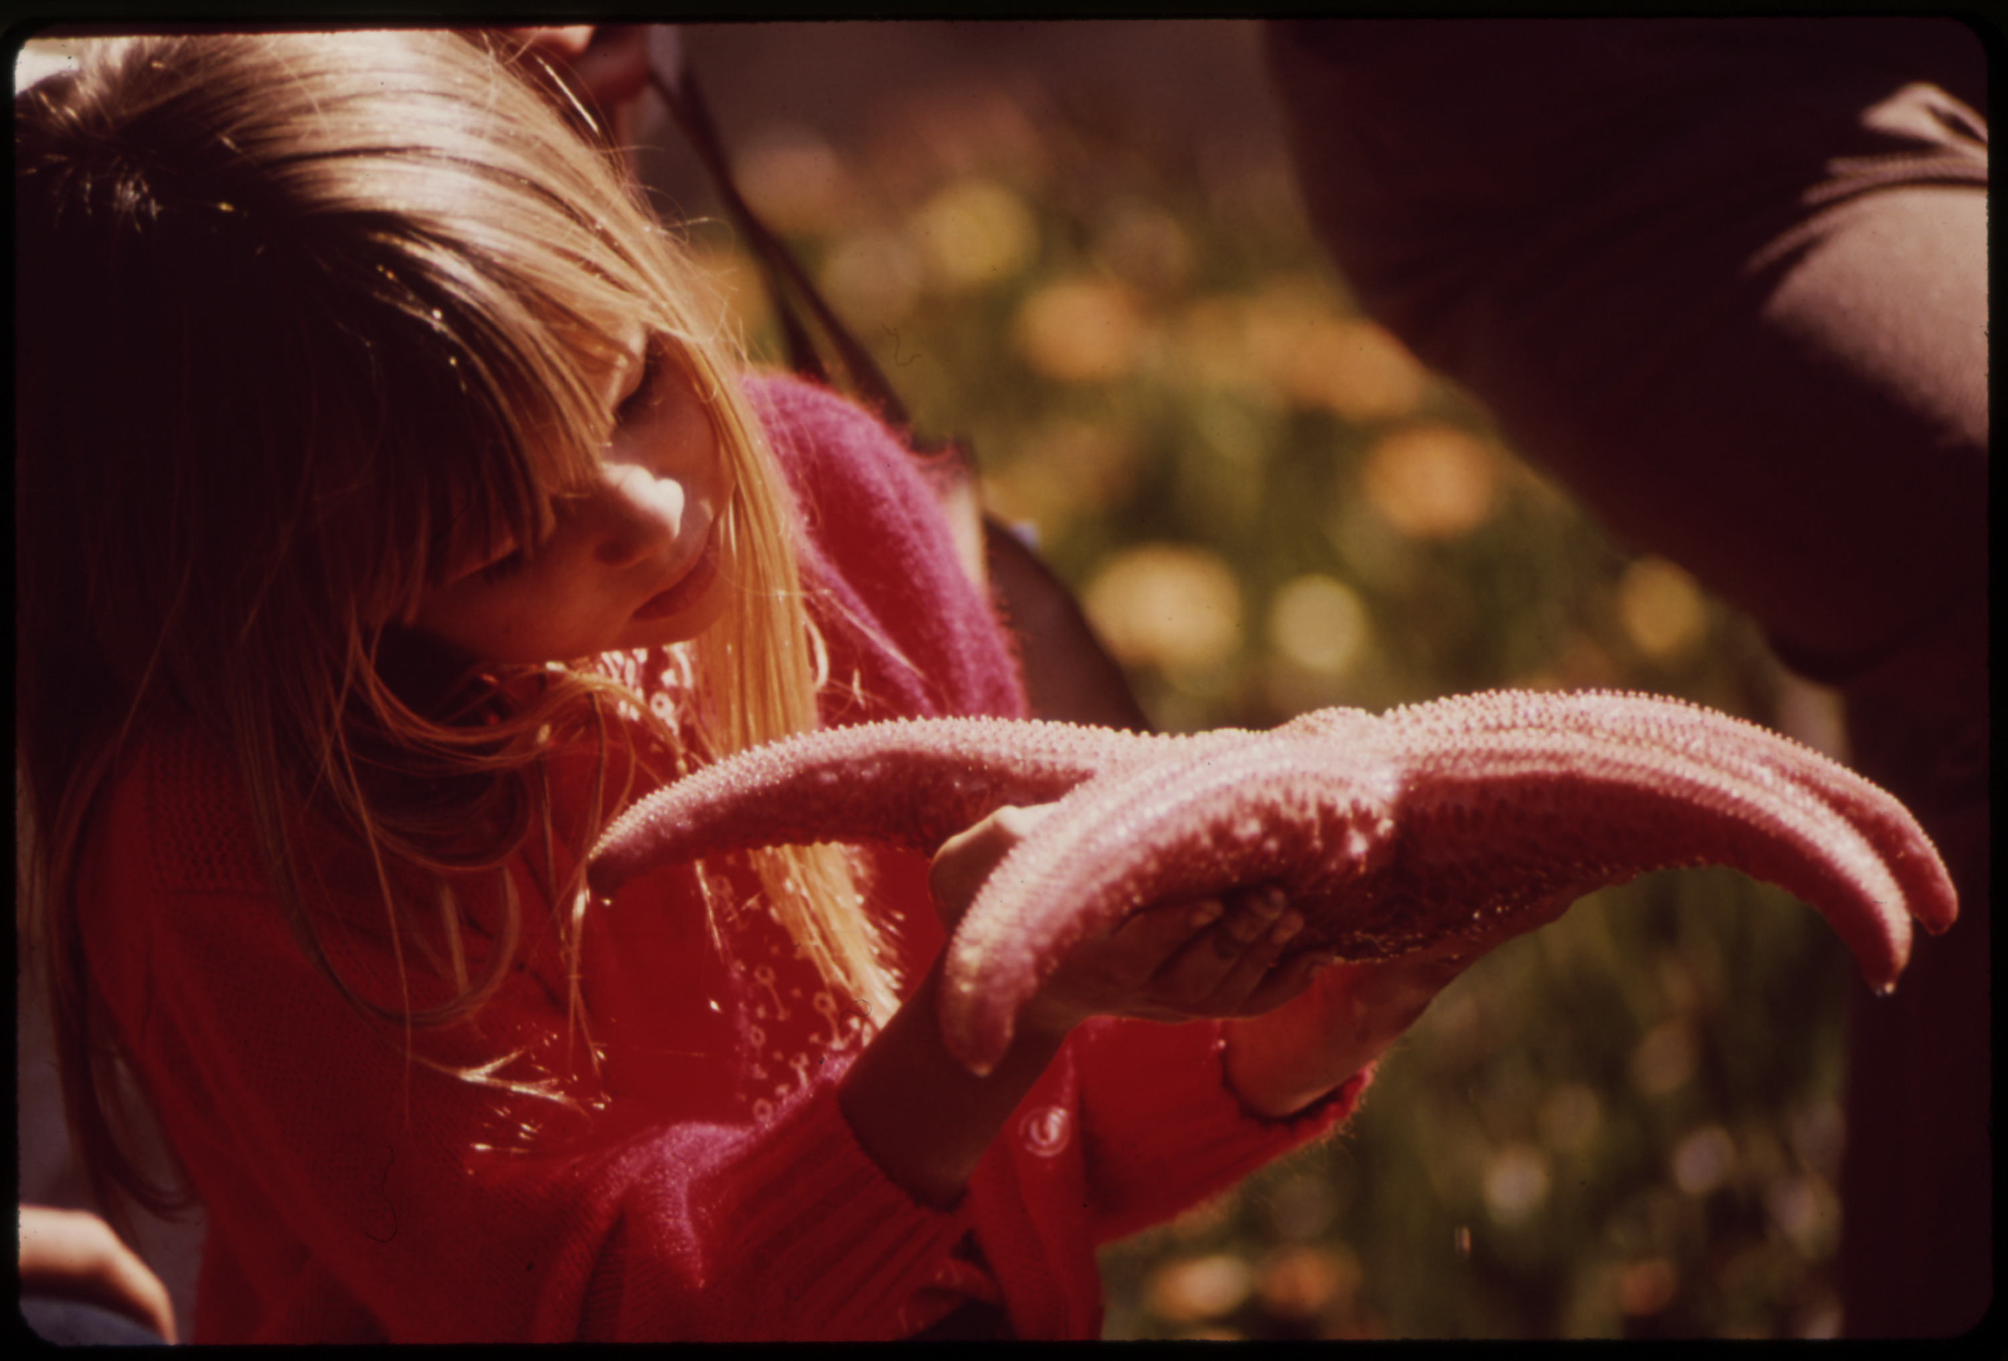
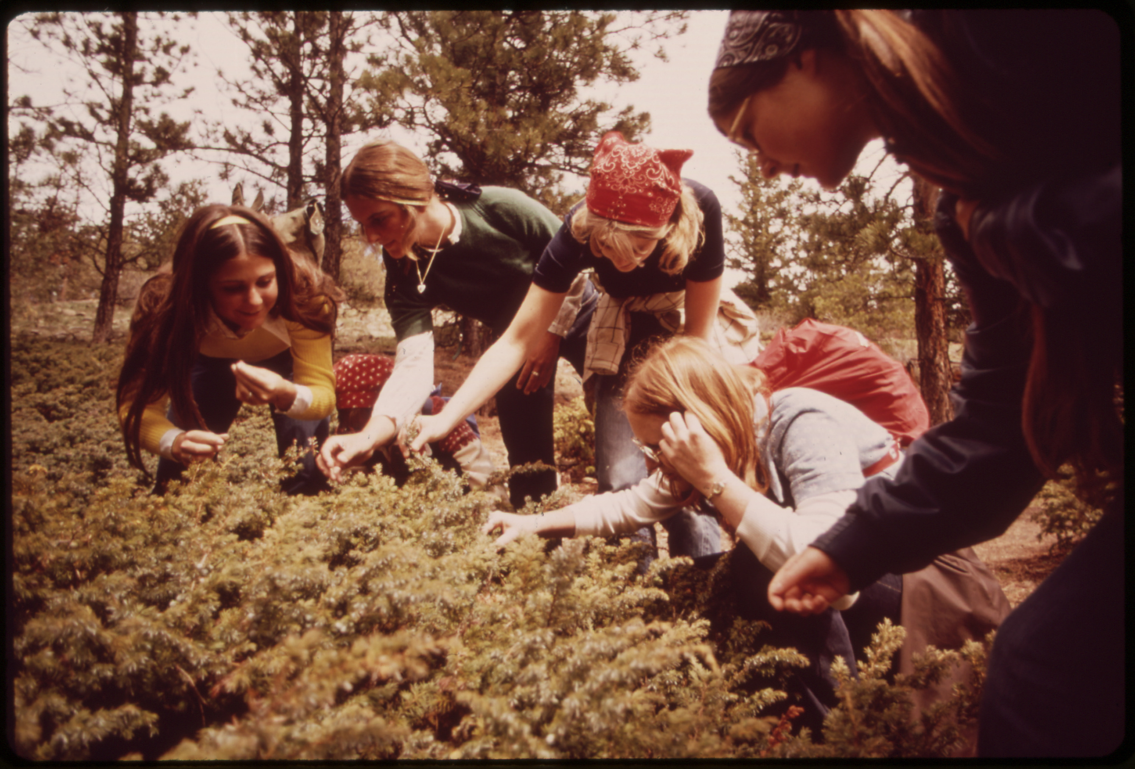
Revisiting the DOCUMERICA Archive
We have been able to make, while not perfect reproductions, much more aesthetically pleasing and natural looking images by color correcting the damaged digitized slides. These corrected images are what we have been using in all previous slides and analyses.
ORIGINAL
CORRECTED
08 – Distant Viewing | Materiality + Color

Slide 59
9. Distant Viewing: Theory + MLLMs
09 – Distant Viewing | Theory + MLLMs

Slide 60

Distant Viewing: Theory + MLLMs
Flip Schulke, Employee of the Donald Dannheim Family who operate a dairy and ice cream store (July 1974).
The core ideas from the theory of distant viewing is that we need to create annotations to do computational analysis of digital images, that the creation of these annotations can be thought of as a digitally-mediated form of viewing at a distance, and that these forms of viewing at a distance are both subject and destructive.
MLLM model + prompt
This photograph captures a scene inside an industrial or agricultural processing facility, possibly a dairy. The image focuses on a female worker engaged in operating machinery used for filling milk bottles….
09 – Distant Viewing | Theory + MLLMs

Slide 61
Distant Viewing: Theory + MLLMs
Flip Schulke, Employee of the Donald Dannheim Family who operate a dairy and ice cream store (July 1974).
The core ideas from the theory of distant viewing is that we need to create annotations to do computational analysis of digital images, that the creation of these annotations can be thought of as a digitally-mediated form of viewing at a distance, and that these forms of viewing at a distance are both subject and destructive.
The potential power of MLLMs for working with collections of digital images further highlights each of these points. Turning images into textual descriptions is arguable closer to the way that we interpret images than previous types of computer vision annotations. Also, these new algorithms have a wide-open set of configurations and options through the choice of prompts and text filtering that accentuate how our decision making that influences the resulting output.
MLLM model + prompt
This photograph captures a scene inside an industrial or agricultural processing facility, possibly a dairy. The image focuses on a female worker engaged in operating machinery used for filling milk bottles….
09 – Distant Viewing | Theory + MLLMs

Slide 62
Distant Viewing: Theory + MLLMs
Flip Schulke, Employee of the Donald Dannheim Family who operate a dairy and ice cream store (July 1974).
The core ideas from the theory of distant viewing is that we need to create annotations to do computational analysis of digital images, that the creation of these annotations can be thought of as a digitally-mediated form of viewing at a distance, and that these forms of viewing at a distance are both subject and destructive.
The potential power of MLLMs for working with collections of digital images further highlights each of these points. Turning images into textual descriptions is arguable closer to the way that we interpret images than previous types of computer vision annotations. Also, these new algorithms have a wide-open set of configurations and options through the choice of prompts and text filtering that accentuate how our decision making that influences the resulting output.
In the era of large language models, understanding the implications of the theory of distant viewing is more important than ever.
MLLM model + prompt
This photograph captures a scene inside an industrial or agricultural processing facility, possibly a dairy. The image focuses on a female worker engaged in operating machinery used for filling milk bottles….
09 – Distant Viewing | Theory + MLLMs

Slide 63

THANK YOU!
Please get in touch!
distantviewing.org
tarnold2@richmond.edu
ltilton@richmond.edu

